Slide 1
The New World of Genre/Form and Demographic Group Terms
Adam L. Schiff
Principal Cataloger, University of Washington Libraries
aschiff@uw.edu
CLA 2017 Preconference
Riverside, California
November 2, 2017
(Updated December 15, 2017)

Slide 2
Workshop Outline
Background
LCGFT
Where to Find LC Genre/Form Terms
General Principles of Application, MARC Coding
Exercises
General Terms
Exercises
Literature Terms
Exercises
Moving Image Terms
Music Terms
Cartographic Terms

Slide 3
Workshop Outline
LCDGT
Audience and Creator/Contributor Characteristics
MARC 385/386
Where to Find LC Demographic Group Terms
Assigning LCDGT
Exercises
SACO
Formulating and Proposing New LCGFT
Formulating and Proposing New LCDGT
General Guidelines
Specific Guidelines for Certain Categories
Online Proposal System
Exercises

Slide 4
Workshop Outline
Other Facets
Time Period of Creation
Language
Place of Creation
Country (Area) of Producing Entity
Music Medium of Performance
Facets and Your Discovery System
Full Implementation of Faceted Vocabularies

Slide 5
Background
LCSH for many decades included headings and subdivisions that were used to describe what a resource is rather than what it is about. Headings can describe numerous non-subject aspects, including:
Genre/form Symphonies World maps Comedy films Sports posters
Creator info Canadian fiction Film posters, Swiss American poetry--
Women authors African American children's writings
Music by Jewish composers
Place of origin Almanacs, Argentinian Folk music--Appalachian Region
Language Inuktitut poetry Short stories, Zambian (English)
Audience Young adult fiction Teen films Music--Dictionaries, Juvenile
Time period of creation Rock music--1961-1970 Tales, Medieval
Music medium of performance Piano quintets Concertos (Bassoon, flute, oboe)
Flutes (3) with orchestra
Notes:
I’ve used different colors to show the different aspects that are mixed in many LCSH terms and subject strings. Red indicates the genre/form aspect.

Slide 6
Background
Starting with genre/form in 2007, LC has been developing new controlled vocabularies to describe some of these aspects, with the long-term goal of limiting LCSH to describe what a resource is about and using the new vocabularies to describe what it is
LCGFT (2007- ): genre/form
LCMPT (2014- ): music medium of performance
LCDGT (2015- ): demographic groups (audience and creator/contributor
characteristics)
New MARC fields/subfields were created to record form of work (380), medium of performance (382), demographic group characteristics (385, 386), place of origin (370), and time period of creation (046 $k/$l and $o/$p, 388)
Existing MARC fields already existed for genre/form (655), language (008/35-37, 041), and country of production (257)

Slide 7
Background
LC has not yet fully implemented LCGFT in all of its cataloging
No changes yet to LCSH policies. Continue to assign LCSH according to the Subject Headings Manual and assign LCGFT in addition
LC has no plans at this time to cancel any of the LCSH headings or form subdivisions that overlap with the “general” terms

Slide 8
LCGFT
Library of Congress Genre/Form Terms

Slide 9
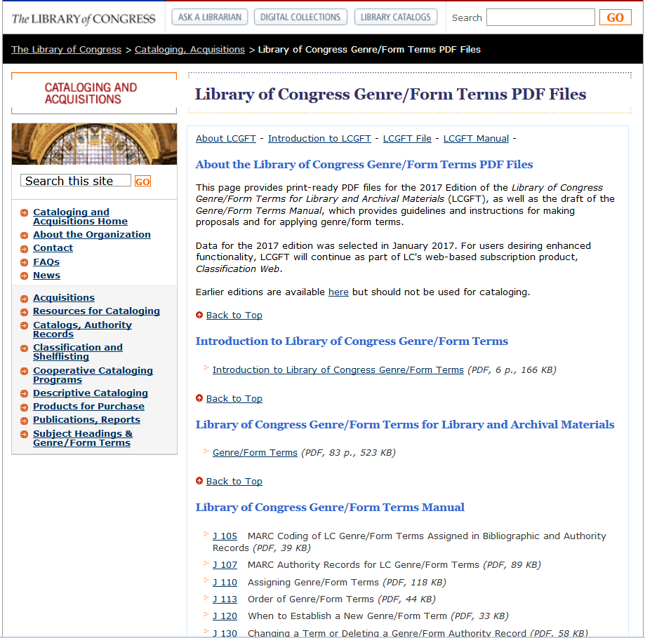
LC Genre/Form Terms
Draft LCGFT Manual at http://www.loc.gov/aba/publications/FreeLCGFT/freelcgft.html
Notes:
General terms were developed with the ALA Subject Access Committee Subcommittee on Genre/Form Implementation General Terms Working Group
Law terms were developed with the American Association of Law Libraries’ Classification and Subject Cataloging Policy Advisory Working Group
Literature terms were developed with the ALA Subject Access Committee Subcommittee on Genre/Form Implementation Working Group on LCGFT Literature Terms
Music terms were developed with the Music Library Association Bibliographic Control Committee Form/Genre Task Force
Religion terms were developed with the American Theological Library Association, coordinating with members of the Association of Jewish Libraries, the Catholic Library Association, and the Council on East Asian Libraries
From ALA/ALCTS/CaMMS Subject Analysis Committee Annual Conference, Chicago, Illinois June 24, 2017 Report from the Subcommittee on Genre/Form Implementation (http://connect.ala.org/files/ALA%20Annual%202017%20%20SAC%20GFIS%20Report.docx): “The Working Group (WG) on Genre/Form of Videogames selected 75 terms from an initial list of hundreds. The WG proceeded to create authority records, and by the time of ALA Annual they had already created records for 55 of the 75 terms. By ALA Midwinter 2018 the WG plans to add scope notes to authority records for all 75 genre terms. Conceivably the specialists at PSD will not be ready to incorporate the production of this new vocabulary to their current list of priorities in the near future. However the WG on Genre/Form of Videogames has been offered the option of adding the vocabulary to the Open Data Registry under the sponsorship of Online Audiovisual Catalogers (OLAC). In that case the G/F of Videogames would be published under the patronage of the Subject Analysis Committee (SAC) and the sponsorship of OLAC. The source code that would be used in bibliographic records would then be $2 olac. There might still be a chance that PSD will make a favorable decision by the time ALA Midwinter 2018 opens.”

Slide 10
LC Genre/Form Terms
Terms so far for: cartographic materials, “general” materials (e.g., dictionaries, encyclopedias), law materials, literature, moving images (films and television programs), music, radio programs and other non-musical sound recordings, and religious materials
SACO proposals for additional terms and revisions to existing terms may be made for all of the areas listed above
Upcoming project: ARLIS/NA Cataloging Advisory Committee is preparing an initial group of art terms (to appear late 2017 or 2018)
Potential addition for video game genres through a vocabulary being developed by ALA Subject Analysis Committee Subcommittee on Genre/Form Implementation Working Group on Genre/Form of Videogames. If not added to LCGFT, OLAC may sponsor it as a stand-alone list of terms.
Notes:
General terms were developed with the ALA Subject Access Committee Subcommittee on Genre/Form Implementation General Terms Working Group
Law terms were developed with the American Association of Law Libraries’ Classification and Subject Cataloging Policy Advisory Working Group
Literature terms were developed with the ALA Subject Access Committee Subcommittee on Genre/Form Implementation Working Group on LCGFT Literature Terms
Music terms were developed with the Music Library Association Bibliographic Control Committee Form/Genre Task Force
Religion terms were developed with the American Theological Library Association, coordinating with members of the Association of Jewish Libraries, the Catholic Library Association, and the Council on East Asian Libraries
From ALA/ALCTS/CaMMS Subject Analysis Committee Annual Conference, Chicago, Illinois June 24, 2017 Report from the Subcommittee on Genre/Form Implementation (http://connect.ala.org/files/ALA%20Annual%202017%20%20SAC%20GFIS%20Report.docx): “The Working Group (WG) on Genre/Form of Videogames selected 75 terms from an initial list of hundreds. The WG proceeded to create authority records, and by the time of ALA Annual they had already created records for 55 of the 75 terms. By ALA Midwinter 2018 the WG plans to add scope notes to authority records for all 75 genre terms. Conceivably the specialists at PSD will not be ready to incorporate the production of this new vocabulary to their current list of priorities in the near future. However the WG on Genre/Form of Videogames has been offered the option of adding the vocabulary to the Open Data Registry under the sponsorship of Online Audiovisual Catalogers (OLAC). In that case the G/F of Videogames would be published under the patronage of the Subject Analysis Committee (SAC) and the sponsorship of OLAC. The source code that would be used in bibliographic records would then be $2 olac. There might still be a chance that PSD will make a favorable decision by the time ALA Midwinter 2018 opens.”

Slide 11
Where Can You Find LCGFT Terms?
OCLC and SkyRiver Authority Records
Classification Web
Catalogers Desktop (if you also have a Classification Web subscription)
Library of Congress Genre/Form Terms PDF Files (https://www.loc.gov/aba/publications/FreeLCGFT/GENRE.pdf)
LC Linked Data Service (http://id.loc.gov/authorities/genreForms.html)
Library of Congress Authorities (http://authorities.loc.gov)

Slide 12
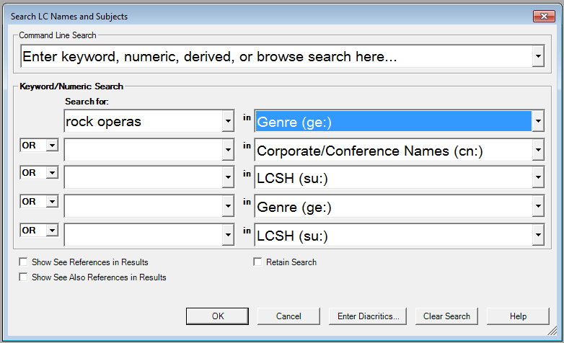
Notes:
Keyword search of genre/form authority records in OCLC Connexion

Slide 13
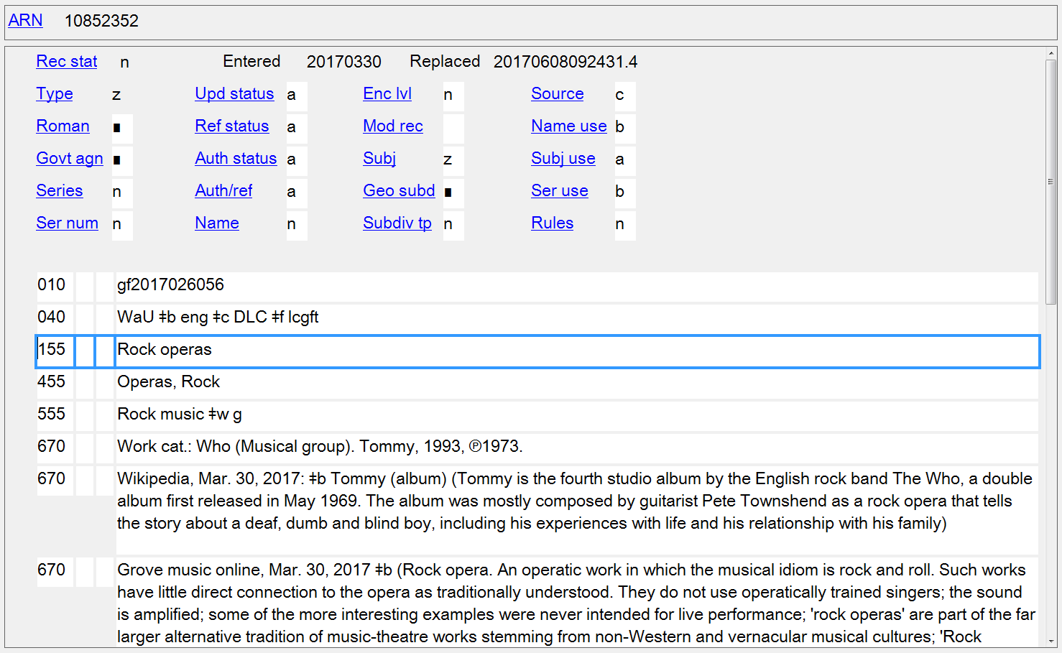
Notes:
LCGFT authority record in OCLC Connexion Client.
When viewing authority records, be sure to check if there is a scope note (field 680).

Slide 14
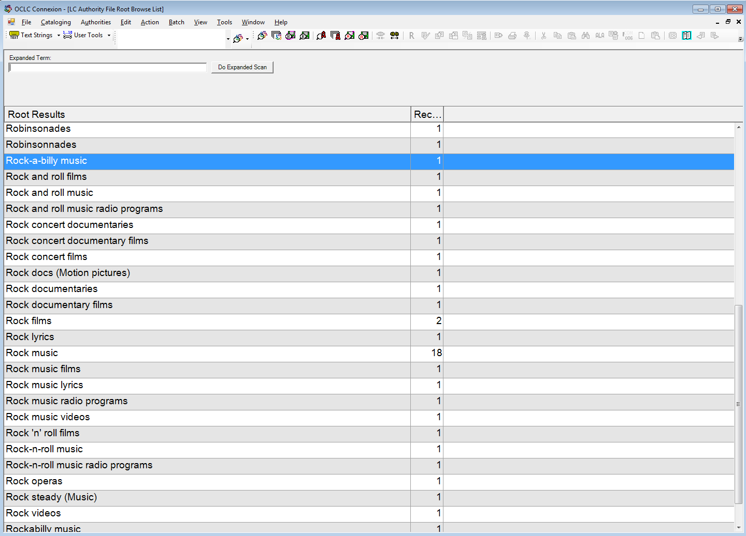
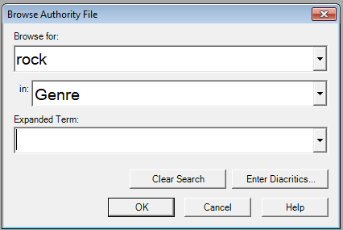
Notes:
ANIMATED SLIDE
Browse search of genre/form authority records in OCLC Connexion

Slide 15
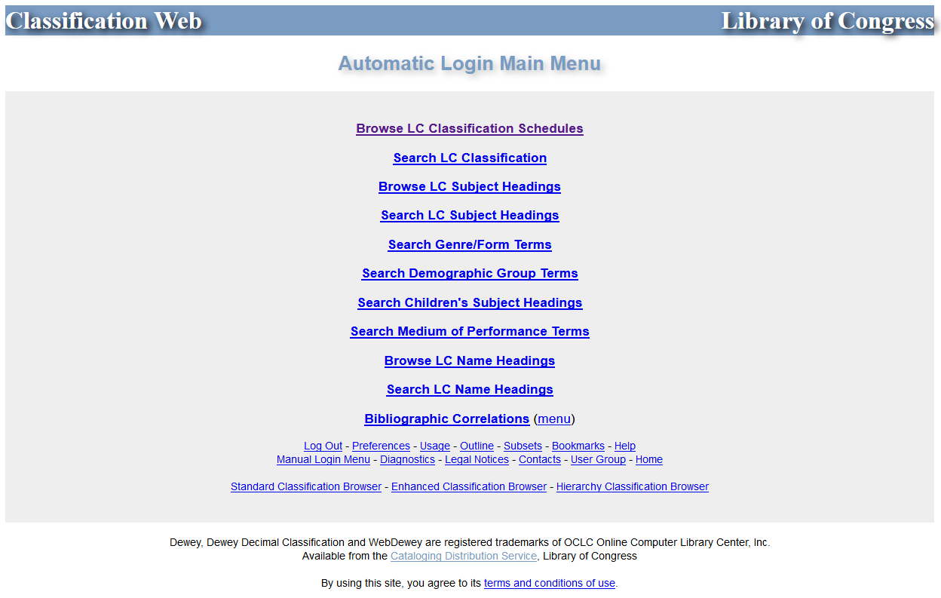
Notes:
Classification Web

Slide 16
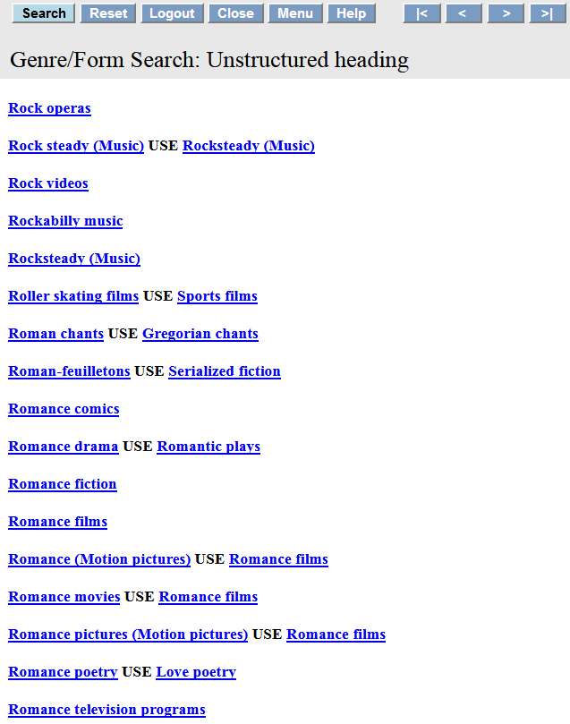
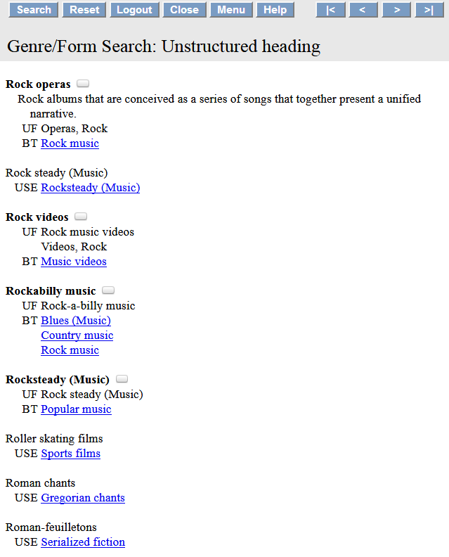
Scope note
Notes:
Classification Web search results for “Rock operas”

Slide 17
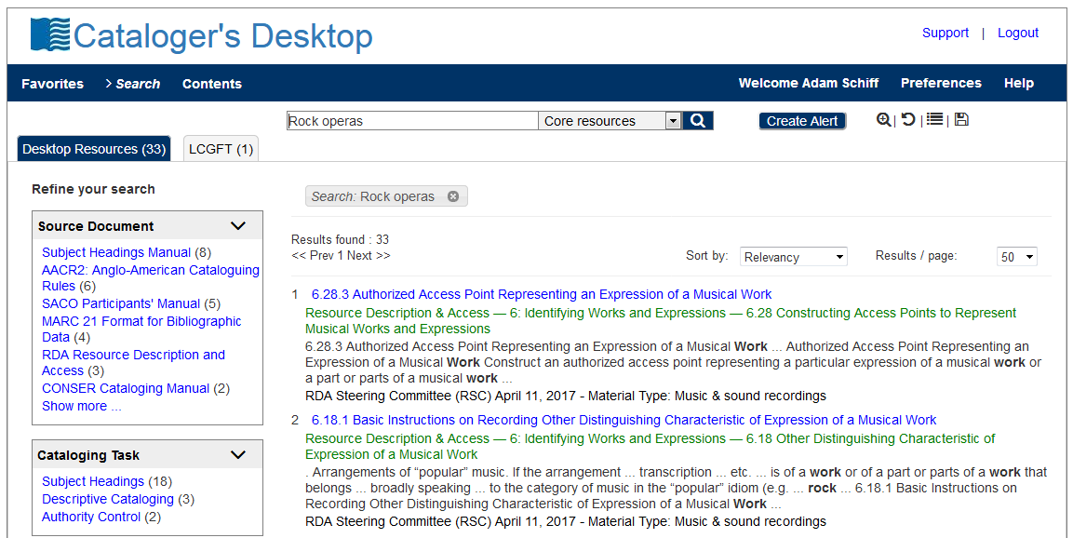
Notes:
Cataloger’s Desktop now includes searching of Classification Web, provided that you have a Class Web subscription.

Slide 18
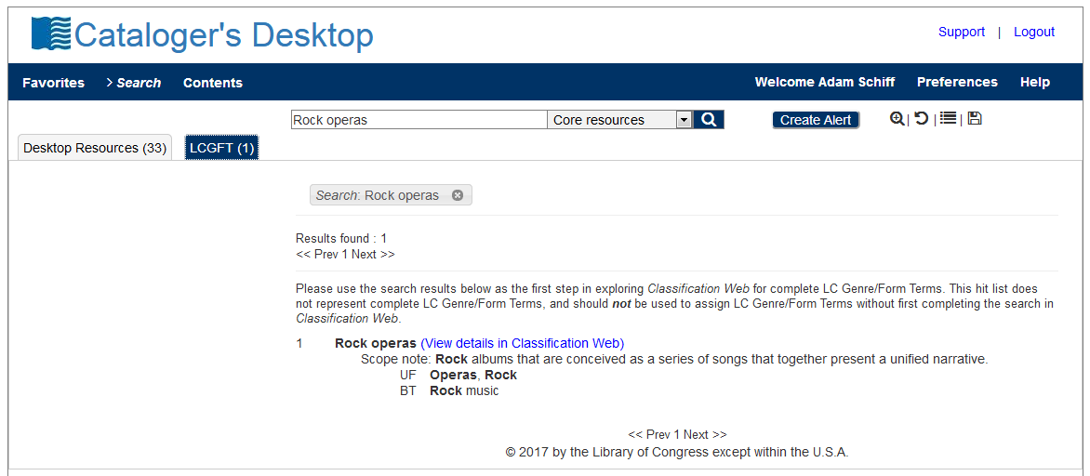

Slide 19
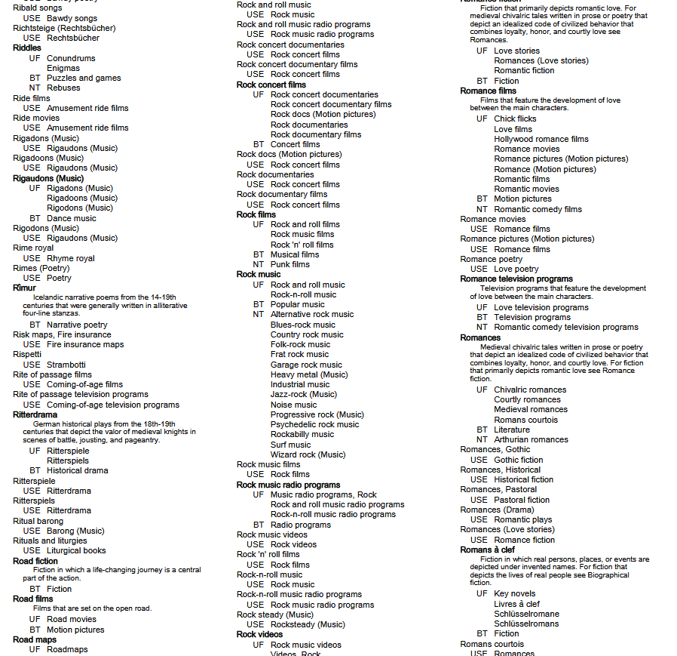
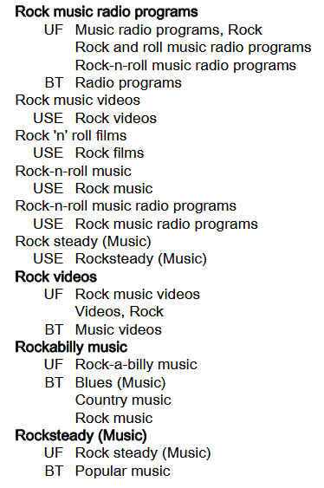
Notes:
ANIMATED SLIDE
This is a screenshot from PDF file of the 2017 Edition of the Library of Congress Genre/Form Terms for Library and Archival Materials (LCGFT). You will notice that our example, “Rock operas,” is not here. This illustrates the drawback of using the PDF file, as it is only compiled once a year, at the beginning of the year. Any terms added after will not be found in the PDF list until the following year.

Slide 20
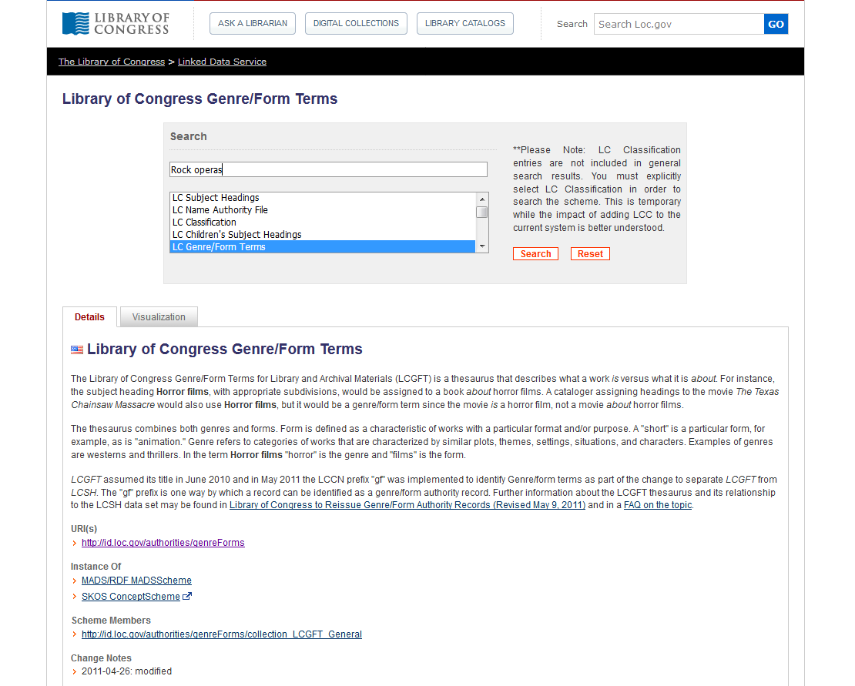
Notes:
LC Linked Data Service

Slide 21
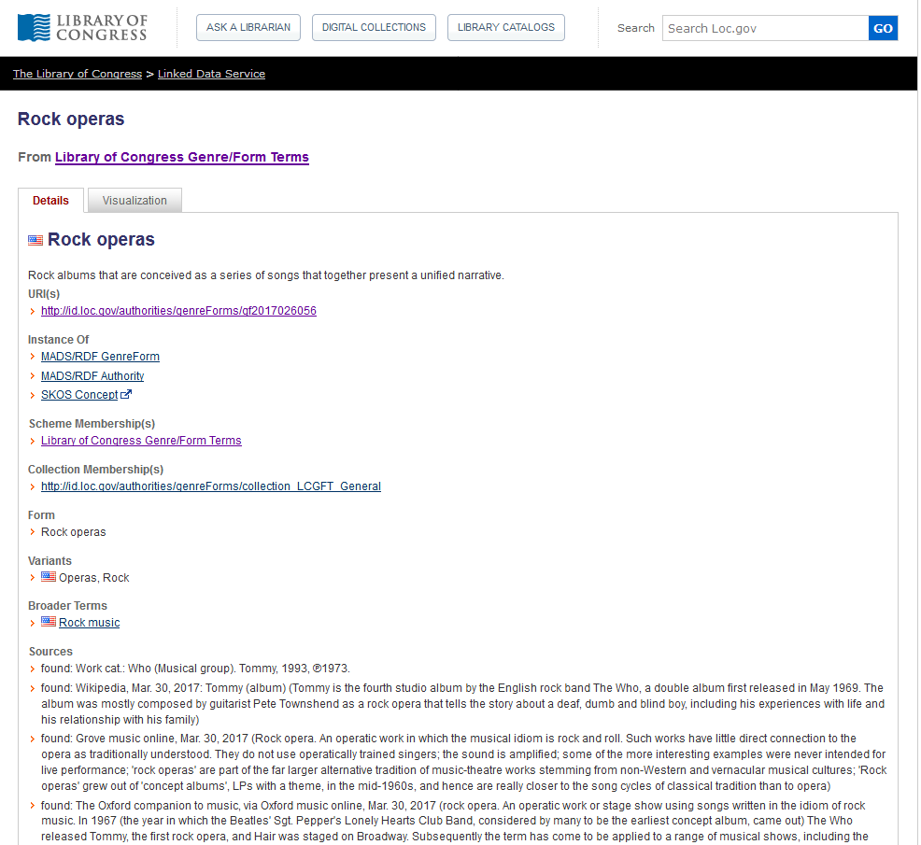
Notes:
LC Linked Data Service

Slide 22
Notes:
Library of Congress Authorities also includes authority records for LCGFT as well as LCSH.

Slide 24
LC Genre/Form Terms
General principles
Consult Introduction to Library of Congress Genre/Form Terms for Library and Archival Materials and the Library of Congress Genre/Form Terms Manual (http://www.loc.gov/aba/publications/FreeLCGFT/freelcgft.html)
Assigned both to individual works and to compilations
Terms that describe works and expressions are eligible: terms for the intellectual or artistic expression of the work and also the original mode of issuance, where applicable

Slide 25
LC Genre/Form Terms
General principles
Terms that describe manifestation attributes generally are ineligible (e.g., DVDs; Large print books; Paperbacks)
A few exceptional manifestation-level terms are in LCGFT (e.g., Internet videos; Video recordings for the hearing impaired), but they should not be considered precedents

Slide 26
LC Genre/Form Terms
General principles
Definition: “Genres and forms may be broadly defined as categories of resources that share known conventions. More specifically, genre/form terms may describe the purpose, structure, content, and/or themes of resources. Genre/form terms describing content and themes most frequently refer to creative works and denote common rhetorical devices that usually combine elements such as plot and setting, character types, etc. Such terms may be closely related to the subjects of the creative works, but are distinct from them.”

Slide 27
LC Genre/Form Terms
General principles
Exclusions: Several other characteristics of works and expressions are closely related to genres and forms, but are not eligible for explicit inclusion in LCGFT:
ethnicity, nationality, or other characteristics of creators
Korean drama; Uighur folk songs; Artists' writings; Films by children; Music by women composers; Shinto poetry; Taoist music; Mexican American posters
intended audience
Children’s stories; Young adult drama; Music for the hearing impaired; Spanish language--Conversation and phrase books (for police)
time period of creation
Medieval music; Han poetry; 19th century maps

Slide 28
LC Genre/Form Terms
General principles
Exclusions: Several other characteristics of works and expressions are closely related to genres and forms, but are not eligible for explicit inclusion in LCGFT:
language
French fiction; Tagalog drama; Urdu wit and humor; Arabic films
place of creation
East Asian periodicals; Southern African newspapers; Inland Empire poetry
country of production
Canadian films; Mexican television programs
geographic location
fiction set in Berlin; films set in Los Angeles

Slide 29
LC Genre/Form Terms
General principles
Exclusions: Several other characteristics of works and expressions are closely related to genres and forms, but are not eligible for explicit inclusion in LCGFT:
popularity of the work
blockbusters; flops
medium of performance
Trumpet music; Choruses (Mixed voices); Bassoon, oboe, violin, cello with orchestra
terms that by their nature require a value judgment on the part of catalogers and users
racist films

Slide 30
LC Genre/Form Terms
General principles
Excluded characteristics may be implicit within a genre or form, e.g.
Fu is a Chinese poetic form from the Han Dynasty
Chansons de geste are a type of Old French epic poetry
Kur̲avañci plays are Tamil musical dance dramas from the 17th and 18th centuries
Silent films generally come from a particular time period of the 20th century
Rubble films are set in the rubble of bombed-out European cities
LCGFT has a few exceptional terms indicative of audience which should not be considered precedents, e.g.
Children's films; Law for laypersons; Television programs for people with visual disabilities

Slide 31
LC Genre/Form Terms
MARC coding
Use MARC 655 (Index Term--Genre/Form) and 380 (Form of Work) in bibliographic records
Use MARC 380 (Form of Work) and perhaps 372 (Field of Activity) in authority records
Include $2 lcgft in MARC fields when LCGFT terms are used
100 1_ Copland, Aaron, $d 1900-1990, $e composer.
240 10 Billy the Kid. $p Suite
245 10 Billy the Kid : $b ballet-suite / $c Aaron
Copland.
250 __ Orchestral score.
655 _7 Suites. $2 lcgft
655 _7 Ballets (Music) $2 lcgft
655 _7 Excerpts. $2 lcgft
655 _7 Scores. $2 lcgft
130 _0 Wo hu cang long (Motion picture)
380 __ Motion pictures $a Action and adventure
films $a Martial arts films $a Romance films
$a Film adaptations $a Fiction films $a
Feature films $2 lcgft
430 _0 Crouching tiger, hidden dragon (Motion
picture)
Notes:
The RDA element “Form of work” can be recorded in bibliographic records, but is much more likely to be used in authority records. If 655 is used in bib records, the use of 380 is probably redundant.
OLAC’s Best Practices for Cataloging DVD-Video and Blu-ray Discs using RDA and MARC21, version 1.0 (January 2015) does give a recommendation to include 380 in video records:
Best Practice Recommendation: Provide the form of work if readily ascertainable. Take terms from a controlled vocabulary (e.g., LCGFT, LCSH, etc.) and capitalize the first word to provide
consistency.
380 __ $a Television program.
380 __ $a Motion picture.
The examples given in the guideline, however, don’t follow the recommendation to take terms from a controlled vocabulary. If they did, they would be:
380 __ $a Television programs $2 lcgft
380 __ $a Motion pictures $2 lcgft

Slide 32
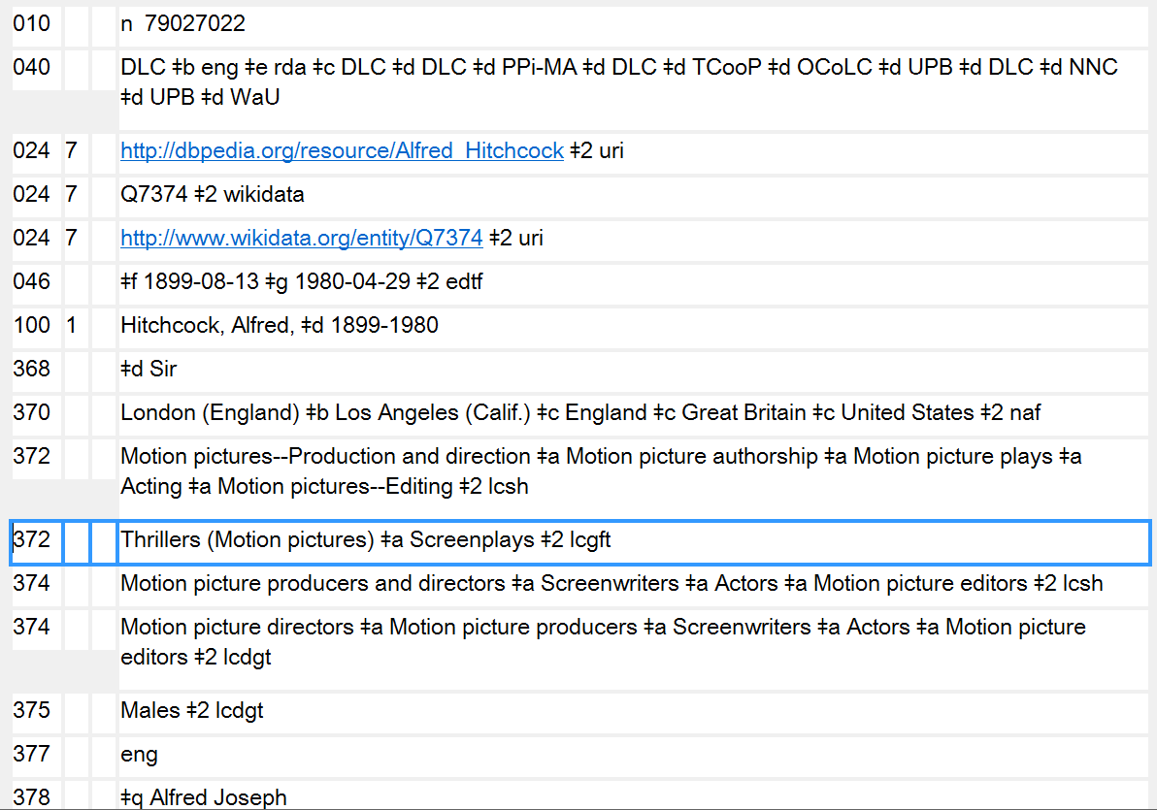
372 - Field of Activity in authority records may also contain genre/form terms
Notes:
Here’s an example of LCGFT terms used for Field of Activity (MARC 372). Alfred Hitchcock is well known as a director of suspense films and as a screenwriter.

Slide 33
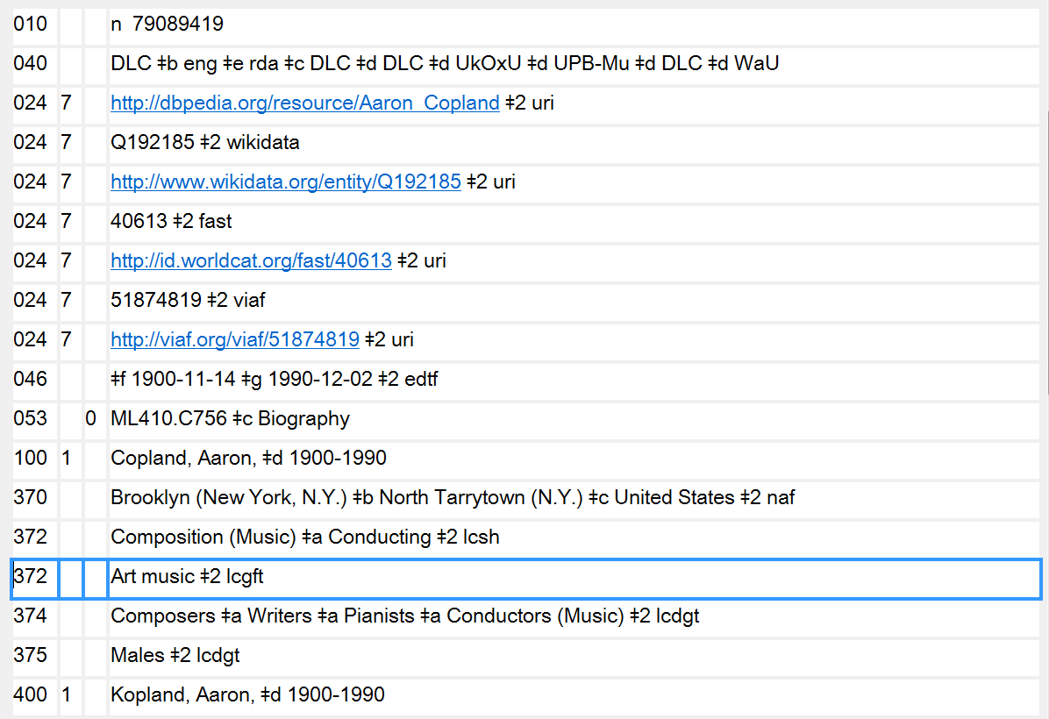
372 - Field of Activity in authority records may also contain genre/form terms
Notes:
Here’s another example of LCGFT terms used for Field of Activity (MARC 372). Aaron Copland was a composer of classical music, “Art music” in LCGFT.

Slide 34
LC Genre/Form Terms
General principles
May use subfield $3 when a term only applies to a part of a resource
245 04 The gold rush ; $b plus, Pay day / $c Film de Dam ; written and directed by Charlie Chaplin.
655 _7 Comedy films. $2 lcgft
655 _7 Silent films. $2 lcgft
655 _7 Fiction films. $2 lcgft
655 _7 $3 Gold rush: $a Feature films. $2 lcgft
655 _7 $3 Pay day: $a Short films. $2 lcgft
Notes:
The slide shows an example of using $3 in the 655 field. The DVD being cataloged contains two films. Both of the films are comedy films, silent films, and fiction films, so the first three 655s in the record apply to all the works. However, one of the works is a feature film and the other is a short film. In this example, the titles of the works that the genre/form term applies to have been used in the $3. But anything appropriate can go into the subfield, e.g. volume numbers, “1st work”, “2nd work”, accompanying disc, and so on. Use whatever is appropriate and makes the most sense.

Slide 35
LC Genre/Form Terms
General principles
May use subfield $3 when a term only applies to a part of a resource
245 02 A German requiem : $b op. 45 / $c Brahms. Bartered bride overture / Smetana. Rhapsodie espagnole / Ravel.
655 _7 Art music. $2 lcgft
655 _7 $3 A German requiem: $a Requiems. $2 lcgft
655 _7 $3 Bartered bride overture: $a Overtures. $2 lcgft
655 _7 $3 Rhapsodie espagnole: $a Rhapsodies (Music) $2 lcgft
Notes:
An example of a sound recording with three different genre/forms of works. $3 may be used to identify the work to which the genre/form term applies. The first term, “Art music,” applies to the compilation as a whole.

Slide 36
LC Genre/Form Terms
General principles
May use subfield $3 when a term only applies to a part of a resource
245 00 Tennessee River Civil War driving tour.
300 __ 1 audio disc (approximately 18 min.) : $b digital ; $c 4 3/4 in. + $e 1 videodisc (approximately
23 min. : sound, color ; 4 3/4 in.) + 1 color map (27 x 19 cm, on sheet 44 x 28 cm, folded to 14
x 11 cm)
520 __ Driving tour of Civil War sites in Tennessee, specifically along the Tennessee River and
surrounding area. Includes audio tour CD with accompanying map. The map includes an
audio CD legend of attractions and GPS coordinates, and URLs to local area tourist websites.
The accompanying DVD covers the same sites referenced on both the audio CD and map.
655 _7 $3 CD: $a Audiobooks. $2 lcgft
655 _7 $3 CD: $a Guidebooks. $2 lcgft
655 _7 $3 Accompanying DVD: $a Travelogues (Motion pictures) $2 lcgft
655 _7 $3 Accompanying DVD: $a Nonfiction films. $2 lcgft
655 _7 $3 Accompanying DVD: $a Short films. $2 lcgft
655 _7 $3 Accompanying map: $a Tourist maps. $2 lcgft
Notes:
Here’s a multipart monograph consisting of an audio disc, videodisc, and map. The use of $3 in 655 helps to identify what LCGFT terms apply to what part of the resource.

Slide 37
LC Genre/Form Terms
General principles
Specificity applies to genre/form the same as it does to subjects. Assign LCGFT terms that are specific to the resource being cataloged. A seemingly broad term like Poetry is specific when you’re cataloging a collection of poems in many different forms
Assign genre/form terms only as they come readily to mind after a superficial review of the resource being cataloged
Assign genre/form terms that correspond to the cataloging treatment of the resource. If cataloging a continuing resource such as a periodical, a monographic series, or a collected set, assign terms that characterize the resource as a whole. If cataloging a work as an analytic, assign terms that characterize the analytic

Slide 38
LC Genre/Form Terms
General principles
Assign terms based on analysis of the resource being cataloged. Genre/form terms do not need to be justified by descriptive cataloging elements
Assign to the resource being cataloged genre/form terms that describe the resource as a whole. Sometimes one term is sufficient, while at other times a complement of terms is necessary
Assign broader or more general terms when it’s not possible to establish a more specific term, when an array of terms is needed (e.g., for a Western romance novel, three terms are needed: Western fiction, Romance fiction, and Novels), or when the LCGFT Manual includes special instructions to do this

Slide 39
LC Genre/Form Terms
General principles
It is permissible to assign both a broader and a narrower term (for a compilation that consists of a predominant genre or form but includes a “significant proportion” of works that would be assigned another term in the hierarchy)
Example: for a poetry collection primarily containing limericks but also containing a significant proportion of other types of humorous poetry, may assign both Limericks and Humorous poetry
If there is a predominant genre/form, assign that term first; if predominant genre/form needs two terms to express it, assign them first
Notes:
First bullet:
GFTM J 110 says “Note: The use of the phrase ‘significant proportion’ is deliberate. Catalogers should take the intent of the resource into account and display good judgment when assigning terms from
multiple levels of the hierarchy in this manner.”

Slide 40
LC Genre/Form Terms
General principles
Don’t assign genre/form terms to works that have no discernible genre/form (e.g., a history of U.S. foreign relations in the 20th century)
For resources with separate parts (e.g., text plus an extensive bibliography or a section of maps; book with accompanying disc) also assign separate terms for the individual parts or materials if they are judged to be significant. May use $3 to identify the part to which a term applies
Notes:
LCGFT Manual J 110

Slide 41
LC Genre/Form Terms
General principles
Number of terms
If a resource consists of two or three genres that make up a broader genre, and that broader genre includes no other than those two or three genres within its scope, assign the broader genre instead of the two or three narrower genres
Title: The best Rosh ha-Shanah and Yom Kippur music: music of the High
Holidays
Term assigned: High Holiday music (rather than Rosh ha-Shanah music and Yom Kippur music)
Notes:
LCGFT Manual J 110
6. Two or three related terms. If a term exists, or can be established (see J 120), that (1) represents the two or three genres or forms displayed by a resource, and (2) includes no other genres or forms within its scope, assign one term instead of two or three narrower terms.

Slide 42
LC Genre/Form Terms
General principles
Number of terms - Rule of Three
If a genre/form term includes in its scope more than three sub-genres or forms, but the resource being cataloged consists of only two or three of those sub-genres or forms, assign the appropriate two or three terms instead of the broader term
Title: Time machine: the history of Canadian 60’s garage, punk, and surf, 1985-95
Terms assigned: Garage rock music
Punk rock music
Surf music
not Rock music, the broader term, because it has more than three NTs
Notes:
LCGFT Manual J 110
7. Rule of three. If a genre/form term includes in its scope more than three sub-genres or forms, but the resource being cataloged consists of only two or three of those sub-genres or forms, assign the appropriate two or three terms instead of the broader term.
If a resource displays more than three of the narrower terms of a single broader term, assign the broader term unless the rule of four, described below, applies.

Slide 43
LC Genre/Form Terms
General principles
Number of terms - Rule of Three
If a resource displays more than three of the narrower terms of a single broader term, assign the broader term unless the rule of four applies
Number of terms - Rule of Four
For resources that display four sub-genres or forms of a broader term, if the four sub-genres or forms comprise only a small portion of the scope of the broader term (i.e., the broader term has many narrower terms in addition to the four in question), assign the four sub-genres or forms instead of the broader term.
Example: poetry anthology that consists of four Japanese forms: Haiku, Senryu, Tanka, and Kyōka. Assign the four specific terms rather than Poetry
Notes:
LCGFT Manual J 110
7. Rule of three. If a genre/form term includes in its scope more than three sub-genres or forms, but the resource being cataloged consists of only two or three of those sub-genres or forms, assign the appropriate two or three terms instead of the broader term.
If a resource displays more than three of the narrower terms of a single broader term, assign the broader term unless the rule of four, described below, applies.
8. Rule of four. In certain circumstances it may be preferable to assign terms for four sub-genres or forms of a broad term. If a term covers a broad range and each sub-genre or form comprises only a small portion of that whole range, assign the four sub-genres or forms. For example, a poetry anthology that consists of haiku, senryu, tanka, and kyōka may be assigned terms for those
four genres instead of the broad term Poetry.
LC practice: Do not exceed four sub-genres or forms under any circumstances.

Slide 44
LC Genre/Form Terms
General principles
Bring out or account for each genre or form in the title and subtitle if they accurately represent the genre(s) and/or form(s) of the resource and if they are useful for retrieval
If the title is general but the work is actually of a more specific genre and/or form, assign terms for the specific genre or form
If many genres and/or forms are listed on the title page in the manner of a table of contents, treat them as a table of contents
Follow additional instructions in the manual for kinds of resources and disciplines (e.g., literature)
Notes:
LCGFT Manual J 110

Slide 45
LC Genre/Form Terms
General principles
Objectivity: Avoid assigning terms that express personal value judgments and opinions about resources being cataloged. Consider the intent of the author or publisher, and if possible assign terms for this orientation without being judgmental (e.g., if collection says it’s humorous poetry, assign the appropriate term even if you don’t find the poems funny)
LCGFT terms are not authorized for any type of subdivision (no $x, $y, $z, or $v)
Not valid: 655 _7 Science fiction $z France. $2 lcgft
655 _7 Science fiction $y 19th century. $2 lcgft
Valid: 655 _7 Science fiction. $2 lcgft
655 _4 Science fiction $z France.
655 _4 Science fiction $y 19th century.
Notes:
LCGFT Manual J 110
The last two valid examples are uncontrolled genre/form access points. They could be added in addition to the controlled form, but they may not be coded as being LCGFT.

Slide 46
LC Genre/Form Terms
General principles
If the classification number reflects the genre/form of the resource, record that genre/form term first
050 00 DS1.5 $b .I58a
111 2_ International Symposium on Asian Studies, $j author.
245 10 Proceedings of the ... International Symposium on Asian Studies.
651 _0 Asia $v Congresses.
651 _0 Asia $x Study and teaching $v Congresses.
655 _7 Conference papers and proceedings. $2 lcgft
655 _7 Serial publications. $2 lcgft

Slide 47
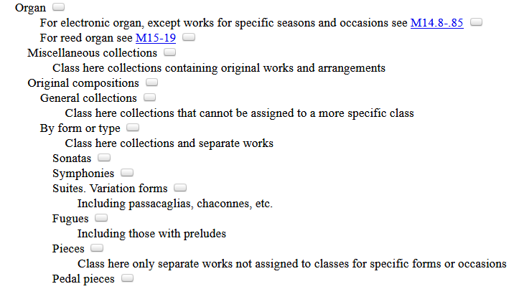
LC Genre/Form Terms
General principles
If the classification number reflects the genre/form of the resource, record that genre/form term first
050 _4 M10 $b .T289 2016
245 00 Ten preludes and fugues from the 19th and 20th centuries : $b for organ / $c compiled by
Esther Criscuola de Laix.
655 _7 Fugues. $2 lcgft
655 _7 Preludes (Music) $2 lcgft
655 _7 Scores. $2 lcgft
Notes:
Since this work has been classed in a number for fugues, the LCGFT term “Fugues” is given as the first 655 field.
"This volume features ten preludes, fugues, and prelude-fugue pairs from the early nineteenth through mid-twentieth centuries, by Charles Zeuner, Carl Czerny, Joseph Sulzer, and others. Included are pieces of a range of difficulties and lengths, with and without pedals, that are suitable for both service playing and concert use"--Back cover.

Slide 48
LC Genre/Form Terms
General principles
If no predominant genre/form and not classified in a number that reflects genre/form, then assign terms in any order considered to be most useful
If terms are assigned for the whole resource and for parts of the resource, assign terms for the whole before terms for the parts
100 1_ Shaw, Bernard, $d 1856-1950, $e author.
245 10 Three plays for Puritans / $c Bernard Shaw ; definitive text under the editorial
supervision of Dan H. Laurence ; with an introduction by Michael Billington.
505 0_ The devil's disciple -- Caesar and Cleopatra -- Captain Brassbound's conversion.
655 _7 Drama. $2 lcgft
655 _7 $3 The devil's disciple ; Captain Brassbound's conversion: $a Melodramas (Drama)
$2 lcgft
655 _7 $3 Caesar and Cleopatra: $a Historical drama. $2 lcgft
655 _7 $3 Caesar and Cleopatra: $a Biographical drama. $2 lcgft
655 _7 $3 Captain Brassbound's conversion: $a Problem plays. $2 lcgft

Slide 49
LC Genre/Form Terms
General principles
If no predominant genre/form and not classified in a number that reflects genre/form, then assign terms in any order considered to be most useful
If terms are assigned for the whole resource and for parts of the resource, assign terms for the whole before terms for the parts
245 10 Orchestral works / $c Henri Dutilleux.
505 0_ Symphony no. 1 -- Tout un monde lointain -- The shadows of time : for 3
children's voices and orchestra -- Métaboles -- Violin concerto : L'arbre des
songes -- Symphony no. 2 : Le double -- Sur le même accord : nocturne for
violin and orchestra -- Les citations : diptych for oboe, harpsichord, bass and
percussion -- Mystère de l'instant -- Timbres, espace, mouvement.
655 _7 Art music. $2 lcgft
655 _7 Symphonies. $2 lcgft
655 _7 Concertos. $2 lcgft
655 _7 Chamber music. $2 lcgft
Notes:
A sound recording of a number of kinds of orchestral works.

Slide 50
LCGFT Exercise - General Principles
You are cataloging Chelsea Quinn Yarbro’s Sins of Omission. Assign LCGFT for this work. Use appropriate MARC 21 coding and consult the PDF list of LCGFT terms.
Notes:
Answer:
655 _7 Paranormal fiction. $2 lcgft
655 _7 Thrillers (Fiction) $2 lcgft
655 _7 Novels. $2 lcgft

Slide 51
LCGFT Exercise - General Principles
You are cataloging the compilation Three Plays, by Arthur Wing Pinero. The plays are The Magistrate; The Second Mrs. Tanqueray; and Trelawny of the “Wells”. The first work is a farce, the second is a thesis play, and the third is a comedy. Assign LCGFT for this collection. Use appropriate MARC 21 coding and consult the PDF list of LCGFT terms.
Notes:
Answer:
655 _7 Drama. $2 lcgft
655 _7 $3 The magistrate: $a Farces. $2 lcgft
655 _7 $3 The second Mrs. Tanqueray: $a Problem plays. $2 lcgft
655 _7 $3 Trelawny of the "Wells": $a Comedy plays. $2 lcgft

Slide 52
LCGFT Exercise - General Principles
You are cataloging the compilation Bred Any Good Rooks Lately?: A Collection of Puns, Shaggy Dogs, Spoonerisms, Feghoots & Malappropriate Stories. Assign LCGFT for this collection. Use appropriate MARC 21 coding and consult the PDF list of LCGFT terms.
Notes:
Answer:
655 _7 Puns. $2 lcgft
655 _7 Shaggy dog stories. $2 lcgft
655 _7 Spoonerisms. $2 lcgft
655 _7 Humorous fiction. $2 lcgft
In LCGFT, Feghoots is a UF for Shaggy dog stories.
The rule of three does not apply, because there are more than three sub-genres of humor here.
“If a resource displays more than three of the narrower terms of a single broader term, assign the broader term unless the rule of four, described below, applies.”
The rule of four applies in this case, because the broader term Humor has many additional narrower terms besides the four above.

Slide 53
LCGFT
General Terms

Slide 54
LCGFT “General” Terms
Terms which are not specific to a particular discipline
Abridgments Almanacs Bibliographies Blogs
Conference papers and proceedings Diaries Dictionaries
FAQs Guidebooks Newsletters Picture books
Sayings Textbooks Yearbooks Zines
Terms for ephemera Calendars Menus Theater programs
Terms for some graphic materials Posters Postcards Paper dolls
Terms for puzzles and games KenKen puzzles Sudoku puzzles
Terms for types of toy and movable books Flip books Pop-up books
Some nonfiction terms Autobiographies Biographies Diaries
Essays Travel writing True crime stories

Slide 55
LCGFT “General” Terms
Many have corresponding headings or form subdivisions in LCSH, but the LCGFT headings may not be identical. For example:
LCSH: $v Biography LCSH: $v Congresses
LCGFT: Biographies LCGFT: Conference papers and proceedings
LCSH: $v Handbooks, manuals, etc. LCSH: Imaginary histories
LCGFT: Handbooks and manuals LCGFT: Counterfactual histories
LCSH: Playbills LCSH: Sound effects books
LCGFT: Playbills (Posters) LCGFT: Sound books
LCSH: $v Tables LCSH: $v Exhibitions
LCGFT: Tables (Data) LCGFT: Exhibition catalogs
Notes:
All LCGFT terms are in the plural form, unlike some LCSH headings. Terms in LCSH with “etc.” were deemed undesirable, so you won’t find them in LCGFT. All terms were reevaluated to be sure that they reflected current and common usage and made sense as stand-alone genre/form terms.

Slide 56
LCGFT “General” Terms
Divided into 10 “top” terms: Commemorative works; Creative nonfiction; Derivative works; Discursive works; Ephemera; Illustrated works; Informational works; Instructional and educational works; Recreational works; Tactile works
These are mainly for gathering the general terms into broad categories; they will rarely be assigned in a bibliographic record because more specific terms are available
Some of the more specific terms may be in the hierarchies of multiple top terms. For example, Handbooks and manuals has two BTs, Instructional and educational works and Reference works, which is an NT of Informational works

Slide 57
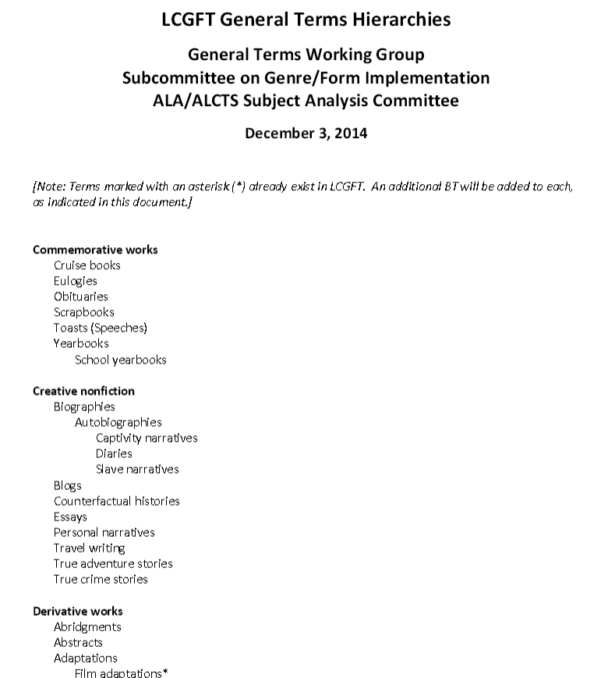
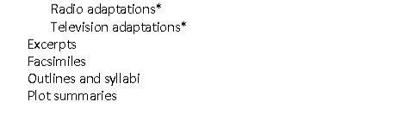
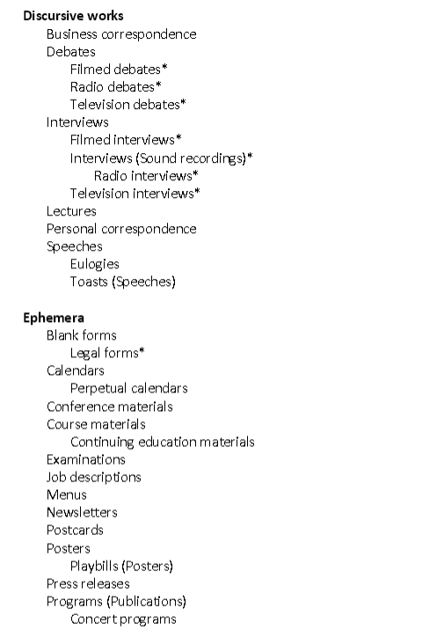
Notes:
LC has posted a hierarchical arrangement of the general terms that the GFIS Working Group created. Note that the current version online, dated December 3, 2014, does not reflect any changes that LC may have made to the records during the editorial process.

Slide 58
General Term Examples
100 1_ Frank, Anne, $d 1929-1945, $e author.
240 10 Achterhuis. $l English
245 14 The diary of Anne Frank / $c prepared by the Netherlands Institute for
War Documentation …
600 10 Frank, Anne, $d 1929-1945 $v Diaries.
650 _0 Holocaust, Jewish (1939-1945) $z Netherlands
$z Amsterdam $v Personal narratives.
650 _0 Jewish girls $z Netherlands $z Amsterdam $v Diaries.
650 _0 Jews $z Netherlands $z Amsterdam $v Diaries.
655 _7 Diaries. $2 lcgft
655 _7 Personal narratives. $2 lcgft
Notes:
Note: I have not shown all of the subjects that were assigned to this work, just the ones that have corresponding LCGFT terms.

Slide 59
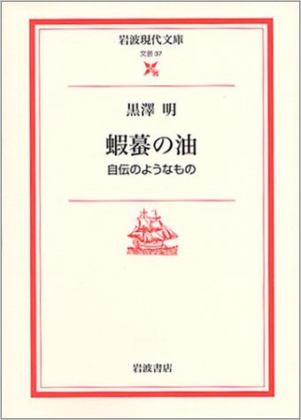
General Term Examples
100 1_ 黒澤明, $d 1910-1998, $e author.
100 1_ Kurosawa, Akira, $d 1910-1998, $e author.
245 10 蝦蟇の油 : $b 自伝のようなもの / $c 黒澤明.
245 10 Gama no abura : $b jiden no yō na mono / $c Kurosawa Akira.
600 14 黒澤明, $d 1910-1998.
600 10 Kurosawa, Akira, $d 1910-1998.
650 _0 Motion picture producers and directors $z Japan
$v Biography.
655 _7 Autobiographies. $2 lcgft
Notes:
Another example where a more specific LCGFT term is assigned in 655 than the form subdivision used in the subject headings. Since this work is an autobiography, Autobiographies is the correct term to assign to this work.

Slide 60
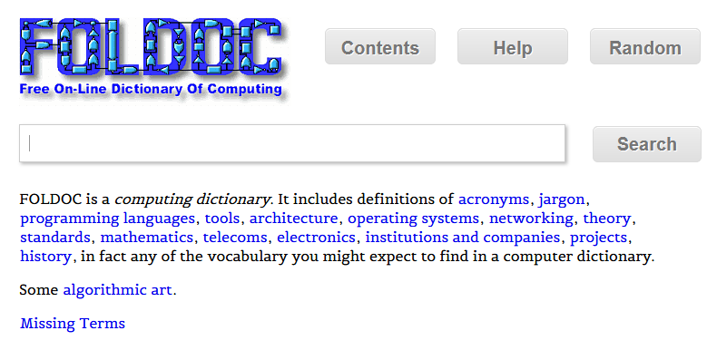
General Term Examples
245 00 FOLDOC : $b free on-line dictionary of computing / $c editor, Denis
Howe.
650 _0 Computer science $v Dictionaries.
650 _0 Computers $v Dictionaries.
650 _0 Microcomputers $v Dictionaries.
655 _7 Dictionaries. $2 lcgft
Notes:
Another very simple case where the LCGFT term is identical to the LCSH form subdivision.

Slide 61
General Term Examples
245 00 中华宝玉石文化概论 = $b Zhonghua baoyushi wenhua gailun / $c 主编周佩玲, 杨辉.
245 00 Zhonghua bao yu shi wen hua gai lun = $b Zhonghua baoyushi wenhua gailun / $c zhu bian Zhou Peiling, Yang Hui.
650 _0 Gem carving $z China $v Textbooks.
655 _7 Textbooks. $2 lcgft
Notes:
Here’s a very simple case where the LCGFT term is identical to the LCSH form subdivision. It won’t always be this simple, however!

Slide 62
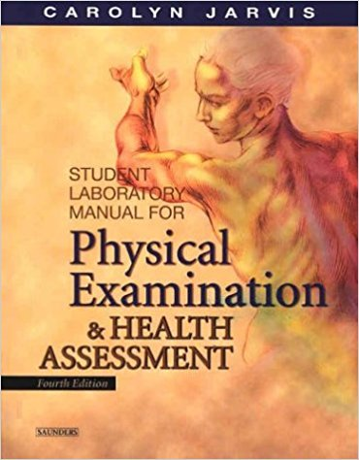
General Term Examples
100 1_ Jarvis, Carolyn, $e author.
245 10 Student laboratory manual for Physical
examination & health assessment, fourth
edition / $c Carolyn Jarvis, MSN, APN, CNP.
500 __ “... a study guide and laboratory manual to
accompany the textbook Physical examination
and health assessment, 4th edition"--Preface.
650 _0 Physical diagnosis $v Laboratory manuals.
650 _0 Nursing assessment $v Laboratory manuals.
655 _7 Laboratory manuals. $2 lcgft
655 _7 Study guides. $2 lcgft
655 _7 Problems and exercises. $2 lcgft
Notes:
Here’s a very simple case where the an LCGFT term is identical to the LCSH form subdivision. It won’t always be this simple, however! And note, that in this case, two additional LCGFT terms are appropriate to add based on the content of the resource.

Slide 63
General Term Examples
100 1_ Gross, John, $d 1935-2011, $e compiler.
245 14 The Oxford book of aphorisms / $c chosen by John Gross.
650 _0 Aphorisms and apothegms.
655 _7 Sayings. $2 lcgft
100 1_ Cordry, Harold V., $d 1943- $e compiler.
245 14 The multicultural dictionary of proverbs : $b over 20,000 adages from more than 120 languages, nationalities, and ethnic groups / $c Harold V. Cordry.
650 _0 Proverbs.
655 _7 Sayings. $2 lcgft
Notes:
In some cases, a single term has been chosen in LCGFT to represent a number of different terms in LCSH.

Slide 64
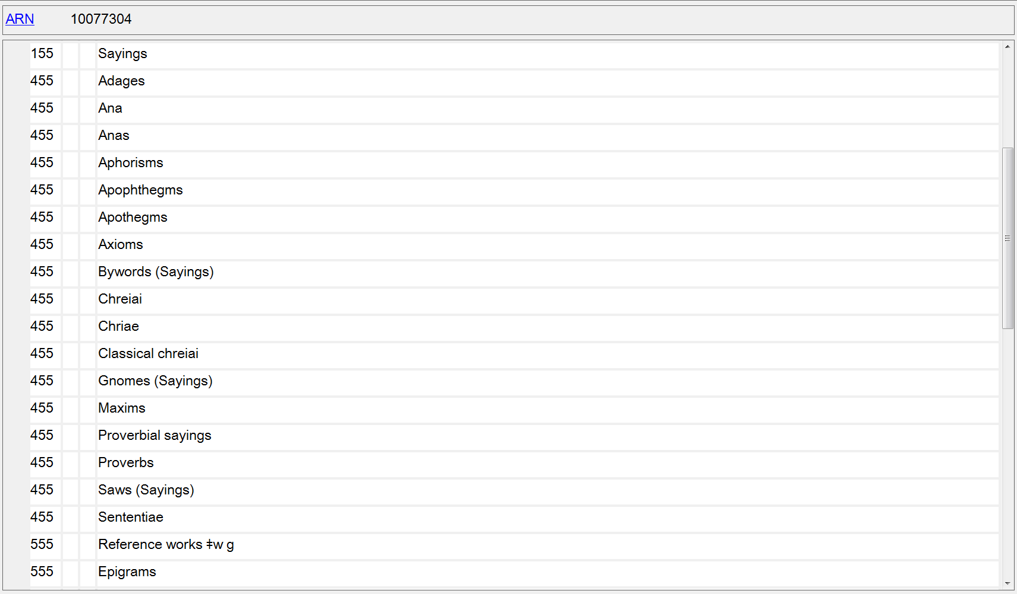
Notes:
The differences in meaning of the terms “Adages”, “Aphorisms”, “Maxims”, “Proverbs”, etc. are so small and hard to discern, and often overlap. A single general term, “Sayings” was chosen for LCGFT.

Slide 65
General Term Examples
100 1_ Crowther, Robert, $e author.
245 10 Amazing pop-up trucks / $c Robert Crowther.
520 __ Text and pop-up illustrations introduce five different kinds of trucks from cement truck to garbage truck, and explain what they can do.
650 _0 Trucks $v Juvenile literature.
650 _1 Trucks.
650 _1 Pop-up books.
650 _1 Toy and movable books.
655 _7 Pop-up books. $2 lcgft

Slide 66
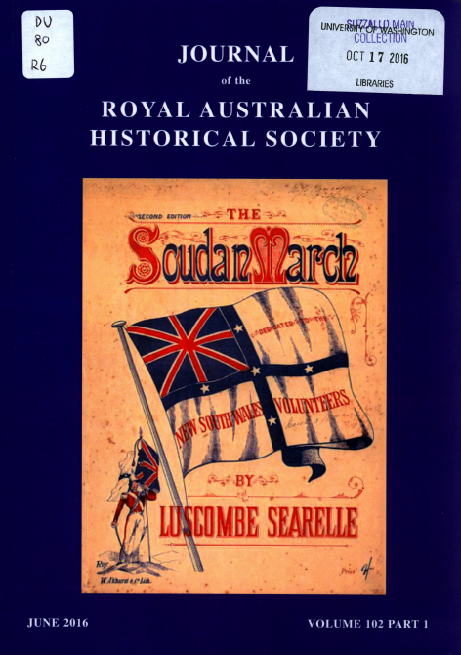
General Term Examples - Serials
245 00 Journal of the Royal Australian
Historical Society.
310 __ Quarterly
651 _0 Australia $x History $v Periodicals.
655 _7 Periodicals. $2 lcgft
710 2_ Royal Australian Historical Society, $e
issuing body.

Slide 67
General Term Examples - Serials
110 2_ Seattle Parks Foundation, $e author.
245 10 Annual report.
246 13 Seattle Parks Foundation annual report
610 20 Seattle Parks Foundation $v Periodicals.
650 _0 Parks $z Washington (State) $z Seattle $v Periodicals.
655 _7 Annual reports. $2 lcgft
Notes:
Another situation in which the LCGFT term assigned does not correspond to the form subdivision used in the subject headings. Annual reports is the specific term appropriate to this work, so only it is assigned from LCGFT.
Note: just because something is issued annually does not make it an “Annual report”
The form subdivision $v Periodicals is used in a much broader sense than the actual definition of the term. Although one might assign the LCGFT term Periodicals, probably the broader term Serial publications is more appropriate for this publication.
From the Subject Headings Manual H 1927: “In subject cataloging practice the term periodical is defined as a publication other than a newspaper that is actually or purportedly issued according to a regular schedule (monthly, quarterly, biennially, etc.) in successive parts, each of which bears a numerical or chronological designation, and that is intended to be continued indefinitely. This definition is broader than the traditional definition, which states that a periodical is generally published more frequently than annually and normally contains separate articles. The term serial is frequently used in a broader sense to refer to any title cataloged as a serial, including periodicals, newspapers, monographic series, etc. The subdivision –Periodicals is used under headings assigned to serials that conform to the subject cataloging definition of periodicals.”

Slide 68
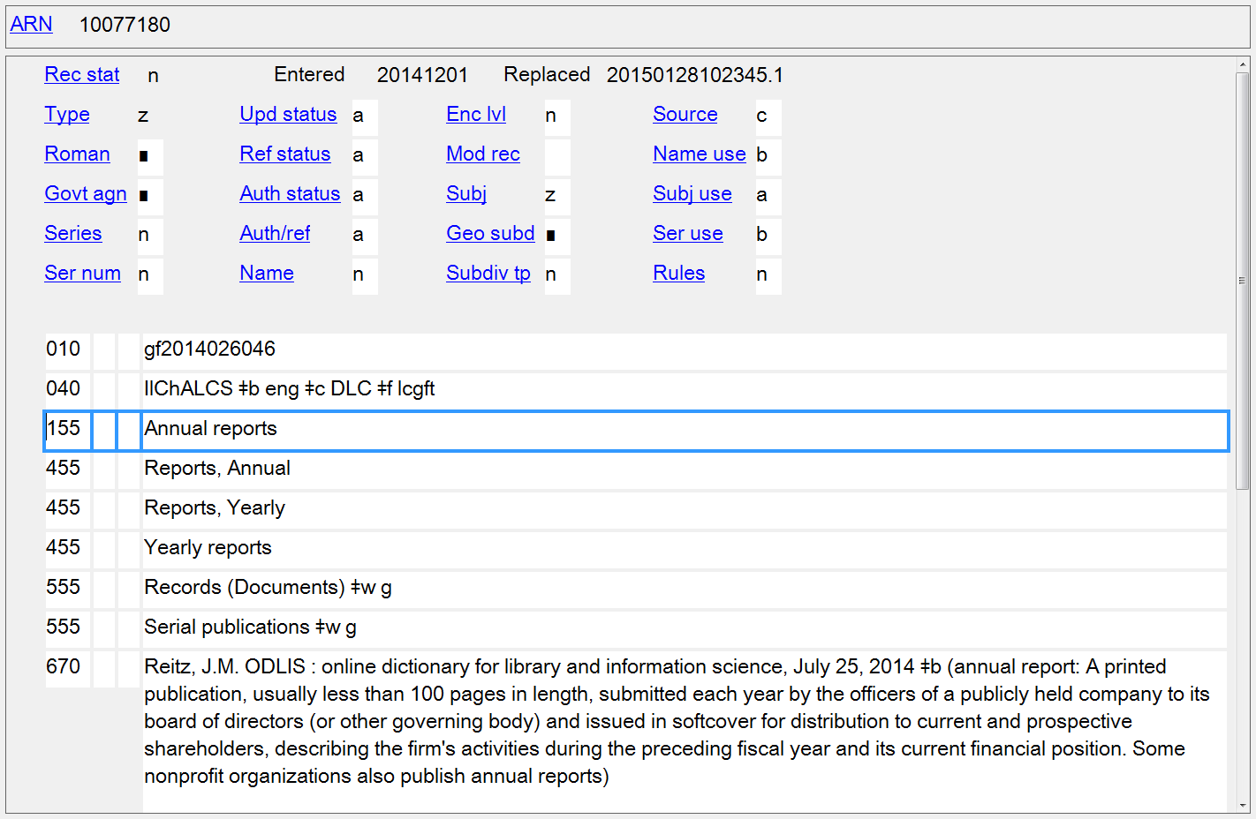
Notes:
As you can see from the broader terms on this record, Annual reports is not considered a type of periodical.

Slide 69
General Term Examples - Serials
245 00 Los Angeles sentinel.
310 __ Weekly
362 1_ Began in 1933.
650 _0 African Americans $z California $z Los Angeles $v Newspapers.
651 _0 Los Angeles (Calif.) $v Newspapers.
651 _0 Los Angeles County (Calif.) $v Newspapers.
655 _7 Newspapers. $2 lcgft
655 _7 African American newspapers. $2 ngl
Notes:
Although LCGFT does not allow explicit inclusion of the audience or creators of a work, you can see that the Newspaper Genre List ($2 ngl) does have such terms.

Slide 70
General Term Examples - Serials
245 10 Understanding North Korea.
264 _1 Seoul : $b Institute for Unification Education,
Ministry of Unification, $c 2012-
310 __ Biennial
362 1_ Began with 2012.
588 __ Description based on: 2012; title from title page.
588 __ Latest issue consulted: 2014.
651 _0 Korea (North) $x History $y 2011- $v Periodicals.
651 _0 Korea (North) $x Social conditions $y 21st century $v Periodicals.
655 _7 Serial publications. $2 lcgft
Notes:
The form subdivision $v Periodicals is used in a much broader sense than the actual definition of the term. Although one might assign the LCGFT term Periodicals, probably the broader term Serial publications is more appropriate for this biennial publication.
From the Subject Headings Manual H 1927: “In subject cataloging practice the term periodical is defined as a publication other than a newspaper that is actually or purportedly issued according to a regular schedule (monthly, quarterly, biennially, etc.) in successive parts, each of which bears a numerical or chronological designation, and that is intended to be continued indefinitely. This definition is broader than the traditional definition, which states that a periodical is generally published more frequently than annually and normally contains separate articles. The term serial is frequently used in a broader sense to refer to any title cataloged as a serial, including periodicals, newspapers, monographic series, etc. The subdivision –Periodicals is used under headings assigned to serials that conform to the subject cataloging definition of periodicals.”

Slide 71
General Term Examples - Serials
245 00 HR handbook for California employers.
__ Annual
650 _0 Labor laws and legislation $z California $v Handbooks, manuals, etc.
650 _0 Personnel management $z California $v Handbooks, manuals, etc.
655 _7 Handbooks and manuals. $2 lcgft
655 _7 Serial publications. $2 lcgft
Notes:
Another example where the LCGFT term does not correspond exactly to the LCSH form subdivision. Catalogers must search the LCGFT genre/form authority records and use the headings found there. Don’t just copy LCSH form subdivisions into the 655 field.
Note: Although this is published annually, it is not an “Annual report.”
Note: $v Handbooks, manuals, etc. is one of the form subdivisions that the Subject Headings Manual (H 1927) says not to add $v Periodicals to:
Do not use –Periodicals as a further subdivision under the following form subdivisions:
–Amateurs' manuals –Atlases –Calendars –Cases –Congresses –Databases –Dictionaries –Digests –Directories –Encyclopedias –Gazetteers –Guidebooks
–Handbooks, manuals, etc. –Juvenile films –Juvenile literature –Juvenile sound recordings –Laboratory manuals –Maps –Newspapers –Observer's manuals –Outlines, syllabi, etc. –Photo maps –Registers –Telephone directories

Slide 72
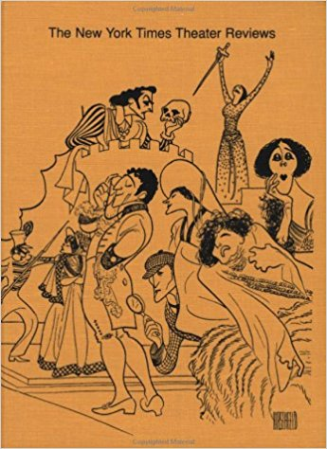
General Term Examples - Serials
245 00 The New York times theater reviews.
310 __ Biennial, $b 1971-72-
650 _0 Theater $z United States $v Reviews
$v Periodicals.
655 _7 Theater reviews. $2 lcgft
655 _7 Serial publications. $2 lcgft

Slide 73
General Term Examples - Serials
245 00 中國新書 = $b China new books / $c 中国新书杂志社.
245 00 Zhongguo xin shu = $b China new books / $c Zhongguo xin shu za zhi she.
310 __ Monthly
650 _0 Books $z China $v Reviews $v Periodicals.
655 _7 Book reviews. $2 lcgft
655 _7 Periodicals. $2 lcgft
245 00 文学新书评 = $b Review of the new literary books.
245 00 Wen xue xin shu ping = $b Review of the new literary books.
310 __ Annual
650 _0 Chinese literature $v Book reviews $v Periodicals.
650 _0 Books $z China $v Reviews $v Periodicals.
655 _7 Book reviews. $2 lcgft
655 _7 Serial publications. $2 lcgft
Notes:
The form subdivision $v Periodicals is used in a much broader sense than the actual definition of the term. Although one might assign the LCGFT term Periodicals, probably the broader term Serial publications is more appropriate for the second publication shown in the slide.
From the Subject Headings Manual H 1927: “In subject cataloging practice the term periodical is defined as a publication other than a newspaper that is actually or purportedly issued according to a regular schedule (monthly, quarterly, biennially, etc.) in successive parts, each of which bears a numerical or chronological designation, and that is intended to be continued indefinitely. This definition is broader than the traditional definition, which states that a periodical is generally published more frequently than annually and normally contains separate articles. The term serial is frequently used in a broader sense to refer to any title cataloged as a serial, including periodicals, newspapers, monographic series, etc. The subdivision –Periodicals is used under headings assigned to serials that conform to the subject cataloging definition of periodicals.”

Slide 74
General Term Examples - Serials
111 2_ Vancouver Queer Film & Video Festival, $j author.
245 14 The ... Annual Vancouver Queer Film & Video Festival : $b festival guide.
310 __ Annual
611 20 Vancouver Queer Film & Video Festival $v Periodicals.
650 _0 Gay and lesbian film festivals $z British Columbia $z Vancouver $v Periodicals.
655 _7 Film festival programs. $2 lcgft
655 _7 Serial publications. $2 lcgft
Notes:
Note: I have not shown all of the subjects that were assigned to this work, just the first two.

Slide 75
General Term Examples - Serials
245 00 Tidal current tables. $p Pacific coast of North America and Asia for the year ...
310 __ Annual
650 _0 Tidal currents $z Pacific Ocean $v Tables $v Periodicals.
650 _0 Tides $z Pacific Ocean $v Tables $v Periodicals.
650 _0 Tidal currents $z Pacific Coast (North America) $x Forecasting $v Periodicals.
650 _0 Tidal currents $z Pacific Coast (Asia) $x Forecasting $v Periodicals.
650 _0 Aids to navigation $z Pacific Coast (North America) $v Sources $v Periodicals.
650 _0 Aids to navigation $z Pacific Coast (Asia) $v Sources $v Periodicals.
655 _7 Tables (Data) $2 lcgft
655 _7 Serial publications. $2 lcgft

Slide 76
General Term Examples - Nontextual
100 1_ King, Coretta Scott, $d 1927-2006, $e author.
245 10 My life, my love, my legacy / $c Coretta Scott King as told to the Rev.
Dr. Barbara Reynolds.
250 __ Unabridged.
300 __ 1 online resource (1 sound file (14 hr., 30 min.)) : $b digital
600 10 King, Coretta Scott, $d 1927-2006.
600 10 King, Martin Luther, $c Jr., $d 1929-1968.
650 _0 Civil rights workers $z United States $v Biography.
…
655 _7 Autobiographies. $2 lcgft
655 _7 Audiobooks. $2 lcgft

Slide 77
General Term Examples - Nontextual
245 00 Travel writers / $c compilation, Steve Cleary.
300 __ 2 audio discs (150 min.) : $b digital, CD audio ; $c 4 3/4 in. + $e 1 booklet (13 unnumbered
pages : illustrations ; 12 cm).
500 __ "A mixture of radio broadcasts and live talks and readings"--Accompanying booklet.
505 0_ disc 1. Marooned on Elephant Island / Leonard D.A. Hussey (3:04). Speaking personally /
Rosita Forbes (7:48). The philosophy of exploration / Freya Stark (17:35). Nuptials of the
East and West / Sacheverell Sitwell (12:46). Interview at her home in Chandolin / Ella
Maillant ; interviewer, Bridget Carter (17:21). On the Bushmen of the Kalahari / Laurens
van der Post (19:10) -- disc 2. The time of my life / Peter Fleming (20:49). The empty
quarter / Wilfred Thesiger (16:02). The last fiesta / Laurie Lee (13:57). Turning points / Eric
Newby (11.28). Trieste and the meaning of nowhere / Jan Morris (6:02). By camel across
Sahara / Geoffrey Moorhouse ; interviewer, Robert Williams (4:55)..
655 _7 Travel writing. $2 lcgft
655 _7 Literary readings (Radio programs) $2 lcgft
655 _7 Interviews (Sound recordings) $2 lcgft

Slide 78
General Term Examples - Nontextual
245 00 Stink bugs of Oregon.
264 1_ Salem, OR : $b Oregon Department of Agriculture, Plant Protection and Conservation Program, Insect Pest Prevention and Management, $c [2017]
300 __ 1 poster ; $b color ; $c 46 x 31 cm
650 _0 Stinkbugs $z Oregon $v Posters.
655 _7 Wildlife posters. $2 lcgft

Slide 79
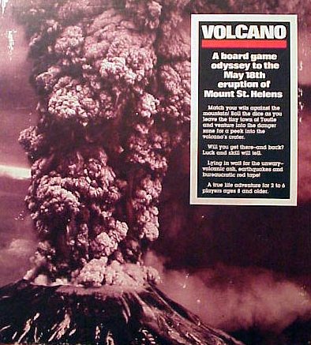
General Term Examples - Nontextual
245 00 Volcano : $b a board game odyssey to the May 18th eruption of Mount
St. Helens.
300 __ 1 game (1 board, 1 rules sheet, 6 colored move markers, 1 dice, 31
blue cards, 37 red cards, and 34 grey cards) : $b paper, cardboard, and
plastic ; $c 34 x 30 x 5 cm
655 _7 Board games. $2 lcgft

Slide 80
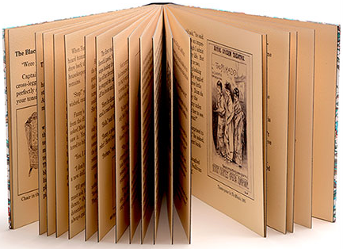
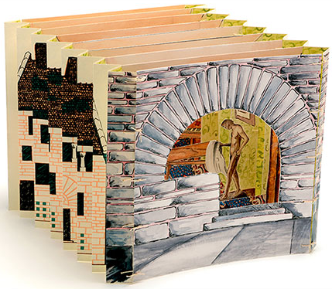
General Term Examples - Nontextual
100 1_ Widmer, Don, $e book artist.
245 10 Fanny and the doll corpse / $c by Don Widmer.
300 __ 2 volumes : $b color illustrations ; $c 21 x 25 cm,
in box 23 x 26 x 6 cm
500 __ Consists of two artist book structures housed in
a drop-spine box. One is in codex format; the other is a tunnel book.
655 _7 Picture books. $2 lcgft
655 _7 Tunnel books. $2 lcgft
655 _7 Historical fiction. $2 lcgft
655 _7 Detective and mystery fiction. $2 lcgft
655 _0 Artists' books.
Notes:
Artists’ books (as of December 2017) is not yet in LCGFT, so the term is coded here with a second indicator value of 0, meaning that the term is from LCSH. However, this term will be coming into LCGFT through the upcoming project to add art terms.

Slide 81
LCGFT Exercises - General Terms
Assign LCGFT for the resources depicted. Use appropriate MARC 21 coding and consult the PDF list of LCGFT terms.

Slide 82
Notes:
Answer:
655 _7 Guidebooks. $2 lcgft
Subjects assigned:
650 _0 Popular music $z California $z San Francisco $x History and criticism.
650 _0 Musical landmarks $z California $z San Francisco $v Guidebooks.
651 _0 San Francisco (Calif.) $v Guidebooks.

Slide 83
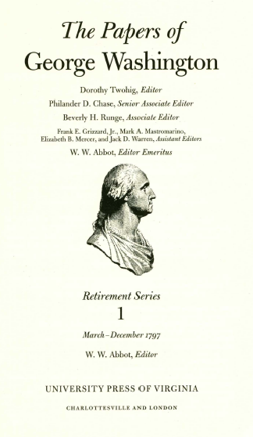
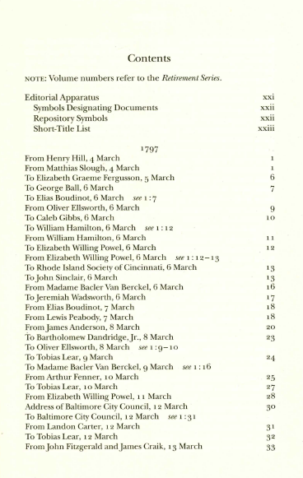
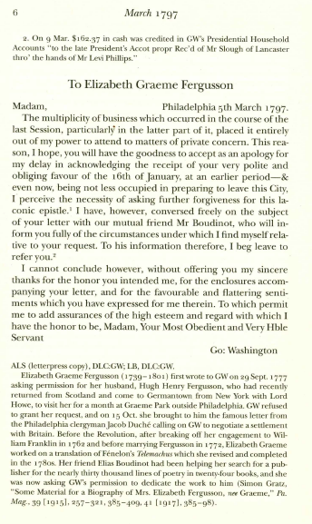
Notes:
ANSWER:
655 _7 Personal correspondence. $2 lcgft
655 _7 Speeches. $2 lcgft

Slide 84
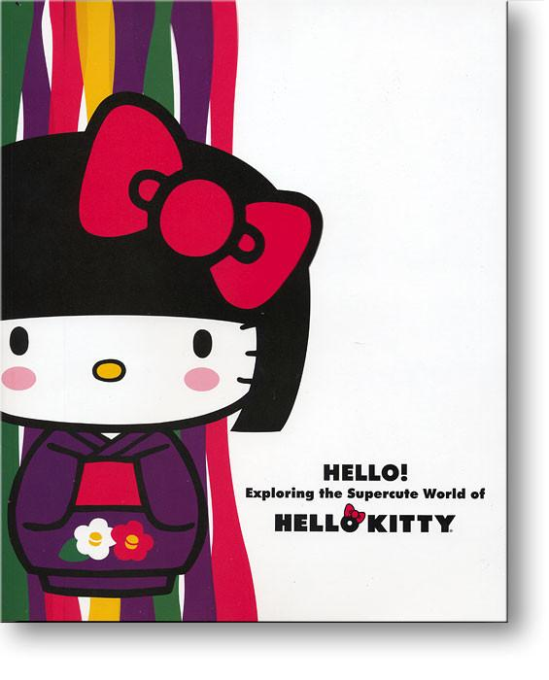
500 __ Published in conjunction with
the exhibition held October 11,
2014-May 31, 2015 at the
Japanese American National
Museum, Los Angeles, California.
600 00 Hello Kitty $c (Fictitious character)
$v Exhibitions.
600 00 Hello Kitty $c (Fictitious character)
$x Collectibles $v Exhibitions.
650 _0 Character toys $x Collectibles $z Japan $v Exhibitions.
650 _0 Licensed products $v Exhibitions.
Notes:
ANSWER:
655 _7 Exhibition catalogs. $2 lcgft
Perhaps also:
655 _7 Illustrated works. $2 lcgft

Slide 85
Notes:
ANSWER:
655 _7 Dictionaries. $2 lcgft
Note: In December 2017, a more specific term, Multilingual dictionaries, was added to LCGFT.

Slide 86
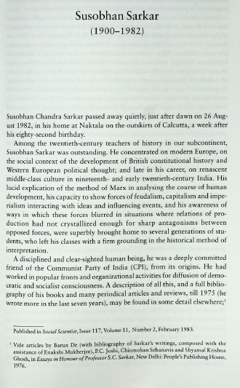
Foreword
To mark the completion of forty years of existence, we are bringing out collections of essays on some specific topics, culled from past numbers of the journal. The collection which follows is of obituary articles published in Social Scientist in the past. Oddly enough, for reasons which are not very clear, the journal published no obituaries until 1983, that is, for the first eleven years of its existence.
Notes:
ANSWER:
655 _7 Obituaries. $2 lcgft

Slide 87
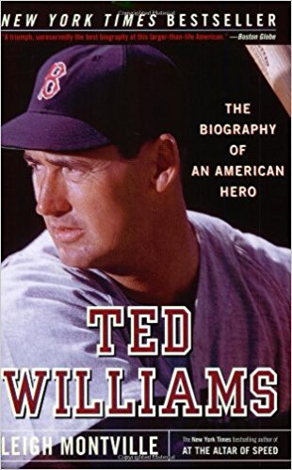
Notes:
ANSWER:
655 _7 Biographies. $2 lcgft

Slide 88
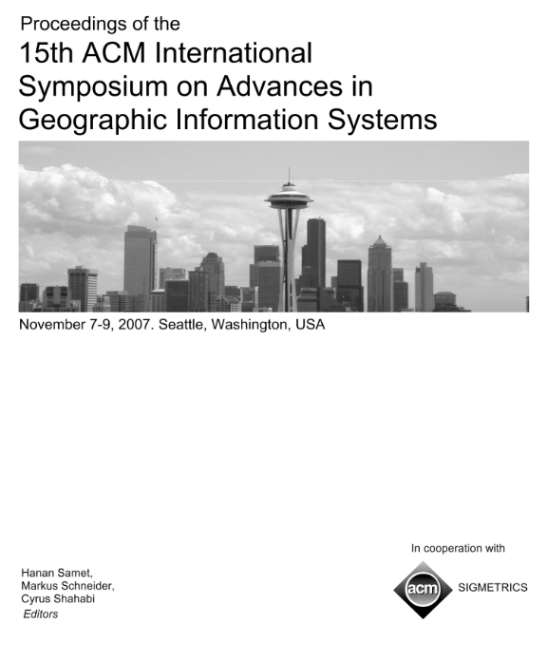
Notes:
ANSWER:
655 _7 Conference papers and proceedings. $2 lcgft

Slide 89
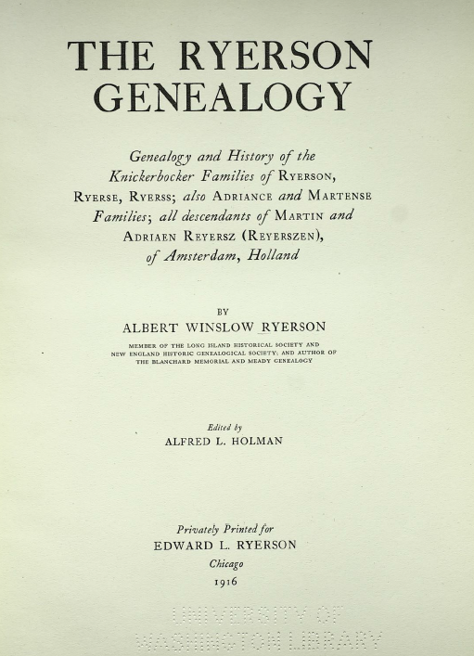
Notes:
ANSWER:
655 _7 Family histories. $2 lcgft

Slide 90
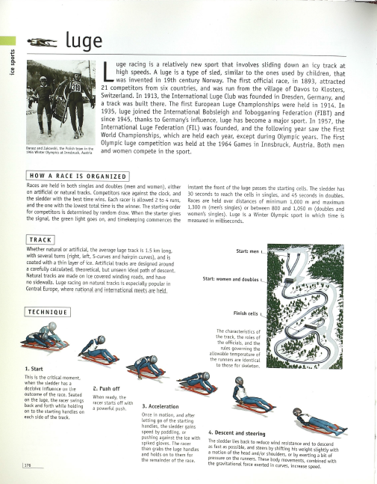
Notes:
ANSWER:
655 _7 Reference works. $2 lcgft
655 _7 Illustrated works. $2 lcgft
or perhaps
655 _7 Trivia and miscellanea. $2 lcgft
655 _7 Illustrated works. $2 lcgft

Slide 91
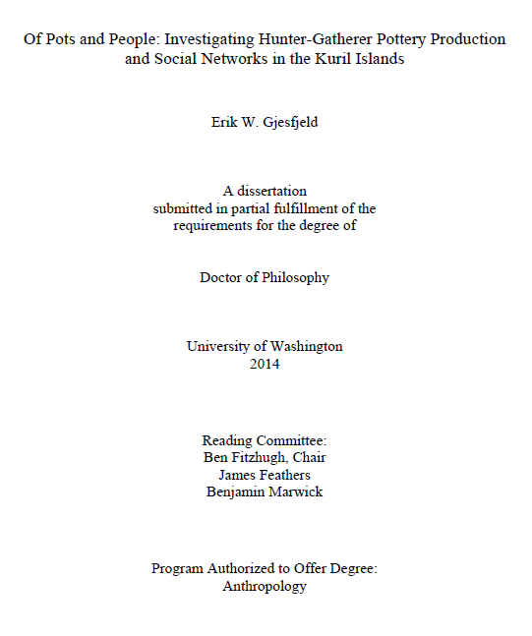
Notes:
ANSWER:
655 _7 Academic theses. $2 lcgft

Slide 92
Notes:
ANSWER:
655 _7 Self-help publications. $2 lcgft

Slide 93
100 1_ Santat, Dan, $e author, $e illustrator.
245 14 The adventures of Beekle : $b the unimaginary
friend / $c Dan Santat.
300 __ 1 volume (unpaged) : $b color illustrations ; $c 29 cm
520 __ "An imaginary friend waits a long time to be
imagined by a child and given a special name, and
finally does the unimaginable--he sets out on a
quest to find his perfect match in the real world."--$c
Provided by publisher.
521 __ Preschool.
521 8_ 480 $b Lexile.
526 0_ Accelerated Reader $c 2.3.
586 __ Caldecott Medal, 2015.
650 _0 Imaginary companions $v Juvenile fiction.
650 _0 Friendship $v Juvenile fiction.
650 _1 Imaginary playmates $v Fiction.
650 _1 Friendship $v Fiction.
Notes:
ANSWER:
655 _7 Picture books. $2 lcgft
655 _7 Fiction. $2 lcgft
For children’s picture books, neither Novels nor Short stories seems appropriate, so probably the best choice is Fiction.

Slide 94
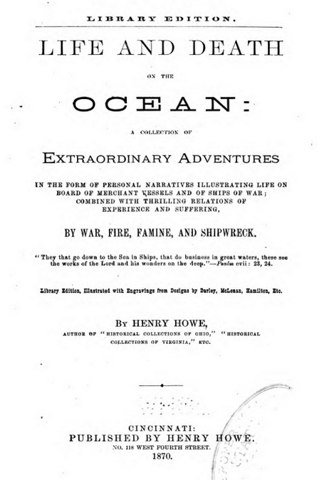
100 1_ Howe, Henry, $d 1816-1893, $e author.
245 10 Life and death on the ocean : $b a collection
of extraordinary adventures in the form of
personal narratives illustrating life on board
of merchant vessels and of ships of war;
combined with thrilling relations of
experience and suffering, by war, fire, famine,
and shipwreck / $c by Henry Howe.
650 _0 Voyages and travels.
650 _0 Seafaring life.
650 _0 Shipwrecks.
Notes:
ANSWER:
655 _7 True adventure stories. $2 lcgft
perhaps also 655 _7 Personal narratives. $2 lcgft

Slide 95
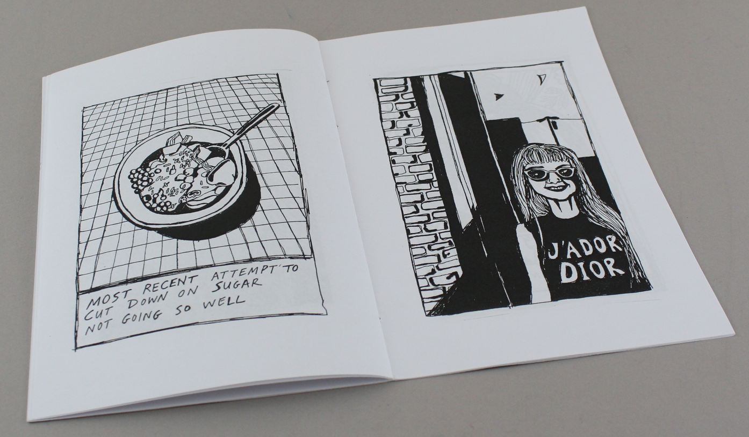
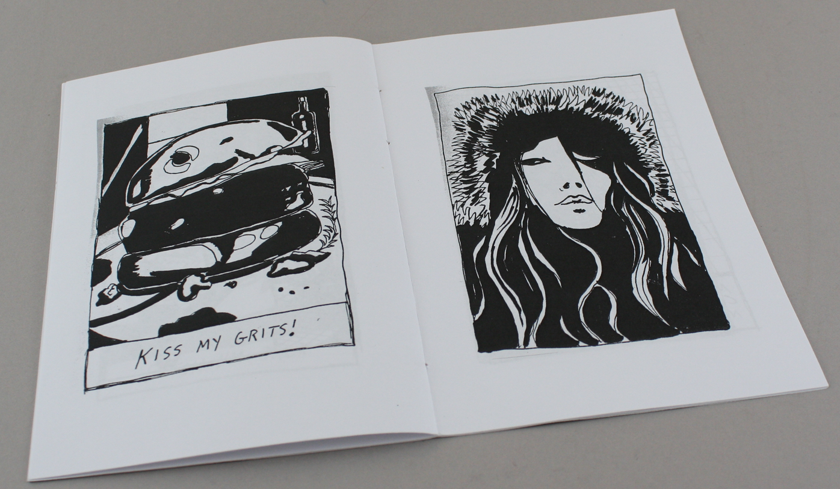
Notes:
ANSWER:
655 _7 Zines. $2 lcgft
655 _7 Illustrated works. $2 lcgft
or
655 _7 Zines. $2 lcgft
655 _7 Comics (Graphic works) $2 lcgft

Slide 96
Notes:
ANSWER:
655 _7 Recipes. $2 lcgft
655 _7 Blogs. $2 lcgft

Slide 97
Notes:
ANSWER:
655 _7 Periodicals. $2 lcgft

Slide 98
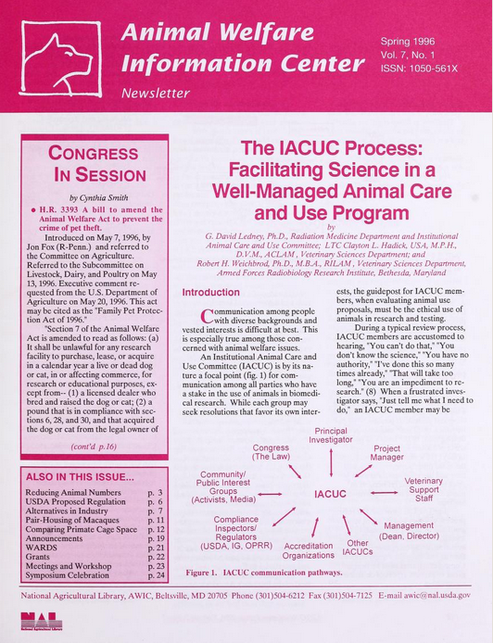
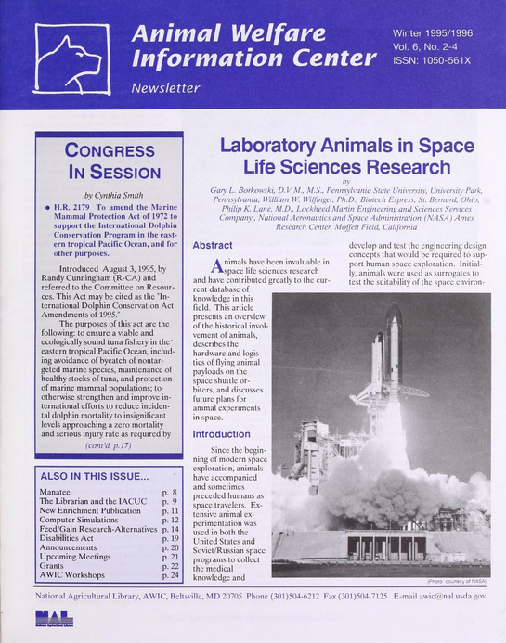
Notes:
ANSWER:
655 _7 Newsletters. $2 lcgft

Slide 99
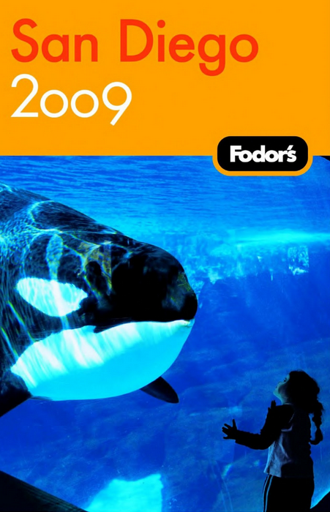
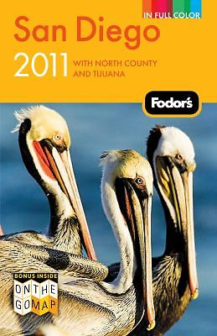
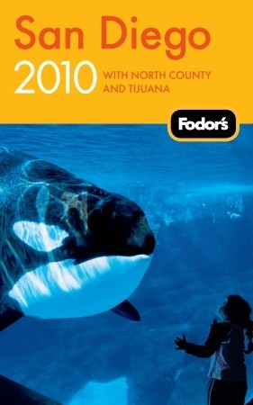
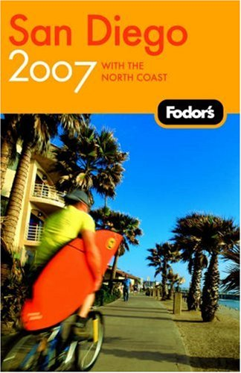
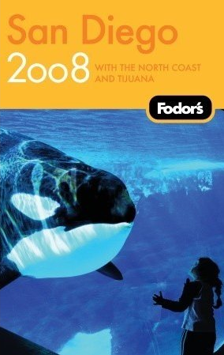
All cataloged on a single record
Notes:
ANSWER:
655 _7 Guidebooks. $2 lcgft
655 _7 Serial publications. $2 lcgft

Slide 100
LCGFT
Literature Terms

Slide 101
LCGFT Literature Terms
Top term: Literature
Used only for collections of literary works composed of multiple genres/forms to which more specific terms cannot be applied.
Five high-level terms under Literature:
Comics (Graphic works)
Drama
Fiction
Folk literature
Poetry
Notes:
The top term Literature is unlikely to be used very much, since more specific terms will generally be available. The scope not for it says: Collections of literary works that are composed of multiple genres and/or forms to which more specific headings such as Lyric poetry or Science fiction cannot be applied.
All of the terms below Literature may be used for both collections and individual works.

Slide 102
LCGFT Literature Terms
Many have corresponding headings in LCSH, but the LCGFT headings may not be identical. For example:
LCSH: Adventure stories LCSH: Motion picture plays LCSH: Horror comic books, strips, etc.
LCGFT: Action and adventure fiction LCGFT: Screenplays LCGFT: Horror comics
LCSH: Comic books, strips, etc. LCSH: Nonfiction novel LCSH: Gothic fiction (Literary genre)
LCGFT: Comics (Graphic works) LCGFT: Nonfiction novels LCGFT: Gothic fiction
LCSH: Horror tales LCSH: Moralities LCSH: Spy stories
LCGFT: Horror fiction LCGFT: Morality plays LCGFT: Spy fiction
LCSH: Plot-your-own stories LCSH: Comedy LCSH: Tragedy
LCGFT: Choose-your-own stories LCGFT: Comedy plays LCGFT: Tragedies (Drama)
LCSH: Mysteries and miracle-plays LCSH: Magic realism (Literature) LCSH: Suspense fiction
LCGFT: Mystery and miracle plays LCGFT: Magic realist fiction LCGFT: Suspense fiction and Thrillers (Fiction)
Notes:
All LCGFT terms are in the plural form, unlike some LCSH headings.

Slide 103
LCGFT Literature Terms
Explicit aspects like audience, creator characteristics, place of origin, language, and time period of creation that are often included in LCSH were out of scope for LCGFT if they are explicit in the term, so you will not find terms like these from LCSH: Children’s poetry; Buddhist stories; Christian fiction; Gay men’s writings; College prose; Byzantine literature; Literature, Medieval; Chinese drama
However, when not explicit, terms may be in LCGFT, e.g.
Azharot Jewish liturgical poems on 613 commandments in the Torah
Bible plays specific religion is not explicit
Chansons de geste a medieval French genre
Comedies of humours an English 16th-17th century drama genre
Fabliaux bawdy medieval tales
Hyangga Korean poetry from Unified Silla (668-935) and Koryŏ dynasties (935-1392)
Jataka stories Buddhist tales about the previous births of the Buddha

Slide 104
LCGFT Literature Terms
Exclusions from LCGFT
Terms that require a value judgment on the part of catalogers and users are ineligible, e.g., Feminist fiction; Patriotic poetry
Terms for literary movements, e.g., Dadaist poetry; Expressionist drama; Beat literature
However, style and technique are eligible, e.g., Frame stories; Metadramas; Parodies (Literature); Noir comics; Satirical literature; Stream of consciousness fiction
Notes:
Frame stories: stories that contain other stories
Metadramas: drama that self-consciously calls attention to its own fictional status as a theatrical pretense, often through the use of a play-within-a-play

Slide 105
LCGFT Literature Terms
LCGFT Manual J 235
Special provisions for literature:
Fiction: in addition to other genre/form terms, assign a term for length when it is readily apparent (Novels; Novellas; Short stories; Flash fiction)
Poetry: For both individual poems and collections of poetry, rely chiefly on the title, introduction, cover information, etc., to determine whether the poetry is of a specific genre or form. If after a superficial review a specific genre or form cannot be determined, assign the term Poetry
Poetry: If the genre or form of a poem or collection of poetry is known to the cataloger due to the cataloger’s academic or cultural background, etc., one or more genre/form terms may be assigned to represent the genre or form (e.g., you know that Homer’s Odyssey is Epic poetry even if the resource you’re cataloging doesn’t say it is)
Notes:
1. Fiction. In addition to terms assigned in accordance with the guidelines in J 110, assign a term that indicates the length of the resource when it is readily apparent (e.g., Novels; Novellas; Short stories; Flash fiction).
Flash fiction: very short fiction of just a page or two; short stories of extreme brevity.

Slide 106
Literature Examples - Fiction
245 04 The Faber book of gay short fiction / $c edited by Edmund White.
260 London ; $a Boston : $b Faber and Faber, $c 1991.
650 _0 Gay men $v Fiction.
650 _0 Gay men's writings, English.
650 _0 Gay men's writings, American.
650 _0 Short stories, American.
650 _0 Short stories, English.
655 _7 Short stories. $2 lcgft
Notes:
A collection of short stories. No specific literary genres/forms are identified other than the length of the fiction.

Slide 107
Literature Examples - Fiction
100 1_ Proulx, Annie, $e author.
245 10 Brokeback Mountain / $c Annie Proulx.
260 __ New York : $b Scribner, $c 2005.
300 __ 55 pages ; $c 19 cm
650 _0 Cowboys $v Fiction.
650 _0 Ranch life $v Fiction.
650 _0 Gay men $v Fiction.
651 _0 Wyoming $v Fiction.
655 _7 Romance fiction. $2 lcgft
655 _7 Western fiction. $2 lcgft
655 _7 Short stories. $2 lcgft
Notes:
An individually published short story.

Slide 108
Literature Examples - Fiction
100 1_ Tartt, Donna, $e author.
245 14 The goldfinch / $c Donna Tartt.
650 _0 Young men $v Fiction.
650 _0 Loss (Psychology) $v Fiction.
650 _0 Artists $v Fiction.
650 _0 Self-realization $v Fiction.
651 _0 New York (N.Y.) $v Fiction.
655 _7 Novels. $2 lcgft
655 _7 Bildungsromans. $2 lcgft
655 _7 Fictional autobiographies. $2 lcgft

Slide 109
Literature Examples - Fiction
245 04 The pearl jacket and other stories : $b flash fiction from contemporary China / $c edited and translated by Shouhua Qi.
650 _0 Flash fiction, Chinese $v Translations into English.
650 _0 Chinese fiction $y 21st century $v Translations into English.
650 _0 Chinese fiction $y 20th century $v Translations into English.
655 _7 Flash fiction. $2 lcgft
Notes:
A compilation of flash fiction by Chinese authors. Flash fiction are stories that are very short, no more than a page or two in length. It is also known as microfiction, short-short stories, and sudden fiction.

Slide 110
Literature Examples - Fiction
245 00 한국 공포 문학 단편선.
245 00 Han'guk kongp'o munhak tanp'yŏnsŏn.
310 Annual
362 1_ Began in 2006.
650 _0 Horror tales, Korean $v Periodicals.
650 _0 Short stories, Korean $v Periodicals.
650 _0 Korean fiction $y 21st century $v Periodicals.
655 _7 Horror fiction. $2 lcgft
655 _7 Short stories. $2 lcgft
655 _7 Serial publications. $2 lcgft
Notes:
This is a compilation of works by different authors, issued as an annual publication, so here we have literature genre/form terms and a general term. For the fiction aspect, two terms are given, one for the genre (horror) and one for the length (short stories).
Genre/Form Terms Manual J 235 Literature
1. Fiction. In addition to terms assigned in accordance with the guidelines in J 110, assign a term that indicates the length of the resource when it is readily apparent (e.g., Novels; Novellas; Short stories; Flash fiction).

Slide 111
Literature Examples - Poetry
100 1_ Tolmie, Sarah, $e author.
245 10 Trio / $c Sarah Tolmie.
490 1_ The Hugh MacLennan poetry series
500 __ "A collection of 120 sonnets in eight parts,
Trio reveals, frame by frame, a married
fortysomething female narrator in love
with two younger men … and torn between
the claims of body and mind”--Page 4 of cover.
650 _0 Love poetry, Canadian.
650 _0 Sonnets, Canadian.
655 _7 Love poetry. $2 lcgft
655 _7 Sonnets. $2 lcgft
Notes:
A collection by one author.

Slide 112
Literature Examples - Poetry
100 1_ Pope, Alexander, $d 1688-1744, $e author.
245 14 The rape of the lock / $c Alexander Pope ;
edited by Elizabeth Gurr.
650 _0 Young women $v Poetry.
650 _0 Catholics $z England $v Poetry.
650 _0 Aristocracy (Social class) $z England $v Poetry.
650 _0 Pride and vanity $v Poetry.
655 _7 Mock-heroic poetry. $2 lcgft
655 _7 Narrative poetry. $2 lcgft
Notes:
An individually published poem.
LCGFT Manual J 235: “If the genre or form of a poem or collection of poetry is known to the cataloger due to the cataloger’s academic or cultural background, etc., one or more genre/form terms may be assigned to represent the genre or form.”

Slide 113
Literature Examples - Poetry
245 00 White lotus : $b a journal of haiku & senryu poetry.
310 __ Semiannual
362 0_ Issue #1 (fall/winter 2005)-
650 _0 Haiku, American $v Periodicals.
650 _0 Senryu, American $v Periodicals.
655 _7 Haiku. $2 lcgft
655 _7 Senryu. $2 lcgft
655 _7 Periodicals. $2 lcgft
Notes:
A journal that publishes two kinds of poetry.

Slide 114
Literature Examples - Poetry
245 04 The best American poetry.
260 New York, N.Y. : $b Collier Books, $c c1988-
260 3_ $3 <2011->: $a New York : $b Scribner Poetry
310 Annual
362 0_ 1988-
650 _0 American poetry $y 20th century $v Periodicals.
650 _0 American poetry $y 21st century $v Periodicals.
655 _7 Poetry. $2 lcgft
655 _7 Serial publications. $2 lcgft
Notes:
Here we have both a literature genre/form term and a general term. The broad term Poetry is used, as the collection contains a large variety of different types of poems.

Slide 115
Literature Examples - Comics
100 1_ Feiffer, Jules, $e author, $e artist.
245 10 Kill my mother : $b a graphic novel / $c Jules Feiffer.
650 _0 Private investigators $v Comic books, strips, etc.
650 _0 Murder $v Comic books, strips, etc.
655 _7 Graphic novels. $2 lcgft
655 _7 Noir comics. $2 lcgft

Slide 116
Literature Examples - Comics
100 1_ Limke, Jeff, $e author.
245 10 Isis & Osiris : $b to the ends of the Earth : an
Egyptian myth / $c story by Jeff Limke ; pencils
and inks by David Witt.
600 00 Isis $c (Egyptian deity) $v Comic books, strips, etc.
600 00 Osiris $c (Egyptian deity) $v Comic books, strips,
etc.
650 _0 Mythology, Egyptian $v Comic books, strips, etc.
655 _7 Mythological comics. $2 lcgft
655 _7 Graphic novels. $2 lcgft

Slide 117
Literature Examples - Drama
100 1_ Hanreddy, Joseph, $e author.
245 10 Pride & prejudice / $c by Jane Austen ; adapted
for the stage by Joseph Hanreddy & J.R. Sullivan.
600 10 Bennet, Elizabeth $c (Fictitious character) $v
Drama.
600 10 Darcy, Fitzwilliam $c (Fictitious character) $v
Drama.
650 _0 Young women $z England $v Drama.
650 _0 Courtship $v Drama.
650 _0 Sisters $z England $v Drama.
655 _7 Domestic drama. $2 lcgft
655 _7 Romantic plays. $2 lcgft
655 _7 Historical drama. $2 lcgft
655 _7 Theatrical adaptations. $2 lcgft

Slide 118
Literature Examples - Drama
245 00 Plays and performance texts by women 1880-
1930 : $b an anthology of plays by British and
American women from the modernist period
/ $c edited by Maggie B. Gale and Gilli Bush-
Bailey.
650 _0 English drama $x Women authors.
650 _0 English drama $y 19th century.
650 _0 English drama $y 20th century.
650 _0 American drama $x Women authors.
650 _0 American drama $y 19th century.
650 _0 American drama $y 20th century.
655 _7 Drama. $2 lcgft

Slide 119
Literature Examples - Folk Literature
245 00 Long ago and far away : $b eight traditional fairy tales
/ $c foreword by Marina Warner ; translated by
Nigel Bryant, David Carter and Ann Lawson Lucas.
505 0_ Sleeping beauty from Perceforest -- Cinderella from
La gatta Cennerentola -- Snow White from La
Schiavottella -- Little Red Riding Hood from Le petit
chaperon rouge -- Little Red Riding Hood from Le
conte de la mère-grand -- Hansel and Gretel from Le
petit poucet -- Jack and the beanstalk -- Beauty and
the Beast from La belle et la bête -- The Little Mermaid
from Undine.
650 _0 Fairy tales.
655 _7 Fairy tales. $2 lcgft

Slide 120
Literature Examples - Folk Literature
100 0_ Gui de Cambrai, $d active 13th century, $e author.
240 10 Barlaam et Josaphat. $l English
245 10 Barlaam and Josaphat : $b a Christian tale of the
Buddha / $c Gui de Cambrai ; translated with notes
by Peggy McCracken ; Introduction by Donald S.
Lopez Jr.
600 00 Gautama Buddha $v Legends.
600 00 Barlaam, $c Saint (Legendary character) $v Legends.
600 00 Josaphat, $c Saint (Legendary character) $v Legends.
655 _7 Legends. $2 lcgft

Slide 121
Literature Examples - Folk Literature/Poetry
100 1_ Agee, Jon, $e author.
245 10 Orangutan tongs : $b poems to tangle your tongue / $c by
Jon Agee.
650 _0 Tongue twisters.
650 _0 Humorous poetry, American.
650 _0 Children's poetry, American.
655 _7 Tongue twisters. $2 lcgft
655 _7 Humorous poetry. $2 lcgft

Slide 122
LCGFT Exercises - Literature Terms
Assign LCGFT for the resources depicted. Use appropriate MARC 21 coding and consult the PDF list of LCGFT terms.

Slide 123
100 1_ Duffy, Damian, $e author, $e artist.
245 10 Kindred : $b a graphic novel adaptation /
$c by Damian Duffy and John Jennings.
650 _0 African American women $v Comic books,
strips, etc.
651 _0 Los Angeles (Calif.) $v Comic books, strips, etc.
651 _0 Southern States $v Comic books, strips, etc.
650 _0 Slaves $v Comic books, strips, etc.
650 _0 Slavery $v Comic books, strips, etc.
650 _0 Slaveholders $v Comic books, strips, etc.
650 _0 Time travel $v Comic books, strips, etc.
700 1_ $i Graphic novelization of (work): $a Butler,
Octavia E. $t Kindred.
Notes:
ANSWER:
655 _7 Science fiction comics. $2 lcgft
655 _7 Graphic novels. $2 lcgft
655 _7 Comics adaptations. $2 lcgft
LCGFT has Time-travel fiction, but this may only be used for fiction (novels, short stories, etc.). Based on that term as a pattern, a SACO proposal could probably be made to establish Time-travel comics.

Slide 124
100 1_ Atwood, Margaret, $d 1939- $e author.
245 14 The handmaid's tale / $c Margaret Atwood.
250 __ Large print edition.
264 1_ Waterville, Maine : $b Thorndike Press,
a part of Gale, Cengage Learning, $c 2017.
300 __ 531 pages (large print) ; $c 23 cm.
340 __ $n large print $2 rdafs
490 1_ Thorndike Press large print core 650 _0 Theocracy $v Fiction.
650 _0 Misogyny $v Fiction.
650 _0 Dystopias $v Fiction.
650 _0 Pregnancy $x Social aspects $v Fiction.
650 _0 Man-woman relationships $v Fiction.
650 _0 Women $v Fiction.
830 _0 Thorndike Press large print core series.
Notes:
ANSWER:
655 _7 Dystopian fiction. $2 lcgft
655 _7 Political fiction. $2 lcgft
655 _7 Religious fiction. $2 lcgft
655 _7 Novels. $2 lcgft
Note: large print is a manifestation element, so it is not eligible to be in LCGFT. If a cataloger wanted, they could assign:
655 _0 Large type books.

Slide 125
Notes:
ANSWER:
655 _7 Poetry. $2 lcgft
There is nothing to indicate that the poems are of specific types and catalogers are not required to examine each poem and try to determine what kind(s) they are.

Slide 126
245 00 Brewing : $b 20 Milwaukee poets / $c edited by Martin J. Rosenblum ;
photographs by G. Reed.
246 30 20 Milwaukee poets
246 3_ Twenty Milwaukee poets
490 1_ The city anthology series of American
poetry
650 _0 American poetry $z Wisconsin $z
Milwaukee.
650 _0 American poetry $y 20th century.
651 _0 Milwaukee (Wis.) $v Poetry.
Notes:
ANSWER:
655 _7 Poetry. $2 lcgft

Slide 127
245 00 Horniman's choice : $b four one act
plays from the "Manchester School“
of playwrights.
264 _1 London : $b Oberon Books, $c 2015.
505 0_ The price of coal / by Harold Brighouse
-- Night watches / by Allan Monkhouse
-- The Old Testament and the New / by
Stanley Houghton -- Lonesome like /
by Harold Brighouse.
651 _0 England, North West $x Social life and
customs $y 20th century $v Drama.
650 _0 One-act plays, English.
650 _0 English drama $y 20th century.
Notes:
ANSWER:
655 _7 One-act plays. $2 lcgft

Slide 128
Back cover:
Villa Miserias is a suburb of a suburb where everyone knows their place and nothing ever changes. Every two years, elections are held for the presidency of the residents’ committee, and every two years there are no surprises. But the balance begins to shift with the arrival of Selon Perdumes and his theory of Quietism in Motion. With his alabaster smile, he uncovers the deepest secrets of the unwary residents, and transforms their fantasies in reality with the help of the loans he offers them. Growing rich from money-lending, Perdumes gradually becomes the spectral power behind the community. But when Max Michels, sunk in an obsessive relationship with the beautiful, black-eyed Nelly, and, struggling to silence the multiple dissenting voices in his head, decides to run for president without Perdumes’ permission, the battle lines are drawn.
A Zero-Sum Game is a universal story, a biting satire of contemporary consumer society and the cult of the individual, written with the vicious precision of Swift and Orwell, liberally sprinkled with biting humor and chilling realism. Debut novelist Eduardo Rabasa, named one of the Hay Festival’s México20 list of the greatest young Mexican writers, focuses a clear, steady authorial gaze upon the sophistry and rationalizations that mask the actual situation in which, for all the choices we are offered, we have little power over our destinies, caught in the paradox of empowerment and impotence that is neoliberal society and the democratic state.
Preliminary page: “Collects outbursts of passionate love, the conflicted relationship between a father and a son, and, above all, a critique of democracy in the shape of political satire.”
Notes:
ANSWER:
655 _7 Novels. $2 lcgft
655 _7 Satirical literature. $2 lcgft
655 _7 Political fiction. $2 lcgft

Slide 129
100 1_ Tempest, Kate, $e author.
245 10 Let them eat chaos / $c Kate Tempest.
500 __ “This poem was written to be read aloud”--Page opposite title page verso.
On back cover:
"Let Them Eat Chaos, Kate Tempest's new long poem written
for live performance and heard on the album release of the
same name, is both a powerful sermon and a moving play for
voices. Seven neighbours inhabit the same London street, but
are all unknown to each other. The clock freezes in the small
hours, and, one by one, we see directly into their lives: lives
that are damaged, disenfranchised, lonely, broken, addicted.
Then a great storm breaks over London, and brings them out
into the night to face each other--and offers them a chance
to connect.”
Notes:
ANSWER:
655 _7 Spoken word poetry. $2 lcgft
655 _7 Narrative poetry. $2 lcgft

Slide 130
245 00 Shivering in a paper gown : $b breast cancer and its
aftermath : an anthology / $c edited by Meaghan Calcari
Campbell, Laurie Hessen Pomeranz, and Doreenda Ziba.
500 __ Essays and poetry.
520 __ The thirty authors who tell their stories are breast
cancer survivors in the San Francisco Bay Area who
were diagnosed with the disease before the age of 45.
They are all members of BAYS, the Bay Area Young
Survivors support and action group.
650 _0 Breast cancer patients' writings, American $z California
$z San Francisco Bay Area.
650 _0 Breast $x Cancer $x Patients $v Literary collections.
650 _0 American essays $z California $z San Francisco Bay Area.
650 _0 American essays $y 21st century.
650 _0 American poetry $z California $z San Francisco Bay Area.
650 _0 American poetry $y 21st century.
Notes:
ANSWER:
655 _7 Essays. $2 lcgft
655 _7 Autobiographies. $2 lcgft
655 _7 Poetry. $2 lcgft

Slide 131
An annual cataloged as a serial
Notes:
ANSWER:
655 _7 Short stories. $2 lcgft
655 _7 Serial publications. $2 lcgft

Slide 132
SEE ALSO NEXT TWO SLIDES
Notes:
ANSWER:
655 _7 $3 The rape of the lock: $a Mock-heroic poetry. $2 lcgft
655 _7 $3 The rape of the lock: $a Narrative poetry. $2 lcgft
655 _7 $3 An essay on man: $a Didactic poetry. $2 lcgft
655 _7 $3 An essay on man: $a Epistolary poetry. $2 lcgft
Note: Philosophical poetry is not established in LCGFT, but it could possibly be proposed through SACO. LCGFT already has Philosophical fiction.

Slide 133
Source: CliffsNotes website
https://www.cliffsnotes.com/literature/c/candide/critical-essays/alexander-popes-essay-on-man
The work that more than any other popularized the optimistic philosophy, not only in England but throughout Europe, was Alexander Pope's Essay on Man (1733-34), a rationalistic effort to justify the ways of God to man philosophically. As has been stated in the introduction, Voltaire had become well acquainted with the English poet during his stay of more than two years in England, and the two had corresponded with each other with a fair degree of regularity when Voltaire returned to the Continent.
Voltaire could have been called a fervent admirer of Pope. ... Even as late as 1756, the year in which he published his poem on the destruction of Lisbon, he lauded the author of Essay on Man. In the edition of Lettres philosophiques published in that year, he wrote: “The Essay on Man appears to me to be the most beautiful didactic poem, the most useful, the most sublime that has ever been composed in any language.” …
Pope denied that he was indebted to Leibnitz for the ideas that inform his poem, and his word may be accepted. Those ideas were first set forth in England by Anthony Ashley Cowper, Earl of Shaftesbury (1671-1731). They pervade all his works but especially the Moralist. Indeed, several lines in the Essay on Man, particularly in the first Epistle, are simply statements from the Moralist done in verse. Although the question is unsettled and probably will remain so, it is generally believed that Pope was indoctrinated by having read the letters that were prepared for him by Bolingbroke and that provided an exegesis of Shaftesbury's philosophy. The main tenet of this system of natural theology was that one God, all-wise and all-merciful, governed the world providentially for the best.
Notes:
Source: CliffsNotes website: https://www.cliffsnotes.com/literature/c/candide/critical-essays/alexander-popes-essay-on-man
ANSWER:
655 _7 $3 The rape of the lock: $a Mock-heroic poetry. $2 lcgft
655 _7 $3 The rape of the lock: $a Narrative poetry. $2 lcgft
655 _7 $3 An essay on man: $a Didactic poetry. $2 lcgft
655 _7 $3 An essay on man: $a Epistolary poetry. $2 lcgft
Note: Philosophical poetry is not established in LCGFT, but it could possibly be proposed through SACO. LCGFT already has Philosophical fiction.

Slide 134
Source: The Victorian Web
http://www.victorianweb.org/previctorian/pope/man.html
Notes:
Source: The Victorian Web: http://www.victorianweb.org/previctorian/pope/man.html
ANSWER:
655 _7 $3 The rape of the lock: $a Mock-heroic poetry. $2 lcgft
655 _7 $3 The rape of the lock: $a Narrative poetry. $2 lcgft
655 _7 $3 An essay on man: $a Didactic poetry. $2 lcgft
655 _7 $3 An essay on man: $a Epistolary poetry. $2 lcgft
Note: Philosophical poetry is not established in LCGFT, but it could possibly be proposed through SACO. LCGFT already has Philosophical fiction.

Slide 135
Annual cataloged on one record. Includes both graphic narrative stories and comic strips. Some are excerpted.
Notes:
ANSWER:
655 _7 Comics (Graphic works) $2 lcgft
655 _7 Excerpts. $2 lcgft
655 _7 Serial publications. $2 lcgft

Slide 136
Issued bimonthly. Includes fiction and nonfiction.
Notes:
ANSWER:
655 _7 Sports fiction. $2 lcgft
655 _7 Short stories. $2 lcgft
655 _7 Novellas. $2 lcgft
655 _7 Creative nonfiction. $2 lcgft
655 _7 Periodicals. $2 lcgft

Slide 137
Moving Image Terms
Top terms: Motion pictures and Television programs. Only used for collections composed of multiple genres and/or forms
LCGFT Manual Instruction Sheet J 240:
The word films refers to resources that are originally recorded and released on motion picture film, on video, or digitally. The phrase television programs refers to those resources that were intended to be telecast.
Assign one of these terms: Fiction films; Nonfiction films; Fiction television programs; Nonfiction television programs
For films, assign either Short films (< 40 min.) or Feature films (40 min. or longer) as appropriate

Slide 138
Moving Image Terms
LCGFT Manual Instruction Sheet J 240:
For moving image resources produced with captions or sign language for viewing by the hearing impaired assign: Films for the hearing impaired or Television programs for the hearing impaired
For moving image resources with additional audio description provided for people with visual disabilities assign: Films for people with visual disabilities or Television programs for people with visual disabilities.
Local policy decision: instead of or in addition to above, may assign Video recordings for the hearing impaired and/or Video recordings for people with visual disabilities
Notes:
First and second subbullets: Note: The terms describe audiences, not genres or forms, and are provided in LCGFT as exceptions.
The terms Video recordings for the hearing impaired and Video recordings for people with visual disabilities, which likewise refer to audiences, are also provided as exceptions. Individual libraries may choose to develop local policies to assign them instead of, or in addition to, the above required terms.

Slide 139
Moving Image Terms
OLAC’s Library of Congress Genre-Form Thesaurus (LCGFT) for Moving Images: Best Practices (http://www.olacinc.org/sites/capc_files/LCGFTbestpractices.pdf)
Terms may be assigned from different levels of the same hierarchy if desired (e.g., Slasher films as well as Horror films; Sex comedy films as well as Comedy films)
Fiction vs. nonfiction: useful for limiting/faceting; guidelines for borderline cases
When to assign Short films and Feature films: films or videos that have been or are likely to have been originally exhibited theatrically or otherwise shown publicly and for films and videos similar in structure and style to films shown in theatrical venues where users may find these categories useful
Accessibility terms: base accessibility form terms on the format in hand, normally video recordings, rather than the original format. Films for the hearing impaired and Films for people with visual disabilities should thus only be used when cataloging moving images in film format. Television programs for [. . .] terms would not be used at all
Notes:
OLAC’s Library of Congress Genre-Form Thesaurus (LCGFT) for Moving Images: Best Practices (December 13, 2011)
Terms may be assigned from the same hierarchy: “First, OPACs, generally, neither do a good job of guiding the user through the syndetic structure nor make it easy to search both the larger category (e.g., Comedy films) and all
of its subcategories (e.g., Screwball comedy films, Parody films) at one time. Assigning terms at different levels would make it easier for users to do comprehensive searches.”
“Secondly, with topical headings, some specificity is lost by using broader headings in addition to headings that are specific to the item because it becomes impossible to retrieve items solely on the general, broader topic (e.g., if a library used Psychology as a subject heading on all psychology-related works as opposed to only general overviews). Genre terms are not specific in this same way. Specialized types of comedies are not lesser members of the general category of comedy.”
Fiction films/Nonfiction films and Fiction television programs/Nonfiction television programs: Though these terms may not seem useful for direct searching, they have great potential as search limits or in faceted interfaces, particularly when combined with genres that are not inherently either fiction or nonfiction, such as Biographical films.
Filmed or televised performances are considered recordings of events, and, therefore, nonfiction. For unclear cases, use cataloger judgment, taking into consideration the intent of the filmmakers and the likely perception of the audience.
Short films vs. Feature films: Do not apply to film serials, materials that were originally made for television, recordings of events such as lectures or conferences, instructional materials, live performances, unedited footage, or materials intended primarily as visual or conceptual art. When in doubt, apply the term.

Slide 140
Moving Image Terms
OLAC’s Library of Congress Genre-Form Thesaurus (LCGFT) for Moving Images: Best Practices (http://www.olacinc.org/sites/capc_files/LCGFTbestpractices.pdf)
Recommends order of genre/form terms: from specific terms to broader terms, followed by terms relating to intended audience, technique, derivation, duration, fiction/nonfiction element, form of distribution, and accessibility. Any local terms should follow the authorized LCGFT terms
Guidance on when to use Internet videos, Podcasts, and Webisodes
Internet videos: only when the piece in hand is on the Internet
Podcasts and Webisodes: for resources in their original format online as well as for DVDs containing them

Slide 141
Moving Image Examples
245 00 Monsters, Inc. / $c Walt Disney Pictures presents ; Pixar Animation Studios film ; producer, Darla K.
Anderson ; written by Andrew Stanton, Daniel Gerson ; directors, Pete Docter, David Silverman, Lee Unkrich.
650 _0 Monsters $v Juvenile drama.
650 _0 Factories $v Juvenile drama.
650 _0 Monsters, Inc. (Imaginary organization) $v Juvenile drama.
650 _0 Girls $v Juvenile drama.
650 _0 Toddlers $v Juvenile drama.
650 _0 Male friendship $v Juvenile drama.
650 _0 Nightmares $v Juvenile drama.
655 _7 Comedy films. $2 lcgft
655 _7 Monster films. $2 lcgft
655 _7 Children's films. $2 lcgft
655 _7 Computer animation films. $2 lcgft
655 _7 Animated films. $2 lcgft
655 _7 Feature films. $2 lcgft
655 _7 Fiction films. $2 lcgft
655 _7 Video recordings for the hearing impaired. $2 lcgft
655 _7 Video recordings for people with visual disabilities. $2 lcgft

Slide 142
Moving Image Examples
130 0_ Modern family (Television program). $n Season 6.
245 10 Modern family. $n The complete sixth season / $c Levitan Lloyd ; 20th Century Fox
Television ; created by Christopher Lloyd & Steven Levitan.
650 _0 Families $z United States $v Drama.
650 _0 Man-woman relationships $z United States $v Drama.
650 _0 Stepfamilies $v Drama.
650 _0 Gay fathers $v Drama.
650 _0 Adopted children $v Drama.
650 _0 Suburban life $v Drama.
651 _0 Los Angeles (Calif.) $v Drama.
655 _7 Television comedies. $2 lcgft
655 _7 Documentary-style television programs. $2 lcgft
655 _7 Fiction television programs. $2 lcgft
655 _7 Television series. $2 lcgft
655 _7 Video recordings for the hearing impaired. $2 lcgft

Slide 143
Music Terms
Use for both sound recordings and notated music
For notated music, there are additional terms that are assigned to bring out the notated aspect (e.g., Chorus scores; Fakebooks (Music); Musical sketches; Parts (Music); Piano scores; Scores; Songbooks; Vocal scores)
LCGFT Manual J 250 Music – “coming soon”
Until J 250 comes out, use: Music Library Association’s Best Practices for Using LCGFT for Music Resources

Slide 144
Music Terms
Music Library Association’s Best Practices for Using LCGFT for Music Resources (http://c.ymcdn.com/sites/www.musiclibraryassoc.org/resource/resmgr/BCC_Genre_Form_Task_Force/BestPractices160621.pdf)
Generally choose the most specific appropriate term available (e.g., Rock music instead of Popular music)
If work combines aspects of two genres/forms that are in different hierarchies, or exemplifies more than one genre/form, give multiple terms (e.g., for an art song, assign both Songs and Art music)
For notated music, give terms for the notated format in addition to any genre/form terms describing the musical work (e.g., for the score and set of parts for a string quartet, assign Chamber music, Scores, and Parts (Music))

Slide 145
Music Terms
Music Library Association’s Best Practices for Using LCGFT for Music Resources
For sound recordings, do not assign Sound recordings, but assign terms for particular types of sound recordings if appropriate (e.g., Film soundtracks, Live sound recordings, Original cast recordings, Remixes (Music), Visual albums)
Guidance on some specific terms (Art music and Folk music; Chamber music; Arrangements (Music); Excerpts)
LCGFT terms should be used in conjunction with LCMPT terms
For now, continue to use LCSH in field 650 according to the guidelines in the Subject Headings Manual

Slide 146
Music Examples
100 1_ Martin, Steve, $d 1945- $e composer, $e librettist.
245 10 Bright star : $b a new musical : original Broadway cast recording /
$c music, book & story by Steve Martin ; music, lyrics & story by
Edie Brickell.
300 __ 1 audio disc (61 min.) : $b digital ; $c 4 3/4 in.
650 _0 Musicals.
655 _7 Musicals. $2 lcgft
655 _7 Original cast recordings. $2 lcgft

Slide 147
Music Examples
100 1_ Segall, Ty, $e composer, $e performer.
245 10 Ty Segall / $c Ty Segall.
264 _1 Chicago, IL : $b Drag City, $c [2017]
264 _4 $c ℗2017
300 __ 1 audio disc : $b analog, 33 1/3 rpm, stereo ; $c 12 in.
340 __ vinyl $2 rdamat
344 __ analog $2 rdatr
344 __ $c 33 1/3 rpm
344 __ $d microgroove $2 rdagw
344 __ $g stereo $2 rdacpc
511 0_ Ty Segall, guitar, vocals ; Emmett Kelly, guitar, vocals ; Mikal Cronin, bass, vocals on "Take
care" ; Charles Moothart, drums, percussion ; Ben Boye, piano, Wurlitzer.
650 _0 Garage rock music.
650 _0 Alternative rock music.
650 _0 Rock music $y 2011-2020.
655 _7 Garage rock music. $2 lcgft
655 _7 Alternative rock music. $2 lcgft
655 _7 Songs. $2 lcgft
Notes:
This is an example of a brand new recording issued on vinyl. To bring out the fact that this is vocal music, Songs is included in the LCGFT terms assigned.

Slide 148
Music Examples
245 00 Russian music from the 1920s.
505 0_ Nocturne / Nikolai Roslavets (7:18) -- Rails : op. 16 / Vladimir Deshevov (1:05) -- Suite for 2 pianos. March ; Waltz ;
Humoresque / Leonid Polovinkin (9:58) -- Concerto for bassoon and strings / Lev Knipper (17:47) -- Fragments : for
nonet, op. 2 / Alexei Zhivotov (7:43) – Chamber symphony in C major, op. 2 / Gavril Popov (32:32).
650 _0 Quintets (Harp, oboe, violas (2), cello)
650 _0 Piano music.
650 _0 Piano music (Pianos (2))
650 _0 Suites (Pianos (2))
650 _0 Concertos (Bassoon with string orchestra)
650 _0 Nonets (Piano, bassoon, clarinet, flute, trombone, violins (2), viola, cello)
650 _0 Symphonies (Instrumental ensemble)
650 _0 Septets (Bassoon, clarinet, flute, trumpet, violin, cello, double bass)
650 _0 Music $z Russia $y 20th century.
655 _7 Art music. $2 lcgft
655 _7 Chamber music. $2 lcgft
655 _7 Suites. $2 lcgft
655 _7 Concertos. $2 lcgft
655 _7 Symphonies. $2 lcgft
Notes:
Note: one could use $3 in the 655s to specify which pieces are which genre/form.

Slide 149
Music Examples
100 1_ Lowry, Todd, $e composer, $e author.
245 10 New Orleans piano styles : $b a guide to the keyboard licks of Crescent City
greats / $c by Todd Lowry.
__ 1 score (77 pages) : $b illustrations ; $c 31 cm + $e 1 audio disc (4 3/4 in.)
348 __ score $2 rdafnm
500 __ Accompanying CD contains demonstrations of all the musical examples in the book
as recorded by Brent Edstrom.
500 __ "Learn to play the piano styles of Jelly Roll Morton, James Booker, Fats Domino,
Professor Longhair, Allen Toussaint, Harry Connick Jr., Dr. John, and more"--Page 4
of cover.
650 _0 Piano $v Methods (Jazz)
650 _0 Piano $v Methods (Jazz) $v Self-instruction.
650 _0 Jazz $z Louisiana $z New Orleans.
655 _7 Jazz. $2 lcgft
655 _7 Methods (Music) $2 lcgft
655 _7 Scores. $2 lcgft

Slide 150
Music Examples
100 1_ Fauré, Gabriel, $d 1845-1924, $e composer.
240 10 Instrumental music. $k Selections
245 10 Berceuse pour violon et orchestre, op. 16, N 50b ; $b Ballade pour piano et orchestre, op. 19, N 56b ;
Élégie pour violoncelle et orchestre, op 24, N 66b ; Romance pour violon et orchestre, op. 28, N 71b ;
Fantaisie pour piano et orchestre, op. 111, N 184b ; Concerto pour violon et orchestre, op. 14, N 47 /
$c Gabriel Fauré ; éditées par Peter Jost.
300 __ 1 score (lxii, 278 pages) : facsimiles ; $c 33 cm.
500 __ The 1st and 4th works originally for violin and piano; the 3rd work originally for cello and piano.
650 _0 Violin with orchestra, Arranged $v Scores.
650 _0 Ballades (Instrumental music) $v Scores.
650 _0 Piano with orchestra $v Scores.
650 _0 Cello with orchestra, Arranged $v Scores.
650 _0 Concertos (Violin) $v Scores.
655 _7 Art music. $2 lcgft
655 _7 $3 1st, 3rd-4th works: $a Arrangements (Music) $2 lcgft
655 _7 $3 2nd work: $a Ballades (Instrumental music) $2 lcgft
655 _7 $3 6th work: $a Concertos. $2 lcgft
655 _7 Scores. $2 lcgft

Slide 151
Music Examples
245 00 Lady Gaga saga : $b bassoon quartet medley.
300 __ 1 score (8 pages) + 4 parts ; $c 28 cm.
348 __ score $a part $2 rdafnm
500 __ A medley of songs made famous by Lady Gaga, including "Telephone,”
"Poker face," and "Bad romance," arranged for bassoon quartet.
650 _0 Woodwind quartets (Bassoons (4)), Arranged $v Scores and parts.
655 _7 Popular music. $2 lcgft
655 _7 Chamber music. $2 lcgft
655 _7 Medleys (Music) $2 lcgft
655 _7 Arrangements (Music) $2 lcgft
655 _7 Scores. $2 lcgft
655 _7 Parts (Music) $2 lcgft

Slide 152
Cartographic Materials
LCGFT Manual: No separate instruction sheet for these materials
Cartographic Resources Manual (2016) available through Cataloger’s Desktop
Replaces LC’s Map Cataloging Manual
Chapter 4. Subject Access:
Assign at least one genre form heading for all cartographic materials. Assign a more specific applicable heading or headings in preference to a general one, that is, Road maps rather than Maps.
There is no set order for genre form headings for maps.
However, for other cartographic materials, the first heading should be specific to the medium, such as Atlases, World atlases, Globes, or Relief models. This heading can then be followed, in no set order, by any another headings that apply, such as Physical maps or Road maps.

Slide 153
Cartographic Materials
Cartographic Resources Manual (2016) available through Cataloger’s Desktop
Chapter 4. Subject Access:
A subsidiary map mentioned in a title, subtitle, or cover, even if not indexed, frequently receives a subject or genre/form tracing depending on prominence, detail, typography, or other factors.
Subsidiary maps, especially insets, which portray a specific subject frequently receive subject or genre/form tracings, whether or not they are indexed.
The genre/form headings Maps, Tourist maps, and Road maps are all considered general headings, and the maps to which they apply are considered general maps. The use of two of the three general headings on the same work should be explained by the title, alternate title, series, or overall publishers’ intent, often clarified by a shows note.
Title: Tourist map of Britain. Title: Tourist road map of Britain.
Subject heading: Great Britain--Maps. Subject headings: Great Britain--Maps.
Genre/form heading: Tourist maps. Roads--Great Britain--Maps.
Genre/form headings: Tourist maps; Road maps
Notes:
See the Special Applications and Instructions section of chapter 4 of Cartographic Resources Manual for additional instructions on special kinds of cartographic resources.

Slide 154
Cartographic Examples
110 2_ Replogle Globes, $e cartographer.
245 10 Replogle world nation series 12 inch diameter globe / $c LeRoy
M. Tolman, chief cartographer ; Terrence E. Donovan, cartographer.
255 __ Scale 1:41,849,600. 660 miles per in. $c (W 180°--E 180°/N 90°--S
90°).
__ 1 globe : $b color, plastic coated paper gores over plastic core,
mounted on spindle crowned by a plastic clockface, in a metal
meridian half circle, on metal base ; $c 31 cm in diameter
500 __ Raised relief globe.
651 _0 Earth (Planet) $v Maps.
655 _7 Globes. $2 lcgft
655 _7 Relief models. $2 lcgft
655 _7 World maps. $2 lcgft

Slide 155
Cartographic Examples
110 2_ Real World Globes, $e cartographer.
245 10 Geological globe of the world = $b Globe géologique du monde / $c Real
World Globes.
246 31 Globe géologique du monde
255 __ Scale 1:27,900,000. 1 cm to 279 km.
300 __ 1 globe : $b color plastic-coated paper over foam core, mounted on
separate ring stand ; $c 46 cm in diameter + $e legend sheet (31 x 61 cm)
and measuring tape
650 _0 Geology $v Maps.
651 _0 Earth (Planet) $v Maps.
655 _7 Globes. $2 lcgft
655 _7 Geological maps. $2 lcgft
655 _7 World maps. $2 lcgft

Slide 156
Cartographic Examples
110 2_ GeoLand Ltd., $e cartographer.
245 10 Georgia--topographical map 1:50 000 / $c GeoLand.
255 __ Scale 1:50,000 $c (E 39°52ʹ--E 46°45ʹ/N 43°51ʹ--N 41°17ʹ).
300 __ 100 maps : $b color ; $c 58 x 69 cm
500 __ General-content topographic quadrangle maps of the Republic of
Georgia also showing points-of-interest and foreign occupation zones.
__ Relief shown by contours and spot heights; relief shown by contours,
shading, spot heights, and rock drawings on some sheets.
651 _0 Georgia (Republic) $v Maps.
650 _0 Military occupation $v Maps.
655 _7 Topographic maps. $2 lcgft
655 _7 Quadrangle maps. $2 lcgft

Slide 157
Cartographic Examples
110 2_ Oxford University Press. $b Cartographic
Department, $e cartographer.
245 10 Oxford school atlas for Pakistan / $c all maps
drawn by the Cartographic Unit, Oxford University
Press, UK ; editorial advisor, Dr. Fazle Karim Khan.
__ Scales differ.
264 _1 Karachi, Pakistan : $b Oxford University Press, $c [2013]
300 __ 1 atlas (112 pages) : $b color illustrations, color maps ; $c 29 cm
651 _0 Pakistan $v Maps.
650 _0 Atlases $z Pakistan.
655 _7 Children's atlases. $2 lcgft
655 _7 World atlases. $2 lcgft

Slide 158
100 1_ Wiedel, Joseph W., $e cartographer.
245 10 Capitol Hill and the Mall / $c J.W.
Wiedel, Univ. of Md. ; produced for and
funded by the United States Department
of Education, Office of Special Education
and Rehabilitative Services.
500 __ Tactile map for the blind.
500 __ Covers the Mall west of the
Washington Monument.
500 __ Place-names in braille and lower-
case type.
500 __ Streets and government buildings in
raised relief.
651 _0 Capitol Hill (Washington, D.C.) $v
Maps.
651 _0 Mall, The (Washington, D.C.) $v
Maps.
650 _0 Public buildings $z Washington
(D.C.) $v Maps.
655 _7 Maps. $2 lcgft
655 _7 Cartographic materials for people
with visual disabilities. $2 lcgft
Cartographic Examples
Notes:
The LCGFT term Cartographic materials for people with visual disabilities is one of those exceptional terms that includes an audience. It’s possible that in the future these will be cancelled or changed to some other form, such as Tactile cartographic materials.

Slide 159
LCDGT
Library of Congress Demographic Group Terms

Slide 160
Audience and Creator/Contributor Characteristics
Explicit indications of audience and creators/contributors of works and expressions are out of scope for LCGFT (although currently there are a few exceptions)
If we stop using LCSH to describe what resources are, this information needs to be retained somewhere
LCSH: Almanacs, Children’s LCSH: Young adult fiction, Korean
LCGFT: Almanacs LCGFT: Fiction (or Novels, Short stories, etc.)
LCSH: Jazz $z Lithuania LCSH: Music by African American composers
LCGFT: Jazz LCGFT: Music (or more specific terms)
LCSH: Music for the blind LCSH: Japanese essays $x Women authors
LCGFT: Music (or more specific terms) LCGFT: Essays
Notes:
From the Introduction to Library of Congress Demographic Group Terms:
“When LCGFT is fully implemented, LCSH form headings – including those that include both form and audience, or form and creator/contributor characteristics – will no longer be assigned to resources that are
for particular audiences, or by members of a particular demographic group. Those headings will be reserved for topical resources about those resources.”

Slide 161
Audience and Creator/Contributor Characteristics
MARC fields 385 and 386 were developed to have a place to record audience and creator/contributor characteristics
Library of Congress Demographic Group Terms (LCDGT) is a controlled vocabulary specific to demographic groups and was developed for use in 385 and 386 fields
Initial group of 387 terms were approved in 2015, and there were 1,090 approved terms as of April 2017
SACO proposals may be made for additional needed terms
LCDGT should be used with the Demographic Group Terms Manual (https://www.loc.gov/aba/publications/FreeLCDGT/freelcdgt.html)

Slide 162
MARC 385 – Audience Characteristics
Indicators both blank
Subfields:
$a – Audience term (R)
$b – Audience code (R)
$m – Demographic group term (NR)
$n – Demographic group code (NR)
$0 – Authority record control number or standard number (R)
$2 – Source (NR)
$3 – Materials specified (NR)
Notes:
Field Definition and Scope
A category of persons for which a resource is intended or a category of persons representing the intellectual level for which the content of a resource is considered appropriate.
If a demographic group is not specified then multiple audience characteristics from the same source vocabulary or code list may be recorded in the same field in separate occurrences of subfield $a and subfield $b. If a demographic group is specified then the characteristics in the field must all come from the same group. Terms from different source vocabularies are recorded in separate occurrences of the field.

Slide 163
MARC 386 – Creator/Contributor Characteristics
Indicators both blank
Subfields:
$a – Creator/contributor term (R)
$b – Creator/contributor term code (R)
$i – Relationship information (R)
$m – Demographic group term (NR)
$n – Demographic group code (NR)
$0 – Authority record control number or standard number (R)
$2 – Source (NR)
$3 – Materials specified (NR)
$4 – Relationship (R)
Notes:
Field Definition and Scope
A group category to which the creator(s) of a work or compilation of works, or the contributor(s) to an expression or compilation of expressions, belongs.
If a demographic group is not specified then multiple creator/contributor group categories from the same source vocabulary or code list may be recorded in the same field in separate occurrences of subfield $a and subfield $b. If a demographic group is specified then the categories in the field must all come from the same group. Terms from different source vocabularies are recorded in separate occurrences of the field.

Slide 164
MARC 385/386 $m and $n
$m – Demographic group term (NR)
$n – Demographic group code (NR)
During the development of the 385 and 386 fields, some commented that many class of persons headings belong to broader group categories that users might want to search or limit by. For example, children, tweens, teenagers, young adults, middle-aged persons, and senior citizens are all examples of age groups. Catholics, Baptists, Jews, Buddhists, Mormons, Muslims, Hindus, and Wiccans are all examples of religious groups.
LC PSD maintains the list of group terms and codes: http://www.loc.gov/standards/valuelist/lcdgt.html

Slide 165
http://www.loc.gov/standards/valuelist/lcdgt.html

Slide 166
385/386 Fields
$m and $n are optional
$2 is optional, but recommended if terms recorded are from a controlled vocabulary. Use lcdgt for terms from LCDGT
May repeat $a when terms are from the same vocabulary:
386 __ Catholics $a Canadians $a Librarians $2 lcdgt
A work or works created by Catholic Canadian librarians
Must repeat the field if $m or $n is used and terms belong to different demographic categories:
386 __ $n rel $a Catholics $2 lcdgt
386 __ $n nat $a Canadians $2 lcdgt
386 __ $n occ $a Librarians $2 lcdgt

Slide 167
385/386 Fields
Must repeat field if terms are from different controlled vocabularies:
385 __ $a Teenagers $2 lcdgt
385 __ $a Adolescents $2 ericd
A work or works for teenagers
386 __ $a Indians, North American $2 mesh
386 __ $a American Indians $2 ericd
386 __ $a Indians of North America $2 lcsh
A work or works created by Native Americans
Notes:
Note: There currently is no collective term in LCDGT for Native Americans

Slide 168
385/386 Fields
Generally, break up compound terms into their components. For example:
386 __ Japanese American women teachers $2 lcsh
use instead:
386 __ Japanese Americans $a Women $a Teachers $2 lcdgt
or
386 __ $a Japanese Americans $2 lcdgt
386 __ $a Women $2 lcdgt
386 __ $a Teachers $2 lcdgt
A work or works created by Japanese American women teachers

Slide 169
386 Field
Use $3 for parts of resource to which the field applies.
245 00 Three contemporary European plays.
386 __ $3 Escalation: obscene $a Austrians $a Men $2 lcdgt
386 __ $3 The propsmaster $a Serbs $a Men $2 lcdgt
386 __ $3 Hand in hand $a Swedes $a Women $2 lcdgt
505 0_ Escalation: obscene / by Werner Schwab ; translated by David
Barnett -- The propsmaster / by Uglješa Šajtinac ; translated by
Duška Radosavljević Heaney -- Hand in hand / by Sofia Fredén ;
translated by Mark Batty.
655 _7 Drama. $2 lcgft
Notes:
$3 - Materials specified
Part of the described materials to which the field applies.
There are other ways to record the gender. For example (shown on the next slide):
386 __ $3 Escalation: obscene $a Austrians $2 lcdgt
386 __ $3 The propsmaster $a Serbs $2 lcdgt
386 __ $3 Hand in hand $a Swedes $2 lcdgt
386 __ $3 Escalation: obscene ; The propsmaster $a Men $2 lcdgt
386 __ $3 Hand in hand $a Women $2 lcdgt

Slide 170
386 Field
Use $3 for parts of resource to which the field applies.
Alternative to the previous slide:
386 __ $3 Escalation: obscene $a Austrians $2 lcdgt
386 __ $3 The propsmaster $a Serbs $2 lcdgt
386 __ $3 Hand in hand $a Swedes $2 lcdgt
386 __ $3 Escalation: obscene ; The propsmaster $a Men $2 lcdgt
386 __ $3 Hand in hand $a Women $2 lcdgt
Notes:
An alternative way to record the same characteristics. There is no one correct way, and there is presently no best practice, although LC practice is to use only one demographic group term per field.

Slide 171
386 Field
Use $3 for parts of resource to which the field applies.
245 00 Cello sonata ; $b Polonaise brillante / $c Chopin. Variations
concertantes / Mendelssohn. Variations on a theme of Rossini /
Martinů. Cello sonata / Debussy. Rhapsody no. 1 / Bartók.
Hungarian wedding dance / Weiner.
386 __ $3 Cello sonata (Chopin) ; Polonaise brillante $a Poles $2 lcdgt
386 __ $3 Variations concertantes $a Germans $2 lcdgt
386 __ $3 Variations on a theme of Rossini $a Czechs $2 lcdgt
386 __ $3 Cello sonata (Debussy) $a French $2 lcdgt
386 __ $3 Rhapsody no. 1 ; Hungarian wedding dance $a Hungarians $2 lcdgt
386 __ Men $2 lcdgt
Notes:
$3 - Materials specified
Part of the described materials to which the field applies.
Will commonly be used for music by composers with different characteristics.
No subfield $3 necessary for the final 386, because all of the compositions are by men.

Slide 172
386 Field
New $i (Relationship information) and $4 (Relationship) can be used to record relationship of the term(s) recorded and the resource described
100 1_ Messiaen, Olivier, $d 1908-1992, $e composer.
245 10 Turangalîla-symphonie / $c Messiaen.
386 __ $i Composer: $a French $2 lcdgt
386 __ $i Instrumentalist (piano): $a French $2 lcdgt
386 __ $i Instrumentalist (ondes Martenot): $a South Koreans $2 lcdgt
386 __ $i Performer: $a Germans $2 lcdgt
386 __ $i Conductor: $a Americans $a Japanese Americans $a Sanseis $2 lcdgt
511 0_ Pierre-Laurent Aimard, piano ; Dominique Kim, ondes Martenot ;
Berliner Philharmoniker ; Kent Nagano, conductor.
Notes:
$i - Relationship information
Designation of a relationship between one or more members of the demographic group recorded in the 386 field and the resource described in the 1XX/245 of the record. This may be an uncontrolled textual phrase or a controlled textual value from a list of relationships between bibliographic resources.
If gender was important, it could be included as another subfield $a in the 386 fields, the 386 fields could be doubled, or the $i could be repeated:
386 __ $i Composer $i Instrumentalist (piano) $i Conductor: $a Men $2 lcdgt
386 __ $i Instrumentalist (ondes Martenot): $a Women $2 lcdgt
Sanseis: third generation Japanese-Americans
Note: In August 2017, OCLC installed its 2017 OCLC-MARC Update, which was supposed to include implementation of $i in fields 370 and 386. However, Connexion is not currently validating this new subfield. OCLC will fix this some time in 2018.

Slide 173
386 Field
New $i (Relationship information) and $4 (Relationship) can be used to record relationship of the term(s) recorded and the resource described
130 0_ Gravity (Motion picture : 2013)
245 10 Gravity / $c directed by Alfonso Cuarón ; written by Alfonso
Cuarón & Jonás Cuarón ; produced by Alfonso Cuarón ; produced
by David Heyman ; executive producers, Nikki Penny, Chris
DeFaria, Stephen Jones ; a Warner Bros. Pictures presentation ; an
Esperanto Filmoj produktado ; a Heyday Films production ; an
Alfonso Cuarón film.
257 __ United States $a Great Britain $2 naf
386 __ $4 http://id.loc.gov/vocabulary/relators/fmd $i Film director: $a
Mexicans $a Men $2 lcdgt
Notes:
$4 - Relationship
Code or URI that specifies the relationship from the entity described in the record to the entity referenced in the field.
In August 2017, OCLC installed its 2017 OCLC-MARC Update, and subfield $4 can now be added to all fields in which it has been included in the MARC format. However, $i is not currently validating in Connexion. OCLC will fix the validation problem some time in 2018.
The PCC Task Group on URIs in MARC will be making some recommendations and best practices for including URIs in records. Stay tuned…

Slide 174
Which Vocabularies to Use?
Any vocabularies that are on the Subject Heading and Term Source Codes list or other appropriate specialized lists such as Occupation Term Source Codes
LCDGT is being developed as a preferred vocabulary to use in these fields
My advice:
1) use LCDGT as first choice
2) propose needed new terms through SACO whenever possible
3) use other vocabularies (LCSH, MeSH, AAT, etc.) as third resort
4) use an uncontrolled/local term as last resort
http://www.loc.gov/standards/sourcelist/subject.html

Slide 175
Where Can You Find LCDGT Terms?
Available in Classification Web and through LC’s Linked Data Service (id.loc.gov)
Now also searchable through Cataloger’s Desktop (if you have a Class Web subscription)
Annually created PDF file at https://www.loc.gov/aba/publications/FreeLCDGT/DEMOGRAPHIC.pdf
Netanel Ganin’s list at http://www.netanelganin.com/projects/lcdgt/lcdgt.html
New and changed terms are posted in the monthly lists at http://www.loc.gov/aba/cataloging/subject/weeklylists; free subscriptions to the monthly lists, via e-mail or RSS feed, can be arranged at http://www.loc.gov/rss
Full MARC 21 authority records in MARC UTF-8 format are free to download from http://classificationweb.net/LCDGT/ and in a variety of formats from the Linked Data Service
Authority records not available in OCLC Connexion or SkyRiver
Notes:
The primary source for access to the approved LCDGT terms is Classification Web. The terms can now also be searched in Cataloger’s Desktop if you also have a Classification Web subscription. There is a PDF file compiled annually posted on the LCDGT Manual web page. Authority records in MARC UTF-8 format may be freely downloaded from http://classificationweb.net/LCDGT/, and they are also available for download in a variety of formats from LC’s Linked Data Service, http://id.loc.gov. Hopefully, with enough interest, people will convince OCLC to make the terms available through Connexion, so you can search the authorities there.

Slide 176
LCDGT Authority Record
Authorized terms are tagged 150 even though they are used in 3XX fields
010 has prefix “dg” and 040 $f “lcdgt”
072 field contains code(s) for the demographic group categories a term falls into
072 code “eth” indicates that the established term Bosnian Swedes is an ethnic/cultural group

Slide 177
Why Use LCDGT?
LCDGT includes many terms that are not in LCSH:
language speakers Chinese speakers Korean speakers
demonyms for persons from states, provinces, regions, etc.
Wisconsinites Newfoundlanders Tuscans
non-U.S. ethnic groups formed as compound terms
Japanese Canadians Asian Australians Bosnian Swedes
members of named religious denominations and political parties
Church of Scotland members Fianna Fáil members (Ireland)
LCDGT terms may be different from LCSH:
phrase headings instead of [Main heading]--[Subdivision] strings
Breast cancer patients Bookstore employees
Native American tribal groups formed differently
Cherokee (North American people) vs. Cherokee Indians
new authority research might lead to choice of different authorized form
Notes:
In LCSH some class of persons headings are formed by adding subdivisions to a main heading:
Breast $x Cancer $x Patients
Bookstores $x Employees
There are no subdivided terms in LCDGT. All terms are formed in direct order as plural nouns.
Terms for Native American tribes are formed the same way in LCDGT as they are for other groups around the world. The term for the tribe or ethnic group is qualified by a qualifier in the form “([demonym] people)”. Hence “Cherokee (North American people)” and “Basques (European people)” and “Bengali (South Asian people)”. This provides consistency throughout the vocabulary and is less North American-centric.

Slide 178
Notes:
LCDGT via Classification Web

Slide 179
Searching by “Subject heading” will result in a browsable list beginning with the term searched
Use the established demographic group codes in the “Subject category code” search and you will get a list of all of the established terms that are members of that demographic group
Notes:
LCDGT via Classification Web

Slide 180
Click on bubble to view MARC record

Slide 181
072 code indicates that the established term Academic librarians is an occupational group
Notes:
Authority record for LCDGT term Academic librarians viewed in Classification Web

Slide 182
Notes:
If you have a subscription to both Classification Web and Cataloger’s Desktop, you can now search LCDGT terms through Cataloger’s Desktop.
In this screenshot, I am searching for the term “Academic librarians”.

Slide 183
Notes:
If you have a subscription to both Classification Web and Cataloger’s Desktop, you can now search LCDGT terms through Cataloger’s Desktop.

Slide 185
id.loc.gov
Notes:
LCDGT via the LC Linked Data Service

Slide 188
Notes:
Screen display after clicking on the Gender Group link

Slide 190
PDF file of terms on the LCDGT web page:
https://www.loc.gov/aba/publications/FreeLCDGT/freelcdgt.html
Caution: only updated annually
Notes:
PDF file of LCDGT on the LCDGT Manual website. This is only updated annually.

Slide 191
Netanel Ganin generates an up-to-date list of LCDGT monthly:
http://www.netanelganin.com/projects/lcdgt/lcdgt.html
Notes:
Netanel Ganin (former of Brandeis University, now at Library of Congress National Audio-Visual Conservation Center) is generating an alphabetical list of the terms for those who don’t have access to Classification Web.

Slide 192
Notes:
New and changed demographic terms are published on the LC Subject Headings Monthly Lists at http://www.loc.gov/aba/cataloging/subject/weeklylists/ or https://classificationweb.net/approved-subjects/

Slide 193
Assigning LCDGT
https://www.loc.gov/aba/publications/FreeLCDGT/freelcdgt.html
Notes:
The LCDGT Manual, currently in a draft edition, is the source for guidelines and principles for assigning and establishing LCDGT terms. The manual is available in PDF form online. The final version, expected some time in 2018, will probably also be available through Cataloger’s Desktop.

Slide 194
Notes:
LCDGT Manual web page.

Slide 195
Assigning LCDGT - Key Points
May add Audience Characteristics (field 385) and Creator/Contributor Characteristics (field 386) to bibliographic and authority records
LC practice: one term per field. Repeat field if recording multiple terms. Optionally include $n code.
385 __ Lawyers $2 lcdgt
385 __ Japanese speakers $2 lcdgt
or
385 __ $n occ $a Lawyers $2 lcdgt
385 __ $n lng $a Japanese speakers $2 lcdgt
Notes:
The Program for Cooperative Cataloging has not yet announced a particular practice or best practice.

Slide 196
Assigning LCDGT - Key Points
LCDGT Manual L 480 (Audience) and L 485 (Creators/Contributors)
Audience may be explicitly stated or implicit. Infer audience through examination of the resource (subject matter, format, etc.).
Liberally assign inferred audiences for juvenile resources, both fiction and nonfiction. Not restricted to age and educational level terms. For example, for a picture book on intercountry adoption for ages 5-9, you could assign both School children and Adoptees, if considered useful for those wishing to find a resource to help explain adoption to young children
No limit to number of terms that can be assigned
Notes:
L 480
1. b. Implicit indication of intended Audience.
Assign one or more terms that describe the intended audience and that come readily to mind from a superficial review of the resource, including the subject matter, format, etc. Assign such terms with caution, since even resources that seem to have a relatively narrow inferred audience may be useful to a wide variety of readers, depending on the viewpoints of the readers. In case of doubt, do not include terms for audiences that are only inferred.

Slide 197
Assigning LCDGT - Key Points
LCDGT Manual L 480 (Audience) and L 485 (Creators/Contributors)
Generally, all editions of a resource should get the same audience terms assigned, unless the audience has changed significantly. Generally, all editions of a resource by the same creator should get the same creator terms.
You may assign terms that overlap in meaning if they are in different group categories (e.g., Teenagers and High school students; Asian Americans and Americans)
Creator/contributor terms should be based on self-identification as a member of a particular demographic group
Avoid assigning terms based solely on a photograph or a person’s name. Gendered titles (Ms., Mr., Madame, contessa) and pronouns (he, she, elle, er, etc.) may be used, with caution, to choose terms describing a person’s gender
Notes:
Avoid assigning terms based on a photograph or picture of the creator, or based on the creator’s name, because they can be misleading regarding age, ethnicity, gender, etc. Gendered titles such as Ms., Mr., or Dottoressa (i.e., an Italian title for a female university graduate) may be useful in assigning terms describing gender, but they must be used with caution, as must pronouns such as he, she, and their equivalents in other languages.

Slide 198
What do each of these people have in common?
Notes:
They are all named Michael.
Michael Learned, actress from the TV show The Waltons
Michael Steele, bassist and guitarist in bands such as The Bangles and The Runaways
Michael Burnham, fictional character on Star Trek: Discovery, portrayed by American actress Sonequa Martin-Green

Slide 199
Assigning LCDGT - Key Points
LCDGT Manual L 480 (Audience) and L 485 (Creators/Contributors)
Demographic terms assigned to one of a creator’s resources generally can be used on other resources created by the same person
Assign a term that is broader or more general than the group it is intended to cover only when it is not possible to establish a precise term, or when an array of terms is needed
Assign a separate term for each discrete element rather than compound terms (e.g., Japanese Americans and Women and Teachers, rather than the LCSH term Japanese American women teachers)
L 487 gives guidance on the order of the terms
If classification number does not reflect either the audience or creator/contributor characteristics, the order doesn’t matter

Slide 200
Assigning LCDGT - Key Points
Follow special instructions in L 510-L 560 if there are any
Age level and Educational level terms can both be assigned
385 __ Teenagers $2 lcdgt
385 __ Junior high school students $2 lcdgt
385 __ High school students $2 lcdgt
Assign Adults only when resource specifically states that as the audience. This can include statements found on a resource such as “Ages 10 and up”:
385 __ Preteens $2 lcdgt
385 __ Teenagers $2 lcdgt
385 __ Adults $2 lcdgt
Many resources may not have a specific audience and that’s OK. Resources with a general audience do not get any audience terms assigned.

Slide 201
Assigning LCDGT - Key Points
Follow special instructions in L 510-L 560 if there are any
Ethnic/cultural terms and nationality/regional terms may both be assigned, even if they share wording (e.g., Korean Americans and Americans)
Assign demonyms based on statements that indicate current or former residence in a place
Do not attempt to distinguish between people who were born and/or grew up in a place and those who moved to that place later in their lives. Do not attempt to discern immigration and naturalization status, except as explicitly indicated on the resource itself.
“… was born and raised in Australia and currently lives in Spain”
386 __ Australians $a Spaniards $2 lcdgt

Slide 202
Assigning LCDGT - Key Points
Follow special instructions in L 510-L 560 if there are any
When the audience or creator/contributor resides below the first-level administrative subdivisions of countries (e.g., a state, a province), assign terms for the first-level administrative subdivision (e.g., for a resident of San Francisco or someone who grew up in San Francisco, assign Californians)
Note: LC is still deciding whether and how to establish demonyms for places below the first-level administrative subdivision of a country
Possible interim practice:
If there is an well known demonym for the local place, assign it without a subfield $2 or with $2 local if you keep your own list of locally assigned terms
For creator/contributors, could also add 370 $g for the place of origin of work
For example: A collection of poetry written by people from San Francisco
370 __ $g San Francisco (Calif.) $2 naf
386 __ San Franciscans or San Franciscans $2 local
386 __ Californians $2 lcdgt

Slide 203
Assigning LCDGT - Key Points
Follow special instructions in L 510-L 560 if there are any
Do not assign language terms just to reflect the language of a resource (e.g., don’t assign audience German speakers to every resource in German). Language terms for audience are usually assigned for resources that instruct speakers of one language who are learning another language.
Bilingual dictionaries may have two audience speaker terms assigned if speakers of both languages would find it useful
245 00 Collins English-Italian, Italian-English dictionary …
385 __ English speakers $2 lcdgt
385 __ Italian speakers $2 lcdgt
Monolingual language dictionaries would not be assigned a language audience term, e.g., don’t assign English speakers to the OED or to A Dictionary of Economics

Slide 204
Assigning LCDGT - Key Points
Do not assign a term from the Occupation/Field of Activity category when the term is redundant with the format of resource being cataloged. That is, don’t assign Composers as a creator characteristic of a score. It’s a score, so its creator must be a composer! Similarly, don’t assign Poets to every book of poetry. However, if you have a novel or non-fiction work written by a composer, then assigning Composers as a creator characteristic is useful.
Consider SACO proposals for new LCDGT terms needed in new cataloging
Continue to follow current subject cataloging policies and procedures as found the Subject Headings Manual. That is, assignment of LCDGT in fields 385 and 386 is in addition to what you assign in 6XX fields.
Notes:
Does anyone ever come to the reference/information desk and ask “do you have any music by composers?” or “do you have any novels by authors?”? Of course not, so adding a creator characteristic that is identical to the format of the resource being cataloged seems redundant and unnecessary. On the other hand, a user might ask if we have any novels written by composers, or music composed by poets. So in those kinds of situations, by all means add the characteristic for which the person is better known.

Slide 205
Examples - Audience
245 00 Monsters, Inc. / $c Walt Disney Pictures presents ; Pixar Animation
Studios film ; producer, Darla K. Anderson ; written by Andrew
Stanton, Daniel Gerson ; directors, Pete Docter, David Silverman, Lee
Unkrich.
385 __ Children $2 lcdgt
650 _0 Monsters $v Juvenile drama.
650 _0 Factories $v Juvenile drama.
650 _0 Monsters, Inc. (Imaginary organization)
$v Juvenile drama.
650 _0 Girls $v Juvenile drama.
650 _0 Toddlers $v Juvenile drama.
650 _0 Male friendship $v Juvenile drama.
650 _0 Nightmares $v Juvenile drama.
Notes:
Another possible 385 that could be useful here, especially since LCGFT does not have the term Family films:
385 Families $2 lcdgt

Slide 206
Examples - Audience
Audn c
100 1_ Maciejewski, Mark, $e author.
245 10 I am Fartacus / $c by Mark Maciejewski.
385 __ Preteens $2 lcdgt
521 1_ 9-13.
650 _0 Middle school boys $v Juvenile fiction.
650 _0 Middle school students $v Juvenile fiction.
650 _0 Antiheroes $v Juvenile fiction.
650 _0 Outcasts $v Juvenile fiction.
650 _0 Practical jokes $v Juvenile fiction.
655 _7 Novels. $2 lcgft
655 _7 Humorous fiction. $2 lcgft
Notes:
Audn (008-22): c = Pre-adolescent
[You can’t have a presentation without a fart joke, right? ;-)]

Slide 207
Examples - Audience
100 1_ Lowry, Todd, $e composer, $e author.
245 10 New Orleans piano styles : $b a guide to the keyboard licks of Crescent City
greats / $c by Todd Lowry.
__ 1 score (77 pages) : $b illustrations ; $c 31 cm + $e 1 audio disc (4 3/4 in.)
385 __ Piano students $2 lcdgt
500 __ Accompanying CD contains demonstrations of all the musical examples in the book
as recorded by Brent Edstrom.
500 __ "Learn to play the piano styles of Jelly Roll Morton, James Booker, Fats Domino,
Professor Longhair, Allen Toussaint, Harry Connick Jr., Dr. John, and more"--Page 4 of
cover.
650 _0 Piano $v Methods (Jazz)
650 _0 Piano $v Methods (Jazz) $v Self-instruction.
650 _0 Jazz $z Louisiana $z New Orleans.
655 _7 Jazz. $2 lcgft
655 _7 Methods (Music) $2 lcgft
655 _7 Scores. $2 lcgft

Slide 208
Examples - Audience
110 2_ Oxford University Press. $b Cartographic
Department, $e cartographer.
245 10 Oxford school atlas for Pakistan / $c all maps
drawn by the Cartographic Unit, Oxford University
Press, UK ; editorial advisor, Dr. Fazle Karim Khan.
__ Scales differ.
264 _1 Karachi, Pakistan : $b Oxford University Press, $c [2013]
300 __ 1 atlas (112 pages) : $b color illustrations, color maps ; $c 29 cm
385 __ High school students $2 lcdgt
651 _0 Pakistan $v Maps.
650 _0 Atlases $z Pakistan.
655 _7 Children's atlases. $2 lcgft
655 _7 World atlases. $2 lcgft

Slide 209
Examples - Audience
245 00 Conozca Andalucia.
264 1_ San Antonio, TX : $b Babbitt Instructional Resources, $c [2013]
300 __ 1 videodisc (31 min.) : $b sound, color ; $c 4 3/4 in. + $e 1 computer disc (4 3/4 in.)
385 __ Spanish students [Term not yet in LCDGT – could be proposed]
385 __ English speakers $2 lcdgt
500 __ "This DVD is for advanced beginning and intermediate students. It is composed of five lessons
devoted to the history and folklore of the old province of Andalucia. The goal of this program is to
help students beginning the study of Spanish to learn about the history, art and folklore of
Andalucia while, at the same time, gain skills in the language itself"--Container.
650 _0 Spanish language $v Films for English speakers.
650 _0 Spanish language $x Study and teaching $x English speakers.
651 _0 Andalusia (Spain) $x Civilization.
651 _0 Andalusia (Spain) $x History.
650 _0 Folklore $z Spain $z Andalusia.
655 _7 Instructional films. $2 lcgft
655 _7 Nonfiction films. $2 lcgft
Notes:
Note: Spanish students is not yet established in LCDGT. If a library were cataloging this resource, they would probably want to propose this term through SACO. The omission of $2 in the first 385 field shows that the term is currently uncontrolled.

Slide 210
Examples - Audience
100 1_ Wiedel, Joseph W., $e cartographer.
245 14 The tactile and large print atlas of the state of Maryland / $c editor,
Margaret Rockwell Pfanstiehl, Ed.D. ; cartographers, Joseph W. Wiedel
and Mary L. Helmsen.
340 __ $n large print $2 rdafs
346 __ $b Braille code.
385 __ Blind $2 lcdgt
385 __ People with visual disabilities $2 lcsh
651 _0 Maryland $v Maps.
655 _7 Atlases. $2 lcgft
655 _7 Braille books. $2 lcgft
655 _7 Cartographic materials for people with visual disabilities. $2 lcgft
655 _0 Large type books.
Notes:
The second 385 field contains a term taken from LCSH, because the needed term was not found in LCDGT. It could be proposed for LCDGT through SACO. This atlas contains both large print and braille, so its audience is both blind persons and people with limited sight.

Slide 211
Examples - Audience
100 1_ Bruce, Hank, $e author.
245 10 Florida gardening for seniors / $c by Hank Bruce.
385 __ Gardeners $2 lcdgt
385 __ Older people $2 lcdgt
385 __ Floridians $2 lcdgt
500 __ A booklet providing gardening advice for
senior Florida gardeners.
650 _0 Gardening for older people $z Florida.

Slide 212
Examples - Audience
100 1_ Berger, Sidney E., $e compiler.
245 14 The dictionary of the book : $b a glossary for book collectors, booksellers,
librarians, and others / $c Sidney E. Berger.
385 __ Book collectors $2 lcdgt [not yet established, but proposed through SACO]
385 __ Booksellers $2 lcdgt [not yet established, but proposed through SACO]
385 __ Librarians $2 lcdgt
520 __ This book offers readers all the terms needed for a thorough understanding of how books
are made, the materials they are made of, and how they are described in the
bookselling, book collecting, and library worlds. Every key term--more than 1,300--that
could be used in booksellers' catalogers, library records, and collectors' descriptions of
their holdings is represented in this dictionary.
650 _0 Bibliography $v Dictionaries.
650 _0 Book industries and trade $v Dictionaries.
650 _0 Book collecting $v Dictionaries.
650 _0 Library science $v Dictionaries.
655 _7 Dictionaries. $2 lcgft

Slide 213
Examples – Creator/Contributor Characteristics
100 1_ King, Coretta Scott, $d 1927-2006, $e author.
245 10 My life, my love, my legacy / $c Coretta Scott King as told to the
Rev. Dr. Barbara Reynolds.
386 __ African Americans $2 lcdgt
386 __ Americans $2 lcdgt
386 __ Civil rights workers $2 lcsh
386 __ Activists $2 lcdgt
386 __ Baptists $2 lcdgt
386 __ Widows $2 lcdgt
__ Women $2 lcdgt
655 _7 Autobiographies. $2 lcgft
655 _7 Audiobooks. $2 lcgft
Notes:
An individual work.
Note: the third 386, Civil rights workers, is not yet in LCDGT. The LCSH term has been recorded, but it could be proposed through SACO to be added to LCDGT.

Slide 214
Examples – Creator/Contributor Characteristics
245 00 Women on the edge : $b writing from Los Angeles / $c edited by
Samantha Dunn and Julianne Ortale ; foreword by Janet Fitch.
386 __ Californians $2 lcdgt
386 __ Women $2 lcdgt
650 _0 Short stories, American $z California $z Los
Angeles.
650 _0 American fiction $x Women authors.
651 _0 Los Angeles (Calif.) $v Fiction.
655 _7 Short stories. $2 lcgft
Also consider including:
386 __ Angelenos [without $2 or with $2 local]
370 __ $g Los Angeles (Calif.) $2 naf
Notes:
This is a compilation of short stories by Californian women. Currently, LC does not accept proposals for demonyms below the level of a state or province, that is, demonyms for local places like cities. There’s nothing that prevents you, however, from recording an uncontrolled term, should you decide that is important for access. Simply record the term without a subfield $2. Another option is to record the local place in the 370 subfield $g (place of origin of work or expression).
Since users looking for American short stories would probably also want to retrieve this collection, it might also be beneficial to include a 386 for Americans as well.

Slide 215
Examples – Creator/Contributor Characteristics
100 1_ Anusauskas, Artūras, $e composer.
245 10 Tylos puota / $c Artūras Anusauskas Jazz Quartet.
386 __ Lithuanians $2 lcdgt
511 0_ Artūras Anusauskas Jazz Quartet (Artūras Anusauskas, piano ;
Aleksandras Fedotovas, alto saxophone ; Eugenijus Kanevičius,
double bass ; Darius Rudis, drums).
650 _0 Jazz $z Lithuania.
650 _0 Jazz $y 2001-2010.
655 _7 Jazz. $2 lcgft
710 2_ Artūras Anusauskas Jazz Quartet, $e performer.
Notes:
A sound recording of jazz by a Lithuanian composer, performed by a Lithuanian jazz quartet.
Another way to do this:
386 __ $i Composer: $a Lithuanians $2 lcdgt
386 __ $i Performer: $a Lithuanians $2 lcdgt
or even
386 __ $i Composer, $i Performer: $a Lithuanians $2 lcdgt

Slide 216
Examples – Creator/Contributor Characteristics
245 00 Shivering in a paper gown : $b breast cancer and its aftermath : an anthology /
$c edited by Meaghan Calcari Campbell, Laurie Hessen Pomeranz, and Doreenda Ziba.
386 __ Breast cancer patients $2 lcdgt
386 __ Women $2 lcdgt
386 __ Californians $2 lcdgt
520 __ The thirty authors who tell their stories are breast cancer
survivors in the San Francisco Bay Area who were diagnosed
with the disease before the age of 45. They are all members
of BAYS, the Bay Area Young Survivors support and action group.
650 _0 Breast cancer patients' writings, American $z California
$z San Francisco Bay Area.
655 _7 Essays. $2 lcgft
655 _7 Autobiographies. $2 lcgft
655 _7 Poetry. $2 lcgft

Slide 217
Examples – Creator/Contributor Characteristics
245 00 Russian music from the 1920s.
505 0_ Nocturne / Nikolai Roslavets (7:18) -- Rails : op. 16 / Vladimir Deshevov (1:05) -- Suite for 2
pianos. March ; Waltz ; Humoresque / Leonid Polovinkin (9:58) -- Concerto for bassoon and
strings / Lev Knipper (17:47) -- Fragments : for nonet, op. 2 / Alexei Zhivotov (7:43) –
Chamber symphony in C major, op. 2 / Gavril Popov (32:32).
386 __ $i Composer: $a Russians $2 lcdgt
386 __ $i Composer: $a Men $2 lcdgt
650 _0 Music $z Russia $y 20th century.
655 _7 Art music. $2 lcgft
655 _7 Chamber music. $2 lcgft
655 _7 Suites. $2 lcgft
655 _7 Concertos. $2 lcgft
655 _7 Symphonies. $2 lcgft
Notes:
A collection of Russian music by different male composers. The optional use of subfield $i is shown.

Slide 218
Examples – Creator/Contributor Characteristics
100 1_ Greenberg, Jay, $d 1991- $e composer.
240 10 Symphonies, $n no. 5
245 10 Symphony no. 5 ; $b Quintet for strings / $c Jay Greenberg.
__ New York, N.Y. : $b Sony Classical, $c ℗2006.
300 __ 1 audio disc : $b digital, SACD ; $c 4 3/4 in.
386 __ $3 Symphony no. 5 $i Composer: $a Teenagers $2 lcdgt
386 __ $3 Quintet for strings $i Composer: $a Preteens $2 lcdgt
386 __ $i Composer: $a Boys $2 lcdgt
__ $i Composer: $a Americans $2 lcdgt
650 _0 Symphonies.
650 _0 String quintets (Violins (2), viola, cellos (2))
650 _0 Music by child composers.
655 _7 Symphonies. $2 lcgft
655 _7 Chamber music. $2 lcgft
700 12 Greenberg, Jay, $d 1991- $t Quintets, $m violins (2), viola, cellos (2)
Notes:
The symphony was written when the composer was 13. The quintet when he was 12. The slide illustrates the application of both subfields $3 and $i.

Slide 219
Examples - Creator/Contributor Characteristics
245 00 Sonata no. 4 / $c Eugene Ysaÿe. Prelude and fugue in B minor / Max Reger.
Recitativo and scherzo / Fritz Kreisler. Sonata no. 3, BWV 1005 / Johann
Sebastian Bach. Tango etudes / Astor Piazzolla.
246 1_ Title from container: $a Violin solo
386 __ $3 Sonata no. 4 $i Composer: $a Belgians $2 lcdgt
386 __ $3 Prelude and fugue in B minor ; Sonata no. 3, BWV 1005 $i Composer: $a Germans
$2 lcdgt
386 __ $3 Recitativo and scherzo $i Composer: $a Austrian Americans $a Americans $2 lcdgt
386 __ $3 Tango etudes $i Composer: $a Argentines $2 lcdgt
386 __ $i Composer: $a Men $2 lcdgt
386 __ $i Instrumentalist: $a Coloradans $a Chinese Americans $a Americans $a Women $a
University and college faculty members $a Violin teachers $2 lcdgt
511 0_ Linda Wang, violin.
700 1_ Wang, Linda $c (Violinist), $e instrumentalist, $e audio producer.
Notes:
Another slide showing how $i and $3 may be combined if necessary.
Linda Wang is String Chair and Professor of Violin at University of Denver's Lamont School of Music
I’ve included both Coloradans and Americans in the last 386 because users might just be looking for any American regardless of state.

Slide 220
Examples - Audience and Creator
100 1_ Lindgren, Astrid, $d 1907-2002, $e author.
240 10 Pippi Långstrump i Humlegården. $l English
245 10 Pippi Longstocking in the park / $c by Astrid Lindgren ;
with pictures by Ingrid Nyman.
385 __ Children $2 lcdgt
386 __ Swedes $2 lcdgt
386 __ Women $2 lcdgt
600 10 Longstocking, Pippi $v Juvenile fiction.
650 _0 Parks $v Juvenile fiction.
650 _0 Criminals $z Sweden $v Juvenile fiction.
650 _0 Girls $z Sweden $v Juvenile fiction.
651 _0 Sweden $v Juvenile fiction.
655 _7 Fiction. $2 lcgft
Notes:
Another individual work. In this example, the cataloger has chose to record the demographic group codes in subfield $n in addition to the LCDGT terms. Both audience (385) and creator/contributor characteristics (386) have been recorded. In this example the creator (Lindgren) and the contributor (Nyman) are both Swedish women. The translator (another contributor) is unnamed.

Slide 221
Examples – Audience and Creator
100 1_ Labrecque, Ellen, $e author.
245 14 The science of a triple axel / $c Ellen Labrecque.
385 __ Preteens $2 lcdgt
385 __ Fourth grade students $2 lcdgt
385 __ Fifth grade students $2 lcdgt
__ Sixth grade students $2 lcdgt
386 __ Pennsylvanians $2 lcdgt
386 __ Women $2 lcdgt
521 1_ 8-12.
521 2_ 4-6.
650 _0 Axel jump $v Juvenile literature.
650 _0 Figure skating $v Juvenile literature.
650 _0 Physics $v Juvenile literature.
650 _0 Sports sciences $v Juvenile literature.
Notes:
Although there is some meaning in overlap between the age group “Preteens” and the educational level groups recorded here, because the terms are from different categories, they can all be recorded.

Slide 222
Examples – Audience and Creator
130 0_ Young American (New York, N.Y.)
245 14 The young American.
__ New York : $b Frank Leslie, $c 1874-1876.
385 __ Teenagers $2 lcdgt
__ Americans $2 lcdgt
650 _0 Adventure stories, American $v Periodicals.
650 _0 American fiction $y 19th century $v Periodicals.
650 _0 Young adult fiction, American $v Periodicals.
655 _7 Action and adventure fiction. $2 lcgft
655 _7 Short stories. $2 lcgft
655 _7 Periodicals. $2 lcgft
Notes:
A serial for teenagers, written by Americans.

Slide 223
Examples - Authority Records
100 1_ Collins, Suzanne. $t Hunger Games (Novel)
370 __ $g United States $2 naf
380 __ Novels $a Dystopian fiction $a Apocalyptic fiction $a Science
fiction $a Action and adventure fiction $2 lcgft
380 __ Young adult fiction $2 lcsh
385 __ Teenagers $2 lcdgt
386 __ Americans $2 lcdgt
386 __ Women $2 lcdgt
530 _0 $i Adapted as motion picture (work): $a Hunger Games (Motion
picture) $w r
500 1_ $i Sequel: $a Collins, Suzanne. $t Catching fire $w r
Notes:
Fields 385 and 386 are also authorized in work and expression authority records.

Slide 224
Examples - Authority Records
100 1_ Mao, Zedong, $d 1893-1976. $t Mao zhu xi yu lu
380 __ Quotations $2 lcgft
386 __ Chinese $2 lcdgt
386 __ Communists $2 lcdgt
386 __ Statesmen $2 lcdgt
386 __ Rulers $2 lcdgt
386 __ Revolutionaries $2 lcsh
386 __ Zhongguo gong chan dang members (China) $2 lcdgt
400 1_ Mao, Zedong, $d 1893-1976. $t 毛主席语录
400 1_ Mao, Zedong, $d 1893-1976. $t 毛主席語錄
Notes:
Note that the term “Revolutionaries” is not yet found in LCDGT. A SACO library could propose it, but the slide shows the term taken from LCSH. The last term, Zhongguo gong chan dang members, is not yet established but has been proposed through SACO.

Slide 225
Examples - Authority Records
100 1_ Benjamin, Martin, $d 1968- $t Swahili phrasebook
380 __ Phrase books $a Dictionaries $2 lcgft
385 __ English speakers $2 lcdgt
400 1_ Benjamin, Martin, $d 1968- $t Swahili phrasebook & dictionary
400 1_ Benjamin, Martin, $d 1968- $t Swahili phrasebook and dictionary
500 1_ $i Author: $a Benjamin, Martin, $d 1968- $w r
Notes:
First subject heading assigned to this work:
650 _0 Swahili language $v Conversation and phrase books $x English.

Slide 226
Examples - Authority Records
130 _0 Anthology of North American Indian and Eskimo music
380 __ Folk dance music $a Folk songs $2 lcgft
386 __ Indians of North America $a Eskimos $2 lcsh
400 1_ Asch, Michael. $t Anthology of North American Indian and
Eskimo music
430 _0 Musica degli Indiani e degli Eschimesi dell'America del Nord
670 __ An anthology of North American Indian and Eskimo music [SR]
1973: $b label (An anthology of North American Indian and Eskimo
music / compiled and edited by Michael I. Asch)
670 __ Musica degli Indiani e degli Eschimesi dell'America del Nord [SR] p1974: $b label (Musica degli Indiani e degli Eschimesi dell'America del Nord)
Notes:
The authority record shown in this slide is for an anthology of music by North American Indians and Eskimos. Again, SACO proposals should be made for ethnic groups not yet in LCDGT.
The slide shows the use of repeatable subfield $a. However, LC policy is to repeat the field.

Slide 227
Examples - Authority Records
130 _0 World's best plays by celebrated European authors
370 __ $g New York (N.Y.) $2 naf
380 __ Monographic series $a Series (Publications) $2 lcsh
380 __ Drama $2 lcgft
386 __ Europeans $2 lcdgt
643 __ New York $a London $b S. French
644 __ f $5 ICU
645 __ t $5 DPCC $5 ICU
646 __ s $5 ICU
670 __ Everyman, a morality play, ©1925: $b series title page (The
world's best plays by celebrated European authors)
Notes:
Example of a series authority record with a creator characteristic added

Slide 228
Examples - Authority Records
130 _0 Gallaudet deaf literature series
380 __ Monographic series $a Series (Publications) $2 lcsh
380 __ Literature $2 lcgft
386 __ $n mpd $a Deaf $2 lcdgt
386 __ $n mpd $a Persons With Hearing Impairments $2 mesh
670 __ Deaf American prose 1980-2010, c2012: $b t.p. (The Gallaudet deaf literature series)
Notes:
Another illustration of using different controlled vocabularies for creators. The inclusion of $n is optional.

Slide 229
Examples - Authority Records
Potential use of $4 and $i. Neither has yet to be implemented in NACO authority records.
046 __ $k 2013 $2 edtf
100 1_ Steinbeck, John, $d 1902-1968. $t Grapes of wrath. $l Italian $s (Perroni)
373 __ Bompiani (Firm)
377 __ ita
__ Perroni
386 __ $4 http://id.loc.gov/vocabulary/relators/trl $i Translator: $a Italians $a
Men $2 lcdgt
400 1_ Steinbeck, John, $d 1902-1968. $t Furore
500 1_ $i Translator: $a Perroni, Sergio Claudio $w r
670 __ Furore, 2014: $b title page (translation by Sergio Claudio Perroni) title
page verso (Bompiani; original title: The grapes of wrath)
670 __ OCLC, March 8, 2016 $b (Furore; translated by Sergio Claudio Perroni;
2013)
Notes:
Example showing the use of 386 $i and $4 (subfields not yet implemented by NACO) to indicate the nationality and gender of the translator.

Slide 230
LCDGT in Other Authority Fields
LCDGT also authorized for use in some other authority fields: 368 $c, 374, 375
Notes:
Note: 385 and 386 are only valid in work and expression authority records. For attributes of persons that don’t fit in any of the other MARC 3XX fields in the authority format, field 368 $c (Other Attributes of Person or Corporate Body) can be used in a personal name authority record. In the example shown in the slide, this person’s nationality has been recorded in 368 $c.
374 - Profession/Occupation
375 - Gender

Slide 231
LCDGT Exercises

Slide 232
Exercise 1
Here are some established terms found in LCDGT:
Americans | High school students | Library employees
British Columbians | Hotel employees | Librarians
Buddhists | Japanese | Males
Calligraphers | Japanese Canadians | Men
Children | Japanese speakers | Monks
Chinese | Journalists | Restaurant employees
Chinese Americans | Junior high school students | Teenagers
Chinese speakers | Korean speakers | Travelers
Chosŏnjok | Koreans | Tourism industry employees
English speakers | Lamas | Women
Females | Lawyers | Zen Buddhists

Slide 233
Assign audience and creator/contributor characteristics for the following resources based on these subject headings assigned:
Children’s poetry, Chinese.
Korean language $v Textbooks for foreign speakers $x Japanese.
Japanese language $v Conversation and phrase books (for restaurant and hotel personnel)
Japanese language $v Conversation and phrase books $x Korean.
4. Sermons, Korean $x Women authors.
5. Mishima, Yukio, $d 1925-1970 $v Translations into English.
6. American drama $x Chinese American authors.
American drama $x Buddhist authors.
Young adult drama, American.
Monks’ writings, Japanese $z British Columbia $z Vancouver.
Zen literature, Japanese $z British Columbia $z Vancouver.
Gautama Buddha $v Juvenile literature.
Notes:
1. 385 Children $2 lcdgt
386 Chinese $2 lcdgt
2. 385 Japanese speakers $2 lcdgt
3. 385 Restaurant employees $2 lcdgt
385 Hotel employees $2 lcdgt
385 Korean speakers $2 lcdgt
4. 386 Koreans $2 lcdgt
386 Women $2 lcdgt
5. 386 Japanese $2 lcdgt
386 Men $2 lcdgt
6. 385 Teenagers $2 lcdgt
386 Americans $2 lcdgt
386 Chinese Americans $2 lcdgt
386 Buddhists $2 lcdgt
7. 385 Children $2 lcdgt
386 Monks $2 lcdgt
386 Zen Buddhists $2 lcdgt
386 Japanese Canadians $2 lcdgt
386 British Columbians $2 lcdgt

Slide 234
Exercise 2 Assign audience and/or creator/contributor characteristics using the PDF list of LCDGT terms and the information provided for the following resources.

Slide 235
245 00 Out of the dump : $b writings
and photographs by children
from Guatemala / $c edited by
Kristine L. Franklin & Nancy
McGirr ; translated from the
Spanish by Kristine L. Franklin.
520 __ A compilation of poems with
photographs by children who
live in the municipal dump in
Guatemala City.
Notes:
ANSWER:
386 __ $n age $a Children $2 lcdgt
386 __ $n nat $a Guatemalans $2 lcdgt
perhaps also: 386 __ $n soc $a Homeless people $2 lcdgt
Note: Including $n is optional. The remaining answers do not show it.

Slide 236
Information found on preliminary pages:
Huw Powell is the author of the adult novel Rush Hour Rules, which was shortlisted for the International Thriller Awards’ Best First Novel. Spacejackers is his first book for children. He lives in Somerset, England with his wife and two children.
FORMAT: middle-grade novel
AGES: 8-12
GRADES: 3-6
Notes:
ANSWER:
385 Preteens $2 lcdgt
385 Third grade students $a Fourth grade students $a Fifth grade students $a Sixth grade students $2 lcdgt
386 Men $2 lcdgt
386 English $a Britons $2 lcdgt
Note: Somerset is a county in England and a SACO proposal has been made to establish the demonym for it, Somersetonians, in LCDGT. In the meantime, English would be sufficient.
Contrary to what it says in the draft LCGFT Manual, I think it may be desirable in some cases to record two demonyms from the same hierarchy. English and Britons is one of those. Having both terms allows a user to limit to either. We don’t yet know how users will want to search and limit, so providing both is, I think, helpful and prudent. Another similar example could be a region within a country and the country itself (e.g., Californians and Americans; Ontarians and Canadians).

Slide 237
245 04 The Faber book of gay short fiction / $c edited by Edmund White.
260 London ; $a Boston : $b Faber and Faber, $c 1991.
650 _0 Gay men $v Fiction.
650 _0 Gay men's writings, English.
650 _0 Gay men's writings, American.
650 _0 Short stories, American.
650 _0 Short stories, English.
655 _7 Short stories. $2 lcgft
An anthology by 32 American and British male authors
Notes:
ANSWER:
386 Gay men $2 lcdgt
386 Britons $2 lcdgt
386 Americans $2 lcdgt
386 Men $2 lcdgt

Slide 238
245 00 Témoignages de l'après-Auschwitz dans la
littérature juive-française d'aujourd'hui : $b
enfants de survivants et survivants-enfants / $c
Annelise Schulte Nordholt (éd.).
650 _0 Jewish children in the Holocaust $z France $v
Personal narratives.
650 _0 Children of Holocaust survivors $z France $v
Personal narratives.
650 _0 Holocaust, Jewish (1939-1945) $v Personal
narratives.
650 _0 Holocaust, Jewish (1939-1945) $x Psychological
aspects.
650 _0 Holocaust, Jewish (1939-1945) $x Influence.
650 _0 World War, 1939-1945 $x Children.
650 _0 Children of Holocaust survivors, Writings of,
French.
650 _0 Holocaust survivors' writings, French.
Notes:
Title translation: Testimonies of the post-Auschwitz in today's Jewish-French literature: children of survivors and survivors-children.
ANSWER:
386 Children of Holocaust survivors $2 lcdgt
386 Holocaust survivors $2 lcdgt
386 Jews $2 lcdgt
386 French $2 lcdgt

Slide 239
100 1_ Lowry, Todd, $e composer, $e author.
245 10 New Orleans piano styles : $b a guide to the keyboard licks of Crescent City
greats / $c by Todd Lowry.
__ 1 score (77 pages) : $b illustrations ; $c 31 cm + $e 1 audio disc (4 3/4 in.)
348 __ score $2 rdafnm
500 __ Accompanying CD contains demonstrations of all the musical examples in the book
as recorded by Brent Edstrom.
500 __ "Learn to play the piano styles of Jelly Roll Morton, James Booker, Fats Domino,
Professor Longhair, Allen Toussaint, Harry Connick Jr., Dr. John, and more"--Page 4
of cover.
650 _0 Piano $v Methods (Jazz)
650 _0 Piano $v Methods (Jazz) $v Self-instruction.
650 _0 Jazz $z Louisiana $z New Orleans.
655 _7 Jazz. $2 lcgft
655 _7 Methods (Music) $2 lcgft
655 _7 Scores. $2 lcgft
Notes:
ANSWER:
385 Piano students $2 lcdgt
There isn’t any information about the author, so you can’t provide any 386 fields. Perhaps: 386 Men $2 lcdgt

Slide 240
On book jacket:
G.P. Putnam’s Sons
an imprint of Penguin Young Readers Group
Found on Goodreads website:
“A wonderful middle grade book”
“This is a great book for a middle schooler”
“a middle grade novel”
Notes:
ANSWER:
385 Preteens $2 lcdgt
385 Middle school students $2 lcdgt
386 Californians $2 lcdgt and perhaps also 386 Americans $2 lcdgt
386 Women $2 lcdgt
Also possibly:
386 Southern Californians or Southern Californians $2 local
[could be added as an uncontrolled term; not yet eligible for inclusion in LCDGT]

Slide 241
Notes:
ANSWER:
386 Chinese Americans $2 lcdgt
386 Americans $2 lcdgt
386 Men $2 lcdgt
386 Music teachers $2 lcdgt
386 University and college faculty members $2 lcdgt
A more specific term instead of Music teachers would be one that’s already in LCSH: Composition teachers (Music). This has been proposed through SACO but is not yet approved.
Note: Dr. Zhou has been a United States citizen since 1999. Cf. https://conservatory.umkc.edu/faculty.cfm?r=152C

Slide 242
245 00 Brewing : $b 20 Milwaukee poets / $c edited by Martin J. Rosenblum ;
photographs by G. Reed.
246 30 20 Milwaukee poets
246 3_ Twenty Milwaukee poets
490 1_ The city anthology series of American
poetry
650 _0 American poetry $z Wisconsin $z
Milwaukee.
650 _0 American poetry $y 20th century.
651 _0 Milwaukee (Wis.) $v Poetry.
Notes:
ANSWER:
386 Wisconsinites $2 lcdgt
perhaps also 386 Americans $2 lcdgt
Could also add an uncontrolled term:
386 Milwaukeeans or Milwaukeeans $2 local
and/or:
370 $g Milwaukee (Wis.) $2 naf

Slide 243
100 0_ Jahri Jah Jah, $d 1968- $e author.
245 10 Tongan for kids / $c by Jahri Jah Jah!.
246 1_ $i Subtitle on cover: $a Words and
phrases in Tongan
246 1_ $i Subtitle on back cover: $a Learn to
speak words and phrases in Tongan
650 _0 Tongan language $v Terms and phrases
$v Juvenile literature.
650 _0 Tongan language $v Conversation and
phrase books $x English $v Juvenile
literature.
650 _0 Tongan language $v Glossaries,
vocabularies, etc. $v Juvenile literature.
650 _0 Picture dictionaries, Tongan $v Juvenile
literature.
655 _7 Picture dictionaries. $2 lcgft
655 _7 Phrase books. $2 lcgft
Notes:
ANSWER:
385 Children $2 lcdgt
385 English speakers $2 lcdgt

Slide 244
245 00 Los Angeles sentinel.
310 __ Weekly
362 1_ Began in 1933.
650 _0 African Americans $z California $z Los Angeles $v Newspapers.
651 _0 Los Angeles (Calif.) $v Newspapers.
651 _0 Los Angeles County (Calif.) $v Newspapers.
655 _7 Newspapers. $2 lcgft
655 _7 African American newspapers. $2 ngl
SEE ALSO NEXT SLIDE
Notes:
ANSWER:
385 African Americans $2 lcdgt
385 Californians $2 lcdgt
and perhaps uncontrolled 385 Angelenos or Angelenos $2 local
Perhaps also creator/contributors:
386 African Americans $2 lcdgt
386 Californians $2 lcdgt
and perhaps 386 Angelenos or Angelenos $2 local

Slide 245
Notes:
ANSWER:
385 African Americans $2 lcdgt
385 Californians $2 lcdgt
and perhaps uncontrolled 385 Angelenos or Angelenos $2 local
Perhaps also creator/contributors:
386 African Americans $2 lcdgt
386 Californians $2 lcdgt
and perhaps 386 Angelenos or Angelenos $2 local

Slide 246
An annual cataloged as a serial
Most authors are from either the Republic of Ireland or Northern Ireland; others are of Irish heritage living in other countries.
Notes:
ANSWER:
386 Irish $2 lcdgt
386 Irish (Republic of Ireland) $2 lcdgt
386 Northern Irish $2 lcdgt
Note: Irish (Republic of Ireland) and Northern Irish are not in the same hierarchy as Irish, so all three terms are permissible:
Irish BT Europeans
Irish (Republic of Ireland) BT Europeans
Northern Irish BT Britons

Slide 247
Back cover:
PATRICK MODIANO was awarded the 2014 Nobel Prize in Literature and is one of the most celebrated French novelists of his generation. Dora Bruder has been translated worldwide into twenty languages.
Notes:
ANSWER:
386 French $2 lcdgt
386 Nobel Prize winners $2 lcdgt
386 Men $2 lcdgt

Slide 248
Notes:
ANSWER:
385 Blind $2 lcdgt
385 Middle school students $2 lcdgt
385 High school students $2 lcdgt
385 Preteens $2 lcdgt
385 Teenagers $2 lcdgt
385 Adults $2 lcdgt
Also possibly:
385 History students $2 lcdgt
385 Americans $2 lcdgt
385 Canadians $2 lcdgt
Geography students and Social studies students could be possible terms as well, but they would have to be proposed through SACO. Another term that could be helpful, People with visual disabilities, has already been proposed, but not yet added to LCDGT.

Slide 249
Preliminary page: “Susan Frohlick is Associate Professor of Cultural Anthropology at the University of Manitoba, Canada.”
Page xv: “like most anthropologists, I cherish being in the field above all”
Page xvii: “Many students in both undergraduate and graduate courses over the past few years have allowed me to discuss my work …”
Page 3: “These observations of mine as a cultural anthropologist …”
Page 10: “familiar to me as a white heterosexual Euro-Canadian woman … My own history of traveling to Europe and other countries abroad as a young woman in the late 1970s …”
Notes:
ANSWER:
386 Anthropology teachers $2 lcdgt
386 Cultural anthropologists $2 lcdgt
386 University and college faculty members $2 lcdgt
386 Women $2 lcdgt
386 Manitobans $2 lcdgt
and maybe also 386 Canadians $2 lcdgt

Slide 250
Back cover:
“Arthur Braverman is an American author and translator, primarily translating from Japanese to English. A Zen Buddhist practitioner, Bravermen lived in Japan for seven years and studied at Antai-ji temple in 1969 training under Kosho Uchiyama. He lives in Ojai, California.”
Notes:
ANSWER:
386 Zen Buddhists $2 lcdgt
386 Californians $2 lcdgt
386 Men $2 lcdgt
Perhaps also uncontrolled 386 Ojaians or Ojaians $2 local
Perhaps also 386 Americans $2 lcdgt

Slide 251
A children’s book about HIV with a First Nations storyline
Includes study material for students, teachers, parents, health educators and others
Author Larry Loyie was born in Slave Lake, Alberta. He spent his early years living a traditional Cree life and treasures the lessons he learned from the elders. He went to residential school from the age of 10 to 14, then began his working life. Larry returned to school later in life to fulfill his childhood dream of becoming a writer. He received the 2001 Canada Post Literacy Award for Individual Achievement (British Columbia). In 2003, Larry was the first First Nations writer to win the Norma Fleck Award for Canadian Children’s Non-Fiction for his first children’s book As Long as the Rivers Flow.
Co-author Constance Brissenden BA, MA is a freelance writer and editor. She is the author of 14 books of travel and history. In 1993, Constance and Larry formed Living Traditions Writers Group (www.firstnationswriter.com) to encourage First Nations people to write about their traditions and stories.
Illustrator Heather D. Holmlund has roots in the northern town of Fort Frances, Ontario, where she grew up. Her source of artistic vision has always been the spiritual essence of the Canadian landscape and its people. Heather attended York University in the visual arts program, before making her home in Pickering, Ontario. She is the award-winning illustrator of As Long as the Rivers Flow.
Notes:
ANSWER:
385 Children $2 lcdgt
386 Canadians $2 lcdgt
386 $i First author: $a Cree (North American people) $a Men $2 lcdgt
386 $i Second author: $a Women $2 lcdgt
386 $i Illustrator: $a Ontarians $a Women $2 lcdgt
Constance Brissenden and Larry Loyie are described as “partners” in online sources, and lived in British Columbia (Loyie died in 2016). If that information were available to the cataloger, they could add:
386 $i Author: $a British Columbians $2 lcdgt

Slide 252
Notes:
ANSWER:
385 Medical personnel $2 lcdgt
385 English speakers $2 lcdgt
386 $i First author: $a Social workers $2 lcdgt
386 Dominican Americans $2 lcdgt
386 Connecticut residents $2 lcdgt
perhaps also 386 Americans $2 lcdgt
Also possible would be to record the genders of the authors in one or more 386, e.g. 386 Men $a Women $2 lcdgt
Other characteristics not yet in LCDGT: pretrial competency examiners; Spanish teachers (this has been proposed but isn’t yet approved), rehabilitation therapists (LCDGT has Physical therapists but that is just one kind of rehabilitation therapist, and we don’t know if she is a physical therapist. Allied health personnel is the BT of Physical therapists, but it seems too broad to be useful. Rehabilitation therapists could be proposed through SACO).
http://study.com/articles/Rehabilitation_Therapist_Education_Requirements.html: “Physical therapists, occupational therapists and substance abuse and behavior disorder counselors are all considered rehabilitation therapists. The educational requirements for these careers vary, with substance abuse and behavior disorder counselors needing a bachelor's or master's degree, while physical therapists are required to have a doctoral degree.”

Slide 253
Back cover: “Tailored specifically for undergraduate students, this Companion offers uniquely comprehensive coverage of the topics necessary for successful communication in psychology, making it a valuable resource for research methods and introductory psychology courses.”
Introduction:
“Most students and even faculty in psychology and related disciplines receive little or no formal training in how to communicate effectively. …
The purpose of this book is to provide the basic information that students and professionals alike need to communicate well and succeed in psychology and related disciplines. …
Chapter 1 is on getting started. It discusses how you can learn about and communicate effectively in psychology and related fields. It contains tips for ensuring that you will make the very best use possible of your college experiences in psychology and related fields.
Chapter 2 presents and discusses eight common misconceptions that students hold about psychology papers. …”
SEE ALSO NEXT SLIDE
Notes:
ANSWER:
385 Undergraduates $2 lcdgt
385 Psychology students $2 lcsh
NOTE: There are terms in LCDGT like Anthropology students, Chemistry students, Law students, etc., but Psychology students is not yet established. It is established in LCSH, however, so it could be recorded with $2 lcsh, or better yet, a SACO proposal could be made to get it into LCDGT.
386 Psychologists $2 lcdgt
386 Psychology teachers $2 lcdgt
386 University and college faculty members $2 lcdgt
386 New Yorkers (New York State) $2 lcdgt
perhaps also 386 Americans $2 lcdgt

Slide 254
Back cover:
Robert J. Sternberg is Professor of Human Development at Cornell University
Karin Sternberg is Research Associate in the Department of Human Development at Cornell University
SEE ALSO NEXT SLIDE
Notes:
ANSWER:
385 Undergraduates $2 lcdgt
385 Psychology students $2 lcsh
NOTE: There are terms in LCDGT like Anthropology students, Chemistry students, Law students, etc., but Psychology students is not yet established. It is established in LCSH, however, so it could be recorded with $2 lcsh, or better yet, a SACO proposal could be made to get it into LCDGT.
386 Psychologists $2 lcdgt
386 Psychology teachers $2 lcdgt
386 University and college faculty members $2 lcdgt
386 New Yorkers (New York State) $2 lcdgt
perhaps also 386 Americans $2 lcdgt

Slide 255
SEE ALSO NEXT SLIDE
Notes:
ANSWER:
385 Undergraduates $2 lcdgt
385 Psychology students $2 lcsh
NOTE: There are terms in LCDGT like Anthropology students, Chemistry students, Law students, etc., but Psychology students is not yet established. It is established in LCSH, however, so it could be recorded with $2 lcsh, or better yet, a SACO proposal could be made to get it into LCDGT.
386 Psychologists $2 lcdgt
386 Psychology teachers $2 lcdgt
386 University and college faculty members $2 lcdgt
386 New Yorkers (New York State) $2 lcdgt
perhaps also 386 Americans $2 lcdgt

Slide 256
Notes:
ANSWER:
385 Undergraduates $2 lcdgt
385 Psychology students $2 lcsh
NOTE: There are terms in LCDGT like Anthropology students, Chemistry students, Law students, etc., but Psychology students is not yet established. It is established in LCSH, however, so it could be recorded with $2 lcsh, or better yet, a SACO proposal could be made to get it into LCDGT.
386 Psychologists $2 lcdgt
386 Psychology teachers $2 lcdgt
386 University and college faculty members $2 lcdgt
386 New Yorkers (New York State) $2 lcdgt
perhaps also 386 Americans $2 lcdgt

Slide 257
Notes:
ANSWER:
The first author is a school principal. That term is not yet in LCDGT. It could and should be proposed. School principals is established in LCSH, so you could use that:
386 $i First author: $a School principals $2 lcsh
If sticking with just what is in LCDGT, the best you can probably do right now is: 386 $i First author: $a Teachers $2 lcdgt
386 $i Second author: $a University and college faculty members $2 lcdgt
386 Washingtonians (Washington State) $2 lcdgt
perhaps also 386 Americans $2 lcdgt
Gender could also be included if judged important, e.g. one way would be:
386 $i First author: $a School principals $2 lcsh
386 $i First author: $a Men $2 lcdgt
386 $i Second author: $a University and college faculty members $a Women $2 lcdgt
386 Washingtonians (Washington State) $2 lcdgt
The need to add terms to LCDGT leads us into the next section, which deals with formulating and proposing new LCDGT terms.

Slide 258
SACO and LCGFT/LCDGT
or, what to do when you need a term that isn’t yet established

Slide 259
“The term I need isn’t in LCGFT or LCDGT”
Assign broader term? Violates principles of specificity, but better than nothing
Assign no term? Disservice to users
Use term from a different controlled vocabulary? Sure, that’s allowed. Be sure to code it correctly as being from that vocabulary. However, LCGFT and LCDGT are purpose-built vocabularies that are preferable.
Propose the new term through SACO? Yes! Good choice!
But how do I do that? Will it hurt? I will teach you! And, only a little

Slide 260
SACO - Subject Authority Cooperative Program
Membership
If already an independent NACO, BIBCO, or CONSER library, automatically also a SACO member
Funnel participants must submit a SACO membership application
Non-PCC libraries may apply to become SACO-only members
FAQ at http://www.loc.gov/aba/pcc/saco/sacofaq.html
Members agree to a goal of 10-12 proposals per year (new or changed LCSH, LCGFT, LCDGT and/or new or changed LC Classification)
Mentors are available for newbies! http://www.loc.gov/aba/pcc/saco/SACOMentors.html
Special version Classification Web allows inputting of proposals online
https://classificationweb.net/Menu/subject.html subject, genre/form, demographic group, and medium of performance proposals
https://classificationweb.net/Menu/proposal.html LC classification proposals
Genre/Form Terms Manual J 140: instructions on inputting proposals
Demographic Group Terms Manual L 435: instructions on inputting proposals
Notes:
Here’s some background about the SACO (Subject Authority Cooperative) program of the PCC.

Slide 261
SACO
SACO proposals
LCGFT/LCDGT Manual instruction sheets J 120-J 195/L 420-L 476 have detailed info
Key points:
Only a single example of the genre/form or demographic group is required to make a proposal
Authority research must be done to show that you have searched to determine what the authorized term and variants should be; if you don’t find anything else about the genre/form that will not cause your proposal to be rejected – you just have to show that you looked for information
Any BTs must be submitted in separate proposal if they aren’t already established (i.e., you can’t have a 555 in a record if there isn’t also an authority where that term is a 155)
Established terms usually reflect American usage
Terms in direct order Radio adaptations not Adaptations, Radio
Tax lawyers not Lawyers, Tax

Slide 262
SACO
SACO proposals
Authority research – citation of sources (J 160/L 440)
1st 670: the resource you are cataloging and relevant information found in it
Additional 670s: include at least one citation to a source in which information was found; beyond this, no general rule about how many citations to include; enough to justify the choice of 155, UF and BT references (455s and 555s), and scope note (680) if provided
Typical sources: general dictionaries and encyclopedias, periodical/ newspaper indexes, subject heading and genre/form lists/thesauri, subject dictionaries/encyclopedias, other scholarly works, web resources
Sources for Genre/Form Terms available on SACO home page; please feel free to suggest additions to it
675 can be used to record sources consulted where no info was found
Consult J 162/L 443 for details on formulating 670/675 citations

Slide 263
Citation of Sources – J 162/L 443
Basic pattern
Main entry. Title, Date of publication: $b location within resource [volume, page, etc.] ([data found])
670 __ $a Kobbé, M. On the way back, 2016: $b p. 4 of cover (social novel)
670 __ $a Roller, Duane W. Ancient geography, 2015: $b prelim. p. (Duane W. Roller is Professor Emeritus of Classics at The Ohio State University) p. opp. t.p. (classicists)
Location can be omitted when
Source being cited is arranged alphabetically and the term being proposed is found in the expected alphabetical place
670 __ $a Dickson, P. Labels for locals, 2006 $b (Kuwait: Kuwaiti, which is also an adjective)
The source cited has the proposed term in its title
670 __ $a Winners and losers : an anthology of great sports fiction, ©1968.
Notes:
L 443

Slide 264
Citation of Sources – J 162/L 443
Serials: provide volume number and/or chronological designation of the issue(s) consulted
670 ## $a Journal of ethnobiology and ethnomedicine, v. 11:26 (2015): $b p. 2 (gastronomy historians)
670 ## $a Culinary chronicles : newsletter of the Culinary Historians of Ontario, winter 2010: $b p. 11 (food historians) p. 13 (foodways historians)
Online resources: give name of website or resource and date it was viewed. May also give specific location where info was found if appropriate
670 ## $a New Zealand Food History Society website, Feb. 26, 2016: $b home page (We are a group of academic and amateur food historians and gastronomers, interested in food, culinary history and the philosophy of eating.)
670 ## $a Culinary chronicles : newsletter of the Culinary Historians of Ontario, winter 2010, viewed online Feb. 26, 2016: $b p. 11 (food historians) p. 13 (foodways historians)
Notes:
L 443

Slide 265
Citation of Sources – J 162/L 443
More Examples:
670 __ Cultures of comics work, 2016: $b p. 36 (mythological comics)
670 __ Cheney-Coker, Syl. The graveyard also has teeth, 1980: $b p. 4 of cover (born in Freetown, Sierra Leone in 1945 and educated at universities in Oregon and Wisconsin; "probably the most interesting of the younger generation of (Sierra Leonean) poets")
670 __ Hirsch, E.D. The new dictionary of cultural literacy, c2002 $b (spoonerism. A reversal of sounds in two words, with humorous effect; named after English clergyman and scholar William Spooner)
670 __ Merriam-Webster dictionary online, Feb. 5, 2016 $b (actor: a person who acts in a play, movie, etc. Synonyms: impersonator, mummer, player, thesp, thespian, trouper)
670 __ The world factbook, via WWW, Jan. 7, 2016 $b (Burma. Location: Southeastern Asia. Nationality: noun: Burmese (singular and plural); adjective: Burmese)
Notes:
L 443

Slide 266
Citation of Sources – L 443
More Examples:
670 __ MeSH browser, Apr. 20, 2017 $b (Formularies. UF Drug Formularies; Essential Medicines List; Formularies, Drug; Preferred Drug List. SN Works that consist of lists of drugs or collections of recipes, formulas, and prescriptions for the compounding of medicinal preparations. Annotation: This heading is used as a Publication Type)
670 __ Dictionary of occupational titles, via WWW, Feb. 12, 2016 $b (Historian. Prepares in narrative, brief, or outline form chronological account or record of past or current events dealing with some phase of human activity, either in terms of individuals, or social, ethnic, political, or geographic groupings)
670 __ OCLC, Jan. 26, 2017 $b (4 titles with "sports poetry" in them; 22 titles with "sports poems"; 1 title with "sports verse"; 10 titles with "sporting verse"; 1 title with "sporting verses"; 3 titles with "sporting poems"; 4 titles with "sporting poetry")
Notes:
L 443

Slide 267
Formulating and Proposing New LCGFT Terms

Slide 268
Formulating LCGFT
LCGFT Manual instruction sheets J 120-J 195 have detailed info
Key points:
Use plural form for entities capable of being counted and singular form for concepts that cannot be enumerated
Chinese operas Black humor
Haiku Courtroom art
Kabuki plays Folk literature
Samurai films Gagaku
Establish terms in English unless:
No English term for the concept exists and foreign terms are used to express the concept even in English-language sources
Festschriften Sasŏl sijo Sewamono
or
No citation can be found in any English-language source and the concept
appears to be unique to the language of the work being cataloged

Slide 269
Formulating and Proposing New LCDGT Terms

Slide 270
Formulating LCDGT - L 420 When to Establish
LCDGT Manual instruction sheets L 420-L 476 have detailed info
L 420 When to Establish a New Demographic Term
Establish new term for “a discrete and identifiable group with which one or more creators or contributors self-identifies, and for explicit or implicit intended audiences … Establish the demographic group when it is first encountered”
Terms generally reflect current American usage. If there is no consensus on the accepted term to use, conduct authority research and then “make an intuitive judgment based on available evidence”
Make UF references from any significantly different terms found for the group
Notes:
L 420

Slide 271
Formulating LCDGT– L 440 Authority Research
Must conduct authority research to determine authorized term, variant terms (UFs), related terms (BTs and/or RTs), appropriate group category code(s), and scope note if one is provided
Must always cite work being cataloged that prompted the need for the proposal
Citing only the work cataloged is never sufficient. Must look for info in other sources and cite those sources. Even if nothing was found, you must show that you did do research
Use multiple 670 fields for sources where info was found and a single 675 for sources where no info was found
Notes:
L 440

Slide 272
Formulating LCDGT– L 440 Authority Research
Patterns may be cited, but not in lieu of authoritative reference sources (e.g., you can cite Chess players as a pattern in a proposal for Checker players, but that is not sufficient)
Sources to consult (print and/or online)
General dictionaries, encyclopedias, and indexes (e.g., Reader’s Guide)
Subject heading lists/thesauri (e.g., LCSH, MeSH, AAT, ERIC, Homosaurus)
Reference sources for particular disciplines (e.g., subject/language dictionaries, encyclopedias, handbooks, etc.)
Web sites, especially for organizations associated with the concept being proposed (e.g., American Society for Environmental History for proposal to establish Environmental historians)
OCLC, for other works that use the proposed term or variants
Notes:
L 440
Bullet 2, sub-bullet 2: Homosaurus is a linked data “International Thesaurus of Lesbian, Gay, Bisexual and Transgender Index Terms”

Slide 273
Formulating LCDGT – L 460 Form of Authorized Term
Terms in direct order Engineering students not Students, Engineering
Terms in plural form Californians not Californian
Terms in English unless
(1) no English term for the group and group is normally referred to in foreign terms even in English-language resources (e.g., Mahorais)
or
(2) no citation can be found in any English-language reference source and concept appears to be unique to the language of the resource being cataloged (e.g., Saint-Barths; Saint-Pierrais et Miquelonnais)
Notes:
L 460
Mahorais is a French term, used also in English, for people from the French territory of Mayotte.

Slide 274
Formulating LCDGT – L 463 Parenthetical Qualifiers
Parenthetical qualifiers used if word or phrase has more than one definition (except if term has commonly accepted meaning as well as other more obscure ones)
Georgians (Republic of Georgia)
Georgians (State of Georgia)
Hawaiians (Polynesian people)
but Sisters not Sisters (Siblings)
Prefer phrases using adjectival qualifier over a parenthetical qualifier
Lay deacons not Deacons (Laity)
Some categories of terms are routinely qualified (e.g., political party members, ethnic groups that are not also demonyms)
Democratic Party members (United States)
Cherokee (North American people)
Notes:
L 463

Slide 275
Formulating LCDGT – L 465, L 468 Categories & BTs
Every term must be assigned to one or more categories of which it is a part. Use code for the category in MARC field 072
BTs given when one group is by definition part of another
BTs may be from different categories
150 __ $a Boys
550 __ $w g $a Children
550 __ $w g $a Males
BTs not assigned when term is not intrinsically part of another established demographic group. Can use inverted UFs to bring related terms together
150 __ $a Law students 150 __ $a Nursing students
450 __ $a Students, Law 450 __ $a Students, Nursing
No BT for Students because it refers to students at all levels and in all disciplines
Notes:
L 465, L 468

Slide 276
Formulating LCDGT – L 468 BTs
“Orphan” terms, i.e., terms with no BTs, are permitted and common. Many terms are not intrinsically part of another established demographic group
“Generally, do not attempt to establish broader terms only to fill hierarchical gaps”
LCDGT LCSH
Notes:
L 468
Second bullet: In LCSH Political science students has a BT Social science students. However, when the LCDGT term Political science students was created, the broader term from LCSH was not also created just to fill an hierarchical gap. Should the term Social science students be needed at some future time in LCDGT, it can be proposed, and then it will be added to the hierarchy of existing terms as needed.

Slide 277
Formulating LCDGT – L 470 RTs
RTs link two terms that are neither broader nor narrower than each other; one of the terms should be strongly implied whenever the other is considered; meanings that overlap to some extent, or the terms are used somewhat interchangeably
African Americans
RT Blacks
Blacks
RT African Americans
RT references not made if terms begin with the same word or word stem or if have a common broader term at any level of hierarchy
Scope notes contrasting the terms are made if the above rule does not permit RTs

Slide 278
Formulating LCDGT – L 473, L 476 UFs & Scope Notes
L 473: “Used For” (UF) references
General rule: after deciding what the authorized term will be, make UFs for other equivalent words and phrases found while conducting authority research
Numerous guidelines, e.g., when to make UFs for inverted references, phrase equivalents, abbreviations, variant spellings, foreign language words or phrases, pejorative terms, etc.
L 476 gives guidance on when to include a scope note and how to word them

Slide 279
Specific Guidelines for Certain Categories
L 510-L 560

Slide 280
Ethnic/Cultural Category – L 520
Use plural form if known. If two plural forms exist, one of which is also the singular form, choose that one.
150 __ Thai
450 __ Thais
670 __ The world factbook, via WWW, Jan. 8, 2016 $b (Thailand. Location: Southeastern Asia. Nationality: noun: Thai (singular and plural); adjective: Thai)
670 __ Merriam-Webster dictionary online, Jan. 8, 2016 $b (Thai, plural Thai or Thais: a native or inhabitant of Thailand)
Notes:
L 520

Slide 281
Ethnic/Cultural Category – L 520
Qualify ethnic groups that are closely identified with a single continent or region and that are not also demonyms by the adjective for the continent or region, followed by the word people
Hmong (Asian people)
Basques (European people)
Lakota (North American people)
Bengali (South Asian people)
In case of conflict within a continent or region, qualify by the adjective for the country or countries in which the group resides or by some other appropriate qualifier
Lamba (Congolese (Democratic Republic) and Zambian people)
Notes:
L 520

Slide 282
Ethnic/Cultural Category – L 520
If authorized term is in English, may make UFs for the name of the group in the official language(s) of the country in which the group resides
150 __ Japanese Canadians
450 __ Canadiens d'origine japonaise
For phrases where final portion of the phrase is a demonym for a country, make an inverted UF reference from the final portion of the authorized term
150 __ Japanese Canadians
450 __ Canadians, Japanese
450 __ Canadiens d’origine japonaise
450 __ Japonaise, Canadiens d’origine
Notes:
L 520

Slide 283
Ethnic/Cultural Category – L 520
Qualify UFs according to same principles for qualifying the authorized term
150 __ Haida (North American people)
450 __ Haidah (North American people)
450 __ Hydah (North American people)
450 __ Kaigini (North American people)
Do not make a BT unless the collective grouping has been established by exception
Notes:
L 520

Slide 284
Language Category – L 530
Establish terms in the form [name of language] speakers or [name of sign language] users
Conflicts are resolved with qualifiers. Two categories:
1) Multiple languages with the same name, spoken in different countries: adjective for
the country or countries or for the continent or region in which the language is
spoken, followed by the word language
… speakers (Angolan and Congolese (Democratic Republic) language)
… speakers (Congolese (Brazzaville) language)
… speakers (North African language)
… speakers (Polynesian language)
2) Multiple languages with the same name, spoken in the same country: adjective for
the country followed by the word language, a space-colon-space, then the name of
the highest-level jurisdiction that disambiguates it (e.g., a province)
… speakers (Papua New Guinean language : Eastern Highlands Province)
Notes:
L 530
Conflict. In case of conflict, disambiguate authorized terms as follows.
(1) Multiple languages with the same name, spoken in different countries. Qualify the term by the adjective for the country or countries in which the language is spoken, followed by the word language. Examples:
Yaka speakers (Angolan and Congolese (Democratic Republic) language)
Yaka speakers (Congolese (Brazzaville) language)
For languages native to three or more countries, qualify by the adjective for the continent or region in which the language is spoken, followed by the word language. Example:
[name of language] (North African language)
[name of language] (Polynesian language)
(2) Multiple languages with the same name, spoken in the same country. Qualify the term by the adjective for the country followed by the word language, a space-colon-space, then the name of the highest
-level jurisdiction that disambiguates it (e.g., a province). Example:
Awa speakers (Papua New Guinean language : Eastern Highlands Province)

Slide 285
Language Category – L 530
Provide UFs for variant names found in English-language reference sources and optionally, for the name of the language in the official language(s) of the country in which the language is spoken
150 __ Spanish speakers
450 __ Castellano speakers
450 __ Castilian speakers
450 __ Español speakers
Do not make a BT unless the collective grouping has been established by exception
Notes:
L 530
The screenshot is from Ethnologue: https://www.ethnologue.com/language/spa

Slide 286
National/Regional Category – L 540
Currently in scope for inclusion: people from these kinds of places:
Continents Europeans South Americans
Supra-national regions Eastern Europeans Pacific Northwesterners
Southeast Asians Sub-Saharan Africans
Countries Chinese French Mexicans Zambians
Sub-national regions Maritimers Southerners (United States) Walloons
First-level administrative subdivisions of countries Bretons Idahoans
Oaxacans Sicilians Yorkshiremen
Currently out of scope: regions, jurisdictions, and local places within first-level administrative subdivisions:
Southern Californians Riversiders Napa Valley residents
Catalina Islanders San Diego County residents Angelenos
Notes:
L 540

Slide 287
National/Regional Category – L 540
Establish terms in English using demonyms found in English-language reference sources. If English-language demonym cannot be found or is not widely used, establish term in form [name of place] residents
If country has more than one official language and one of them is English, establish the term in English and make UFs from other official language forms
Follow chart in L 540 for how to qualify in case of conflicts
Do not consider demonyms for local places below the first-level administrative subdivision when testing for conflict
Notes:
L 540

Slide 288
National/Regional Category – L 540
Make UFs for variant demonyms. For jurisdictional name changes, include UFs for demonyms based on the earlier name(s) of the jurisdiction. Optionally, make UFs for foreign-language demonyms in the language(s) of the country
150 __ Sri Lankans 150 __ Swiss
450 __ Ceylonese 450 __ Schweizer
450 __ Suisses
450 __ Svizzeri
Follow chart in L 540 for making BTs
Note exception for making BTs for territories that are on a continent other than the continent of their controlling jurisdiction
150 __ Guadeloupians
550 __ $w g $a French
550 __ $w g $a West Indians
Notes:
L 540

Slide 289
Occupation/Field of Activity Category – L 545
Use phrases rather than qualified terms
Criminal defense lawyers not Lawyers (Criminal defense)
Terms for employees of specific corporate bodies are not eligible
University of Southern California employees
Wells Fargo Bank employees but Bank employees
Do not make a BT to indicate the gender, religion, or sexual orientation of the group
150 __ Nuns
550 __ $w g $a Buddhists
550 __ $w g $a Catholics
550 __ $w g $a Women
Do not assign terms in this category also to the gender, religion, or sexual orientation categories (“occ” should be only 072 code)
Notes:
L 545

Slide 290
Religion Category – L 550
Eligible terms: religion, denomination, sect, etc.
Buddhists
Russian Orthodox Church members
Shiites
Mahayanists
Individual congregations not eligible
Saint Nicholas Russian Orthodox Cathedral members
Temple De Hirsch Sinai members
Religious orders are included in the social category (e.g., Benedictines; Jesuits)
No BTs for members of religions. For members of denomination, sect, etc., make BT for the religion of which they are part
Notes:
L 550

Slide 291
Social Category – L 560
Identifiable social groups that cannot be included in the other categories
Included in this category rather than others:
Members of religious orders
Members of worldwide scouting movement organizations
Members of political parties
Not included in Social Category:
Members of other kinds of organizations (e.g., professional associations): not eligible for inclusion in LCDGT California Library Association members
Members of religions, religious denominations, sects, etc.: see Religion Category
Church of Scotland members
Russian Orthodox Church members
See detailed instructions in L 560 for formulating terms for members of political parties
Notes:
L 560

Slide 293
Terms in black are established
Terms in green are new proposals.
Terms in brown are change proposals.

Slide 295
SACO Exercise 1 - LCGFT
Based on the information provided in the following slides, you will create a SACO proposal.
You are cataloging an English translation of Machiavelli’s play, La mandragola:
100 1_ Machiavelli, Niccolò, $d 1469-1527, $e author.
240 10 Mandragola. $l English $s (Shawn)
245 14 The mandrake / by Niccolò Machiavelli ; translated by Wallace Shawn.
264 _1 New York, N.Y. : $b Dramatists Play Service, Inc., $c [1978]
There’s no mention of it in the text of your book, but you were an Italian major (lucky!) and you know that this play is an example of commedia erudita. You first search LCGFT to see if this genre/form is already established.

Slide 296
LCGFT in Class Web

Slide 297
LCSH in Class Web

Slide 298
SACO Exercise 1 - LCGFT
Darn! The term you want to use isn’t in LCSH either.
You could assign the broader term Comedy plays. But you really want to give the specific genre/form for this work, so you decide to do a SACO proposal. You know that LC won’t just take your word for it, so you do some authority research in several dictionaries and encyclopedias.
Hodgson, Terry. The Drama Dictionary, ©1988
Commedia erudita. ‘Learned comedy’. The written comedy of Italy in the early sixteenth century, as compared with the improvised Commedia dell’Arte. A realistic and sardonic form of comedy, best represented perhaps by La Mandragola (c.1518) by Machiavelli and I Suppositi (1509) by Ariosto. It derived from the Roman farce of Terence (c.190 or c.180-159 B.C.) and Plautus (c.254-184 B.C.).

Slide 300
The New Penguin Dictionary of the Theatre, 2001
commedia erudita An Italian theatrical form of the 16th century, a more scholarly counterpart to the commedia dell’arte. Unlike the commedia dell’arte, the commedia erudita was based upon written scripts (derived largely from the comedies of Plautus and Terence) and was intended for performance before educated audiences. Among those who wrote for the commedia erudita were Aretino, Ariosto, Della Porta, and Machiavelli.
The Methuen Drama Dictionary of the Theatre, 2011
commedia erudita In 16th-century Italy, a more scholarly version of the commedia dell’arte. Unlike the latter, it was performed to educated audiences and used written scripts, many derived from the comedies of Plautus and Terence. A representative play is Machiavelli’s La Mandragola (1520), a satire on Florentine society in which a corrupt priest helps a woman’s husband, lover, and mother to betray her. Other writers in the genre were Bernardo Bibbiena, whose La Calandria (1506) was adapted from Plautus’s Menaechmi, Pietro Aretino, who based his Il Marescalco (1533) on Plautus’s Casina, Giambattista Della Porta, who wrote over 30 plays of this kind, and the poet Lodovico Ariosto.
Pavis, Patrice. Dictionary of the Theatre: Terms, Concepts, and Analysis, ©1998
commedia erudita An Italian brand of comedy of intrigue from the Renaissance, often written by Humanists to counterbalance the rather coarse imitations of the comedies of Plautus and Terence and the popular genre of commedia dell’arte -- for example, I Suppositi by Ariosto (1509), La Mandragola by Machiavelli (1520).

Slide 301
SACO Exercise 1 - LCGFT
Based on the information from the research you have done, prepare a SACO proposal:
155 ## $a ________________________________________________________
455 ## $a ________________________________________________________
455 ## $a ________________________________________________________
555 ## $w g $a ____________________________________________________
555 ## $a ________________________________________________________
670 ## $a Work cat.: _______________________________________________
670 ## $a ________________________________________________________
670 ## $a ________________________________________________________
670 ## $a ________________________________________________________
675 ## $a ________________________________________________________
680 ## $a ________________________________________________________
952 ## $a LCGFT pattern: ____________________________________________
Notes:
ANSWER:
155 Commedia erudita
455 Erudita, Commedia
555 $w g $a Comedy plays
670 Work cat.: Machiavelli, N. The mandrake, 1978 $b (example of commedia erudita)
670 Hodgson, T. The drama dictionary, ©1988 $b (Commedia erudita. ‘Learned comedy’. The written comedy of Italy in the early sixteenth century, as compared with the improvised Commedia dell’Arte. A realistic and sardonic form of comedy, best represented perhaps by La Mandragola (c.1518) by Machiavelli and I Suppositi (1509) by Ariosto)
670 Encyclopædia Britannica online, <date viewed> $b (Commedia erudita, (Italian: “learned comedy”), 16th-century Italian dramatic form that, unlike its theatrical contemporary, the vernacular and improvisational commedia dell’arte, followed scripts written in Latin or Italian that were based on the scholarly works of earlier Italian and ancient Roman authors; themes, motifs, situations, and the use of stock characters by the commedia erudita greatly influenced the commedia dell’arte, whose repertoires, especially in northern Italy, resembled the commedia erudita in their tight structures based on the three dramatic unities (time, place, action); example: Niccolò Machiavelli, La mandragola (1524; ”The Mandrake”))
670 The new Penguin dictionary of the theatre, 2001 $b (commedia erudita: An Italian theatrical form of the 16th century, a more scholarly counterpart to the commedia dell’arte. Unlike the commedia dell’arte, the commedia erudita was based upon written scripts (derived largely from the comedies of Plautus and Terence) and was intended for performance before educated audiences)
670 The Methuen Drama dictionary of the theatre, 2011 $b (commedia erudita: In 16th-century Italy, a more scholarly version of the commedia dell’arte. Unlike the latter, it was performed to educated audiences and used written scripts, many derived from the comedies of Plautus and Terence. A representative play is Machiavelli’s La Mandragola (1520); other writers in the genre were Bernardo Bibbiena, Pietro Aretino, Giambattista Della Porta, and Lodovico Ariosto)
952 LCGFT pattern: Commedia dell'arte
Note: Could possibly add 455 Learned comedies, but this seems more to be just a translation for English speakers of what the Italian term means, and not an actual term used in English to describe this genre.

Slide 302
SACO Exercise 2 - LCDGT
Based on the information provided in the following slides, you will create a SACO proposal.
You are cataloging a book, and so far your record looks like this:
100 1_ Blum, Shellie, $d 1964- $e author.
245 10 Waterski girl wonder : $b a journey of perseverance / $c Shellie Blum.
264 _1 [United States] : $b [publisher not identified], $c [2012]
264 _4 $c ©2012
300 __ 231 pages : $b illustrations ; $c 24 cm
600 10 Blum, Shellie, $d 1964-
655 _7 Autobiographies. $2 lcgft

Slide 304
SACO Exercise 2 - LCDGT
From inside the book
Page 2: “I was born on Mother’s Day, May 10, 1964, at Camp Lejeune Marine Corps base in Jacksonville, North Carolina”
Page 18: “I learned to barefoot water ski from a slalom step off longline in back of the boat--on my first try!”
Page 18: “I was the only 12-year-old girl barefooting professionally in a ski show in 1976.”
Page 26: “The guy skiers’ pre-show duties were nothing compared with what we girls had to do.”
Page 32: “My obsession with sports--especially water-skiing”
Page 39: “my real joy was jumping the 6-foot jump ramp”
Page 78: “She is probably the best if not the only female freestyle skier in the world, and certainly one of the most versatile.”

Slide 305
Based on what you know so far, what demographic group characteristics would you like to record for the creator of this autobiography? Which ones are established already and which ones are not? (See the next screen in addition to your PDF of LCDGT)
SACO Exercise 2 - LCDGT
Notes:
ANSWER:
She is American - LCDGT: Americans
She is female/a woman - LCDGT: Women
She is a waterskier - LCDGT: not established

Slide 306
Screenshots from LCDGT in Class Web
Notes:
LCDGT does not have a term established for waterskiers, or even skiers. Other kinds of athletes are established.

Slide 307
Screenshots from LCSH in Class Web
Notes:
LCSH doesn’t have an established term for waterskiers either, so it can’t be used as a pattern.

Slide 308
SACO Exercise 2 - LCDGT
Reference sources
Webster’s New World College Dictionary, ©2010
skier: a person who skis; related terms: Nordic skier; Jet Skier; heli- skier; water-skier
water-ski: to be towed for sport by holding onto a line attached to a speedboat while standing on water skis; derived form: water-skier
The American Heritage Dictionary of the English Language, ©2000
water-ski: To ski on water while being towed by a motorboat; —water-skier

Slide 309
SACO Exercise 2 - LCDGT
Based on the information from the book and the research you have done, prepare a SACO proposal:
072 #7 $a ___ $2 lcdgt
150 ## $a _________________________________________________________________
450 ## $a _________________________________________________________________
450 ## $a _________________________________________________________________
550 ## $w g $a _____________________________________________________________
550 ## $a _________________________________________________________________
670 ## $a Work cat.: _________________________________________________________
670 ## $a _________________________________________________________________
670 ## $a _________________________________________________________________
670 ## $a _________________________________________________________________
675 ## $a _________________________________________________________________
680 ## $a _________________________________________________________________
952 ## $a LCDGT pattern: ____________________________________________________
Notes:
ANSWER:
072 #7 $a occ $2 lcdgt
150 ## $a Water-skiers
450 ## $a Skiers, Water-
450 ## $a Waterskiers
550 ## $w g $a Athletes
670 ## $a Blum, Shellie. Waterski girl wonder, 2012: $b bk. jkt. (waterskier; first female freestyle waterski ramp jumper in the world) p. 26 (skiers)
670 ## $a Webster’s new world college dictionary, ©2010 $b (water-ski: to be towed for sport by holding onto a line attached to a speedboat while standing on water skis; derived form: water-skier)
670 ## $a The American heritage dictionary of the English language, ©2000 $b (water-ski: To ski on water while being towed by a motorboat; --water-skier)
675 ## $a LCSH, <date viewed>
952 ## $a LCDGT pattern: Figure skaters; Swimmers

Slide 310
SACO Exercise 3 - LCDGT
Based on the information provided in the following slides, you will create a SACO proposal.
You are cataloging a book, and so far your record looks like this:
245 00 Counterpoint and other poems.
264 _1 Nairobi, Kenya : $b Oxford University Press, East Africa Ltd., $c 2010.
300 __ xii, 163 pages ; $c 21 cm.
490 1_ Contemporary African literature (CALi). Poetry
650 _0 East African poetry (English) $y 21st century.
655 _7 Poetry. $2 lcgft
830 _0 Contemporary African literature. $p Poetry.

Slide 311
From the foreword:
Page x: “This anthology has been put together with the express aim of offering early twenty-first century East African readers of English language poetry opportunities for partaking in comprehensive poetic experience.”
Page xi: “The universality of the experience of being human together with the communicability of even the strangest of experiences across human groups partly account for the inclusion of poems by non-East Africans and of previously published poems by East Africans in this anthology. Early twenty-first century East African readers should not find it unduly difficult to understand these ‘strange’ utterances.”

Slide 312
The content of the anthology is chiefly poetry by male and female writers from East Africa, but it also includes a few poems by others (William Blake, Thomas Hardy, Wilfred Owen, Léopold Sédar Senghor, William Shakespeare, and Wole Soyinka)
Questions:
Is there a stated audience for this compilation?
Are there any creator/contributor characteristics that ought to be recorded?
Notes:
ANSWERS:
Audience:
East African readers
Creator/contributors:
East Africans (key characteristic that should be recorded); possibly also Men/Women
Blake, Hardy, Owen, and Shakespeare are English/British
Senghor is Senegalese/West African
Soyinka is Nigerian/West African

Slide 313
Screenshots of LCDGT from Classification Web

Slide 314
Screenshots of LCSH from Classification Web

Slide 316
Merriam-Webster’s Geographical Dictionary. Third edition. ©1997
East Africa. A term often used of the area now comprising the countries of Tanzania, Kenya, Uganda, Rwanda, Burundi, and Somalia; sometimes used to include also other neighboring countries of E Africa.
The American Heritage Dictionary of the English Language. Fourth edition. ©2000
East Africa A region of eastern Africa including southern Somalia, Kenya, Tanzania, and often other nearby areas.
Oxford Dictionaries website, viewed October 5, 2017
East Africa The eastern part of the African continent, especially the countries of Kenya, Uganda, and Tanzania.

Slide 317
SACO Exercise 3 - LCDGT
Based on the information from the book and the research you have done, prepare a SACO proposal. Include a scope note.
072 #7 $a ___ $2 lcdgt
150 ## $a _________________________________________________________________
450 ## $a _________________________________________________________________
450 ## $a _________________________________________________________________
550 ## $w g $a _____________________________________________________________
550 ## $a _________________________________________________________________
670 ## $a Work cat.: ________________________________________________________
670 ## $a _________________________________________________________________
670 ## $a _________________________________________________________________
670 ## $a _________________________________________________________________
675 ## $a _________________________________________________________________
680 ## $a _________________________________________________________________
952 ## $a LCDGT pattern: ____________________________________________________
Notes:
ANSWER:
072 #7 $a nat $2 lcdgt
150 ## $a East Africans
550 ## $w g $a Africans
670 ## $a Work cat.: Counterpoint and other poems, 2010: $b p. xi (poems by East Africans)
670 ## $a Britannica online, <date viewed> $b (Eastern Africa, part of sub-Saharan Africa comprising two traditionally recognized regions: East Africa, made up of Kenya, Tanzania, and Uganda; and the Horn of Africa, made up of Somalia, Djibouti, Eritrea, and Ethiopia.)
670 ## $a Merriam-Webster’s geographical dictionary, ©1997 $b (East Africa. A term often used of the area now comprising the countries of Tanzania, Kenya, Uganda, Rwanda, Burundi, and Somalia; sometimes used to include also other neighboring countries of E Africa)
670 ## $a The American heritage dictionary of the English language, ©2000 $b (East Africa. A region of eastern Africa including southern Somalia, Kenya, Tanzania, and often other nearby areas)
670 ## $a Oxford dictionaries website, viewed October 5, 2017 $ b (East Africa. The eastern part of the African continent, especially the countries of Kenya, Uganda, and Tanzania.)
680 ## $a Residents of Kenya, Tanzania, and Uganda collectively.
952 ## $a LCDGT pattern: Southern Africans

Slide 318
Other Facets (Briefly)

Slide 319
Other Facets
Time Period of Creation
Language
Place of Creation
Country (Area) of Producing Entity
Music Medium of Performance
Notes:
We’ll take a quick look at some other facets that can be coded in records. I will not discuss another, medium of performance, for which another recent LC controlled vocabulary has been created, LCMPT (LC Medium of Performance Thesaurus for Music).

Slide 320
Time Period of Creation
If we stop using LCSH terms to describe what something is, we now know where to put genre/form, audience, and creator characteristics. But what about LCSH strings that include chronological information?
Rock music $y 1971-1980
Orchestral music $y 18th century
American poetry $y 20th century
European drama $y Renaissance, 1450-1600
Poetry, Medieval
Notes:
LCSH strings describing what something is may include a chronological aspect, either as part of a main heading (Poetry, Medieval) or as a chronological subdivision. If we limit LCSH to works about something, we know how to deal with the genre/form, audience, and creator/contributor characteristics, but what about the chronological aspect? For that, we have two options in MARC.

Slide 321
MARC 046 - Special Coded Dates (R)
$k - Beginning or single date created (NR)
$l - Ending date created (NR)
$o - Single or starting date for aggregated content (NR)
$p - Ending date for aggregated content (NR)
046 __ $k 2017 $o 1800 $p 1899 $2 edtf
Anthology of 19th century poetry published in 2017
046 __ $k 2006 $o 1932 $p 1940 $2 edtf
DVD set of films originally released 1932-1940 and issued as a collection in 2006
Notes:
$o - Single or starting date of original release of the contents of a collection/aggregation.
$p - Ending date of original release of the contents of a collection/aggregation.
MARC 045 - Time Period of Content (NR) has also been used to record creation dates for some types of resources, specifically, for printed music and sound recordings.
For books and continuing resources, this field indicates the period depicted by the content of the item (e.g., history of the 16th century would be coded as 045 ##$at-t- or 045 2#$bd1500$bd1599).
For collections of mixed materials, this field indicates the time period covered by the collection.
For computer files, this field indicates the period covered by the data in the file (e.g., a data file containing statistics for the period 1950-1960 would be coded 045 ##$ax5x6).
For cartographic material, this field indicates the date portrayed on the item, that is, the situation date. A currently prepared map of Rome in 50 B.C. would be coded for the B.C. date. A remote-sensing map which depicts the time the satellite recorded the image would be coded for that time.
For printed music and sound recordings, this field indicates the period of the composition, and will usually relate to the date of the composition. If the precise date of composition cannot be determined, an approximate date (or range of dates) or the dates of the composer are used.
For motion pictures and videorecordings, this field indicates the time period depicted in the film (e.g., a videorecording documentary of the history of the brewing industry in Wisconsin for the period 1900-1986 would be coded 045 2#$bd1900$bd1986).
For two-dimensional nonprojectable graphic representations, this field indicates the time period depicted in the graphic (e.g., a collection of photographs from 1870 to 1930 would be coded 045 ##$aw7x3).
For artifacts, this field indicates the time period covered by the content of the artifact (e.g., a model of an automobile repair shop of the 1920-1930 period would be coded 045 ##$ax2x3).
For naturally occurring objects, this field indicates the time period of the content, that is, the time period that the item originated (e.g., a geode would be coded for the time period when it was formed).

Slide 322
MARC 388 - Time Period of Creation (R)
First indicator - Type of time period Second indicator - Undefined
# - No information provided
1 - Creation of work
2 - Creation of aggregate work
Subfields: $a - Time period of creation term
$0 - Authority record control number or standard number (R)
$2 - Source of term
$3 - Materials specified
Notes:
While 046 is used for coded dates of creation, field 388 was created to record controlled vocabulary for time period of creation.
First indicator:
1 - The time period of creation or origin of the work/expression, or of the components of an aggregate work/expression considered collectively.
2 - The time period of creation or origin of an aggregate work/expression.
First indicator value 1 is probably what will be used most of the time, unless you consider it important to bring out the time of creation of an aggregate (e.g. a compilation created in the 21st century of 19th century poetry).

Slide 323
What Vocabulary To Use in 388
LC maintains a list called Temporal Term Source Codes (https://www.loc.gov/standards/sourcelist/temporal.html). But there is nothing currently on the list!
“Many general subject lists and thesauri also contain controlled vocabularies for specifying time periods. Thus those general sources may also be used in usage elements identified for temporal terms, with the appropriate source code (see Subject Heading and Term Source Codes)”
Maybe some day LC will decide it needs to create the LCTTT (LC Temporal Terms Thesaurus)
For now, use terms from other general lists, e.g., LCSH, FAST
Notes:
First bullet: in other words, LC has not yet identified any sources for terms that are limited to just time periods.
“Temporal Term Sources contains a list of sources of terms used to record time periods in bibliographic records and assigns a code to each source. The purpose of this list is to identify the vocabulary used in records. For code assignment, general structure, usage, and maintenance guidelines see Source Codes for Vocabularies, Rules, and Schemes. Many general subject lists and thesauri also contain controlled vocabularies for specifying time periods. Thus those general sources may also be used in usage elements identified for temporal terms, with the appropriate source code (see Subject Heading and Term Source Codes). Only sources that are specific for time periods are listed here.”

Slide 324
Rock music $y 1961-1970
046 __ $k 1969 $2 edtf
110 2_ Moody Blues (Musical group), $e performer. $4 prf
245 10 To our children's children's children / $c the Moody Blues.
260 __ New York, NY : $b Threshold, $c ℗2008.
300 __ 1 audio disc : $b digital ; $c 4 3/4 in.
388 1_ Nineteen sixties $2 lcsh
and/or
388 1_ Nineteen sixty-nine, A.D. $2 lcsh
and/or
388 1_ 1961-1970 $2 fast
and/or
388 1_ 1969 $2 fast
500 __ Originally released November 1969.
650 _0 Rock music $y 1961-1970.
650 _0 Progressive rock music.
655 _7 Progressive rock (Music) $2 lcgft
Notes:
As you can see from this slide, there are a variety of possibilities that could be used to record time period of creation. As far as I am aware, there are no best practices yet developed for this. There is also no purpose-built controlled vocabulary for time periods. LCSH and FAST are typically being used at this time. Perhaps at some point LC will decide it needs to create the LCTTT - LC Temporal Terms Thesaurus.

Slide 325
European drama $y Renaissance, 1450-1600
046 __ $k 2012 $o 1450~ $p 1560 $2 edtf
245 00 Comic drama in the Low Countries, c.1450-1560 : $b a critical
anthology / $c edited and translated by Ben Parsons and Bas Jongenelen.
__ Cambridge ; $a New York : $b D.S. Brewer, $c 2012.
386 __ Dutch $a Flemings $2 lcdgt
388 1_ Renaissance $2 lcsh
388 1_ 1450-1560 $2 fast
650 _0 Dutch drama (Comedy)
650 _0 Dutch drama (Comedy) $v Translations into English.
650 _0 Dutch drama $y Early modern, 1500-1700.
650 _0 Dutch drama $y Early modern, 1500-1700 $v Translations into English.
650 _0 European drama $y Renaissance, 1450-1600.
650 _0 European drama $y Renaissance, 1450-1600 $v Translations into English.
655 _7 Farces. $2 lcgft
655 _7 Humorous monologues. $2 lcgft

Slide 326
Orchestral music $y 18th century Orchestral music $y 19th century
045 1_ $b d1786 $b d1775 $b d1864 $b d1899
046 __ $o 1775 $p 1899 $2 edtf
245 00 Violin concertos by Black composers of the 18th & 19th centuries.
386 __ Blacks $2 lcdgt
386 __ Men $2 lcdgt
388 1_ Eighteenth century $a Nineteenth century $2 lcsh
505 0_ Violin concerto no. 4 in D major (1786) / Chevalier J.J.O. de Meude-Monpas (16:56) --
Violin concerto in A major, op. 5 no. 2 (1775) / Chevalier de Saint-Georges (23:43) --
Violin concerto in F-sharp minor (1864) / Joseph White (21:34) -- Romance in G major
for violin and orchestra (1899) / Samuel Coleridge-Taylor (12:33).
650 _0 Concertos (Violin)
650 _0 Concertos (Violin with string orchestra)
650 _0 Violin with orchestra.
650 _0 Orchestral music $y 18th century.
650 _0 Orchestral music $y 19th century.
655 _7 Concertos. $2 lcgft
Notes:
Two 388 fields could be used instead of a single one with repeated subfield $a’s.
Note: subsequent research has determined that Meude-Monpas had no African ancestry. Historical references had named him a “Black Musketeer”, but research disclosed that “Black” referred to the color of the horses used by the members of his unit, not to the composer's race. Cf. http://africlassical.blogspot.com/2007/09/violin-concertos-by-black-composers-of.html
Additional 386s on the bibliographic record:
386 $3 Violin concerto no. 4 in D major ; Violin concerto in A major $a French $2 lcdgt
386 $3 Violin concerto in F-sharp minor $a Cubans $2 lcdgt
386 $3 Romance in G major for violin and orchestra $a English $a Britons $2 lcdgt
386 $3 Violin concerto in A major ; Violin concerto in F-sharp minor ; Romance in G major for violin and orchestra $a Racially mixed people $2 lcsh
Additional 6XXs:
650 _0 Concertos (Violin)
650 _0 Concertos (Violin with string orchestra)
650 _0 Violin with orchestra.
650 _0 Music by Black composers.
655 _7 Concertos. $2 lcgft

Slide 327
Language
Code language in 008/35-37 and 041 and record notes in 546
Give nationality/demonym for place of residence and other creator characteristics in 386
008/35-37 fre 008/35-37 fre
650 _0 French poetry. 650 _0 French poetry $z Brazil.
386 __ French $2 lcdgt 386 __ Brazilians $2 lcdgt
008/35-37 fre
650 _0 Short stories, French $z Ghana.
386 __ Ghanaians $2 lcdgt
Notes:
First example: the 386 refers to the nationality or residence of the creators, not the language.
Second example: title of book: Poèmes français d'écrivains brésiliens.
Third example: title of book: La belle Fleure et d'autres histoires = "Beautiful Fleure" and other stories : 20 stories for your reading pleasure, with comprehension texts / J.N.D. Dodoo. J.N.D. Dodoo is a professor at the University of Ghana.

Slide 328
Place of Creation
In addition to recording demonyms for the place where a creator is from in 386, consider giving place of creation in 370 $g. It’s possible they might not be the same place, however (e.g., a musical work created by an American composer while living in Italy).
245 00 Short stories from Mozambique / $c edited by Richard Bartlett.
370 __ $g Mozambique $2 naf
386 __ Mozambicans $2 lcdgt
546 __ Translated from the Portuguese.
650 _0 Short stories, Mozambican (Portuguese) $v Translations into English.
655 _7 Short stories. $2 lcgft

Slide 329
Country (Area) of Producing Entity
Field 257 in bibliographic records
Field 370 $c or $g in bibliographic and authority records
New subfield $i in 370 and/or 386 could be used to explain the relationship
245 00 Monsters, Inc. / $c Walt Disney Pictures presents ; Pixar Animation
Studios film ; producer, Darla K. Anderson ; written by Andrew
Stanton, Daniel Gerson ; directors, Pete Docter, David Silverman, Lee
Unkrich.
257 __ United States $2 naf
370 __ $i Production company: $c United States $2 naf
386 __ $i Production company: $a Americans $2 lcdgt
Notes:
MARC 257 - At the June 2017 ALA conference, a proposal was approved to rename the field from Country of Producing Entity to Area of Producing Entity, so that jurisdictions that have strong film cultures and are often treated as countries can be used in this field, even if they are not legally recognized as countries. Examples: Palestine, Hong Kong, Taiwan, Quebec.
MARC 370 Bibliographic
$c - Associated country
A country with which the work is identified. Dates that pertain to the country are recorded in subfields $s (Start period) and $t (End period).
$g - Place of origin of work or expression
The place(s) from which a work or expression originated. Dates associated with place of origin of work or expression are recorded in subfields $s (Start period) and $t (End period).
$i - Relationship information
Designation of a relationship between the associated place recorded in the 370 field and the resource described in the 1XX/245 of the record. This may be an uncontrolled textual phrase or a controlled textual value from a list of relationships between bibliographic resources.
MARC 370 Authority
$c - Associated country
A country with which the person, corporate body, family, or work is identified. Dates that pertain to the country are recorded in subfields $s (Start period) and $t (End period).
$g - Place of origin of work or expression
The place(s) from which a work or expression originated. Dates associated with place of origin of work or expression are recorded in subfields $s (Start period) and $t (End period).
$i - Relationship information
Designation of a relationship between the associated place recorded in the 370 field and the 1XX entity in the record. This may be an uncontrolled textual phrase or a controlled textual value from a list of relationships.
The 370 field shown in the slide is redundant with the 257 field. In the authority format however, there is no field specifically for country of production. The use of the subfield $i could help explain the relationship. In 2018, OCLC will fix a validation error that has not allowed $i to be added to bibliographic records. For authorities, NACO and OCLC have not yet implemented subfield $i.

Slide 330
Facets and Your Discovery System
We have deconstructed LCSH into a number of facets, and we have other additional facets that describe works. Now what does your ILS do with all of it?
Possibilities:
Index everything for keyword
Provide facets for limiting
Provide browse searches
Other ideas?

Slide 332
Notes:
ANIMATED SLIDE

Slide 333
Notes:
ANIMATED SLIDE
University of Washington Primo discovery system (sandbox version) has a number of facets available. This slide illustrates a keyword search for “novels”. The user can then limit further by creator demographic group, original language, and audience, among other facets.

Slide 334
Notes:
ANIMATED SLIDE
This search for “films” shows facets for Country of Production, Creator Demographic Group, Original Language, Original Date, and Audience, among others.

Slide 335
Notes:
This slide illustrates a keyword search for “scores”.
For music, there are facets for Number of Parts, Medium of Performance, Medium of Performance Statement, Musical Key, and Numeric Designation.
Medium of Performance facet lists each medium separately, while Medium of Performance Statement represents the complete list of all the instruments, voices, etc. found in a single 382 field.

Slide 336
Notes:
ANIMATED SLIDE
Note under Work Information that we have the demographic terms from the 386 field, and the creation date from the 046 $k and $l.

Slide 337
Notes:
ANIMATED SLIDE
At the bottom of the slide you can see the medium of performance information and work information, including Time Period of Creation, taken from the 388 field.

Slide 338
Notes:
ANIMATED SLIDE
Brigham Young University is the only other library that I’m aware of that is displaying LCDGT audience and creator/contributor terms. The terms are also keyword indexed for searching. No limiting facets yet, however.

Slide 339
Notes:
Screenshot from Indiana University Libraries catalog. There are no facets available for limiting by genre/form or medium of performance, but these are labeled clearly in the full display of the record.

Slide 340
Notes:
UCLA displays Medium of Performance fairly well.

Slide 341
Notes:
Los Angeles Public Library has a Genre facet and a Primary Audience facet.

Slide 342
Notes:
Stanford University Libraries - nicely done display of medium of performance information

Slide 343
Notes:
University of North Texas Libraries displays performance medium, but the display could be clearer. The total number of performers isn’t clear, and there’s no reason to display “lcmpt”.

Slide 344
Full Implementation of Faceted Vocabularies

Slide 345
Finally - What About All Our Old Records?
In order for faceted vocabularies to work best, we will need to figure out how to add facets to legacy records. Think about how many literature and music records don’t have any genre/form terms in them. Audience and creator/contributor terms would also be helpful.
ALCTS CaMMS Subject Analysis Committee has issued a white paper: A Brave New (Faceted) World: Towards Full Implementation of Library of Congress Faceted Vocabularies (http://hdl.handle.net/11213/8146)

Slide 346
A Brave New (Faceted) World
Key Points:
need critical mass of bibliographic metadata that includes these faceted attributes
full-scale implementation requires a combination of broad and comprehensive training of catalogers (“current implementation”) and retrospective implementation through the development of nuanced and powerful machine algorithms
requires buy-in and support of national and international entities like PCC, LC, OCLC and library systems vendors
addition of genre/form terms should be a core requirement for PCC records
strongly encourage the addition of 382 fields, using LCMPT terms whenever appropriate
add LCDGT to both bibliographic and authority records, until authority records are created for all personal names and works and expressions; then just add to authority records
shows how retrospective enhancement of records could be achieved based on fixed field values and codes, LCSH and classification numbers, and other data already in records

Slide 347
Thank You!

